Slide 1
AI Supported Claims Adjudication with openIMIS Health Finance Systems PartnerHack, 21.06.2021

Slide 2
Content
openIMIS
Claims Adjudication
Global Good

Slide 3
openIMIS

Slide 4
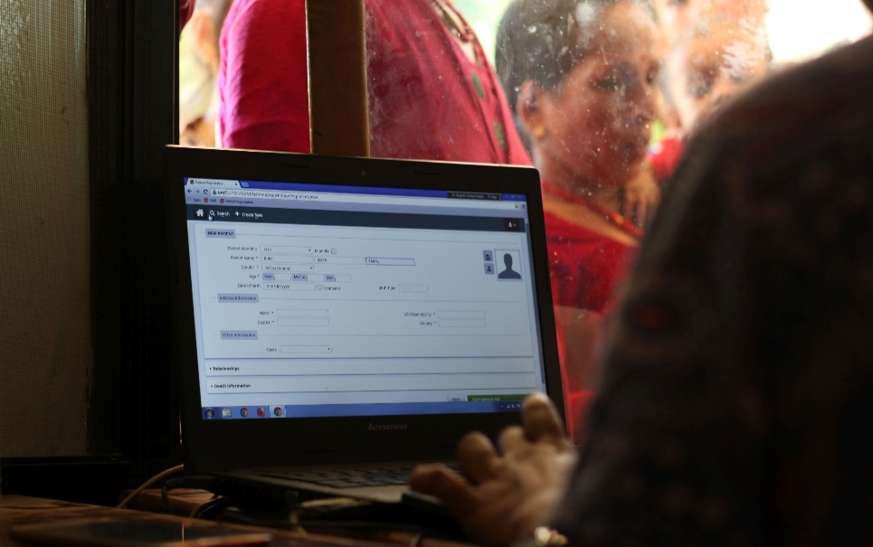
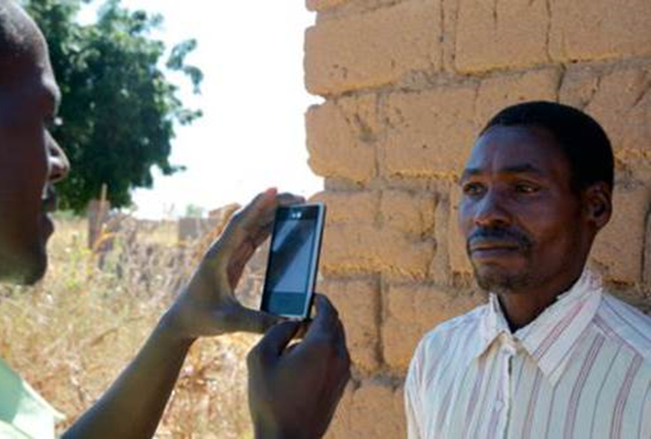
What is openIMIS?
openIMIS is an
open source software for manging health financing processes. It helps digitzing the link between patients, providers and payers for health care.
It is supported by a
community of developers, users and implementers
With the joint mission to
Increase and improve universal health coverage (UHC)

Slide 5
Where is openIMIS used?
Nepal
The Gambia
Chad
Cameroon
Djibouti
DRC
Tanzania

Slide 6
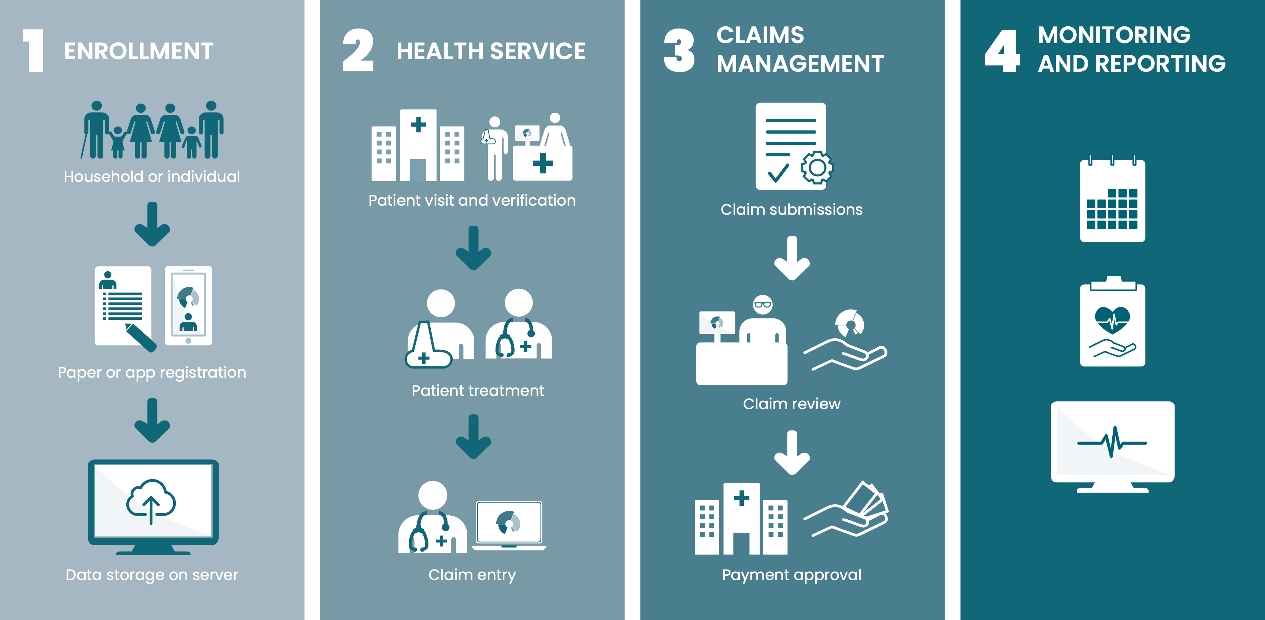
openIMIS Workflows
COMING IN 2021:
AI based claims adjudication

Slide 7
Claims Adjudication

Slide 8
Manual Claims Adjudication
Claims Submission
Manual Claims Evaluation
Payment
Claims Response

Slide 9
Problem: Number of Claims

Slide 10
Bottelneck: Human Adjudicators
Estimation (openIMIS Nepal):
1 officer = 100 claims per day max
Currently employed:
16 officers = 1,600 claims per day
Needed:
300 officer = 30,000 claims per day

Slide 11
Problem: Number of Claims

Slide 12
Rule Based Automation
Submission
Rules Engine
Manual Evaluation
Payment
Response

Slide 13
Rule Based Workflow Option
Aim:
Reduce workload
Method:
Automatically reject formally incorrect claims
No manual verification of rejected claims
 Formally this is already Artificial Intelligence (but not Machine Learning and not the hype thing)

Slide 14
AI Supported Automation
Submission
Rules Engine
AI
Manual QA
Pay
Response

Slide 15
Global Good

Slide 16
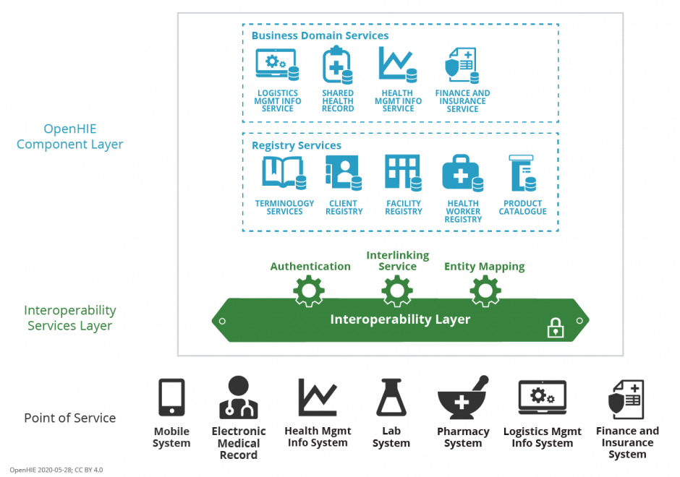
Integration into OpenHIE

Slide 17
Architectural Integration
monolithic
modular
AI
openIMIS
openIMIS
Web User Interface
Web User Interface
Claims
UI
Business Logic
Business Logic
Claims
AI
Data Access Layer
Data Access
Claims
DA
Data Base
Data Base
DB

Slide 18
Customization & Packaging
Customization (Examples)
Claim (FHIR)
ClaimsResponse (FHIR)
Engine
Attributes
Categories
Age
Accepted
Diagnosis
Rejected
Claim Value
Trained Model
Σ{}∞ƒ∂∫∏≈Ω
Monitoring & Quality Assurance

Slide 19
Product Value Chain
Gathering Data
Data analysis and visualization
Cleaning Data
Per implementation (data scientist)
Evaluation metrics and acceptance criteria
Training and evaluating ML model
Per implementation (automated)
openIMIS-AI module development
Quality monitor module development
Global Good
Module user acceptance testing
Operations
Per implementation (implementer)
Finalizing metrics and acceptance criteria

Slide 20
Contacts SwissTPH:
Dragos Dobre (dragos.dobre@swisstph.ch)
Simona Dobre (simona@dobre.fr)
Contacts GIZ S2HSP Nepal:
Alexandra Plüschke (alexandra.plueschke@giz.de)
Nirmal Dhakal (nirmal.dhakal@giz.de)
Purushottam Sapkota (purushottam.sapkota@giz.de)
Contacts GIZ Bonn:
Ralf Radermacher (ralf.Radermacher@giz.de)
Saurav Bhattarai (saurav.bhattarai@giz.de)
Konstanze Lang (konstanze.lang@giz.de)
Uwe Wahser (uwe.wahser@giz.de)
More information on openIMIS
Website: www.openIMIS.org
(sign up for the newsletter!)
openIMIS wiki: wiki.openIMIS.org
Source code: github.com/openimis
Documentation: docs.openIMIS.org
Demo: demo.openIMIS.org

