Slide 1
Project Introduction
Brief discussion June 07 2021
Topic – Mobile application - Sunil Parajuli

Slide 2
HIB web and mobile APP status
UX/UI design openimis HIB for new mobile app
graqhql integration with app (working on backend)
Web module (in planning phase)(probably after next week)

Slide 3
Agenda
Insuree can easily pay the fee through offline/online payment without visiting HIB
Insuree can receive information from HIB.
Can check available health services and claims
Can visit HF based on current location of user.

Slide 4
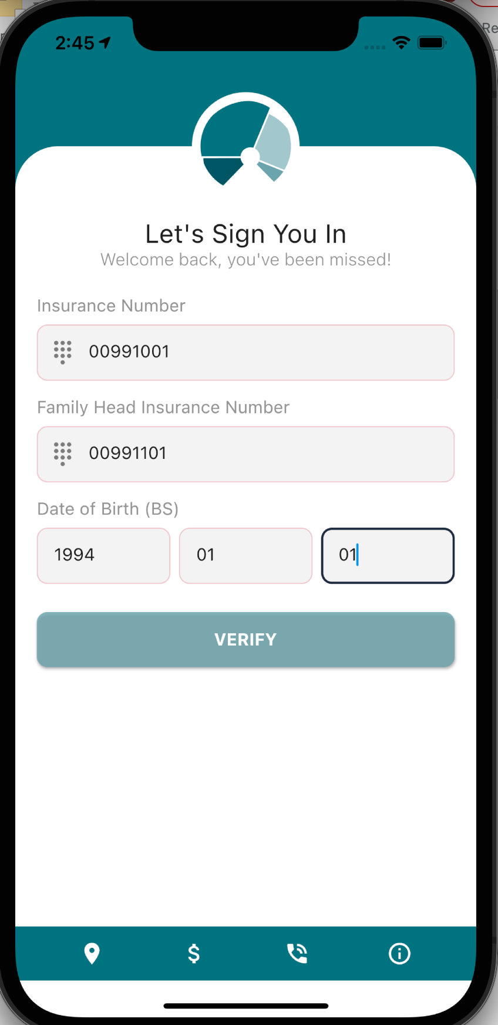
Login Page
The login parameter will be Insuree’s chfid, Family Head Insuree chfid and Date of birth of the insuree.
Authentication : Token based, // no interaction with django user model, since users are currently only admins and employees from HF.

Slide 5
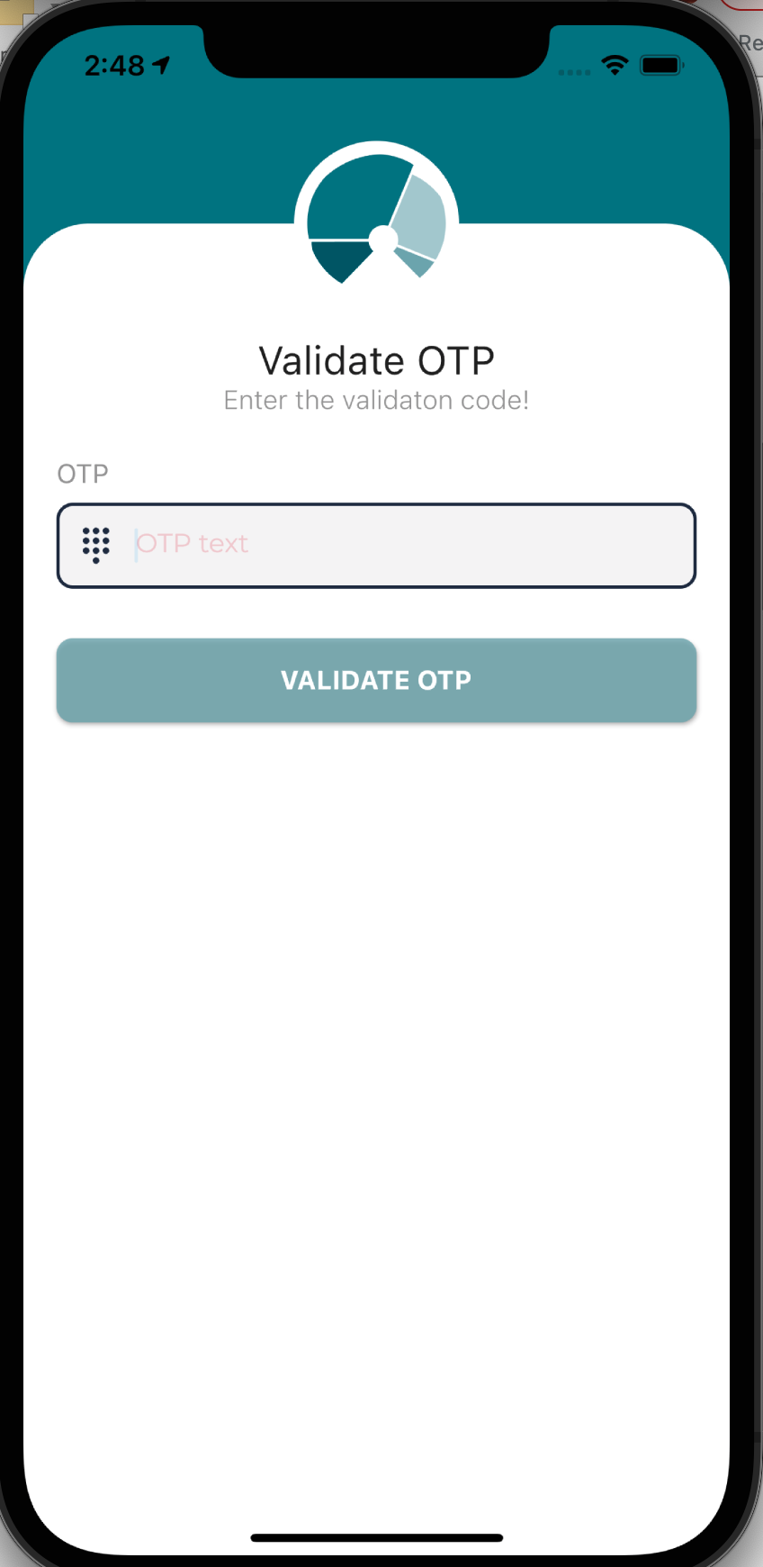
Verification of One Type Password
Every New Login, The Insuree has to verify his/her OTP, The insuree later can verify otp either by email or phone number associated to the account

Slide 6
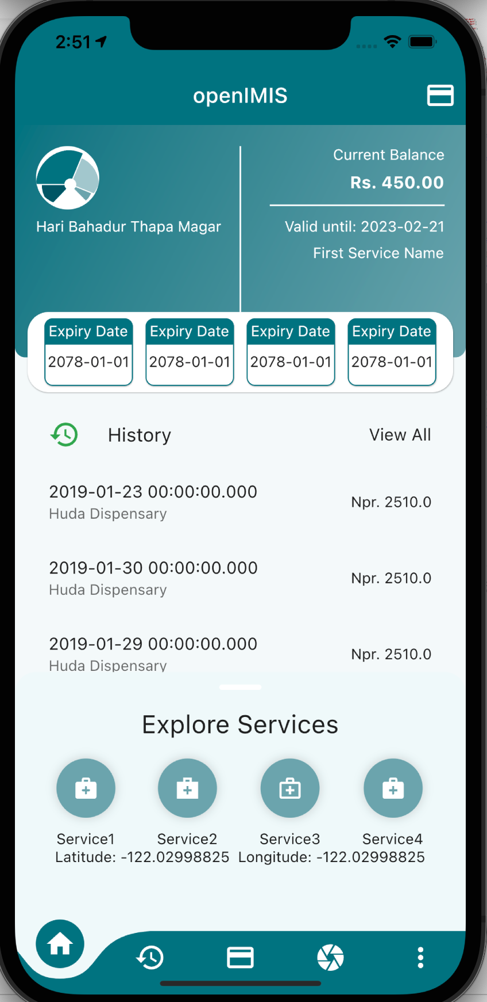
Homepage
Insuree’s basic policy information with expiration date.
Insuree’s service history (latest 5 {configurable })
Claim history with items/services
Draggable screen with other services

Slide 7
Homepage
Insuree’s basic policy information with expiration date.
Insuree’s service history (latest 5 {configurable })
Claim history with items/services
Draggable screen with other services

Slide 8
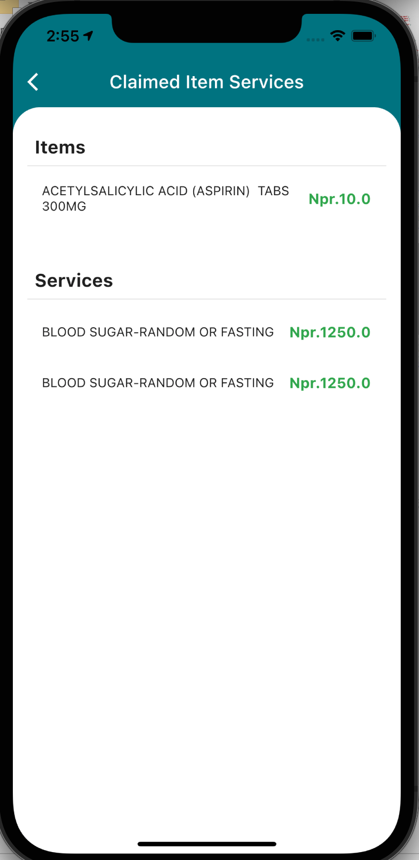
Sample screen of claim services
The sample screen of particular claim which has claimed item and services by HealthFacility

Slide 9
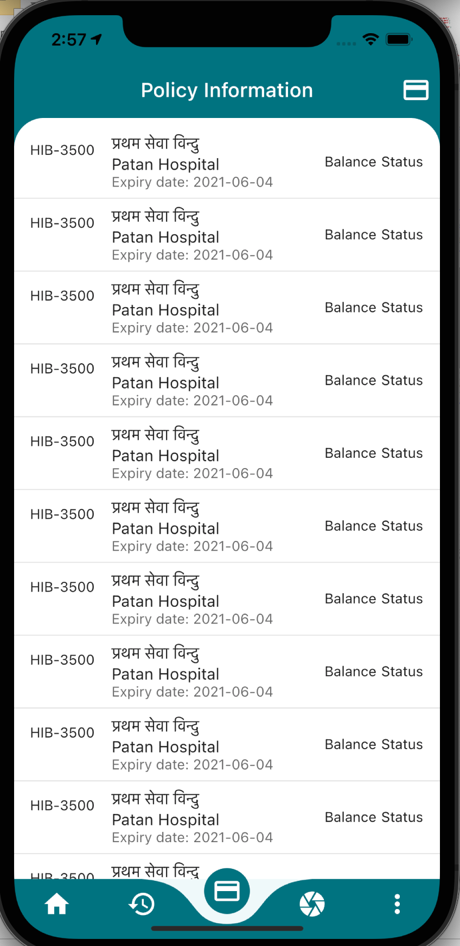
Sample screen of Policy of the Insuree
The sample list view of the policies (including history and current) of the insuree.

Slide 10
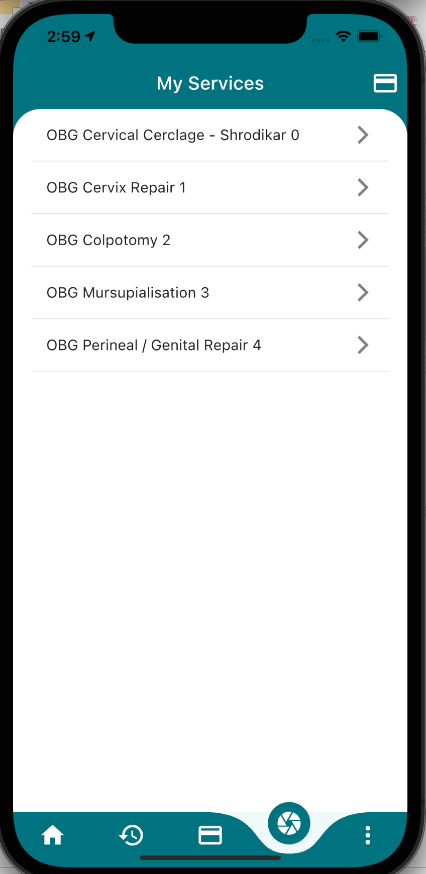
Services offered by Health Facility
The list of generic health services provided by Health Facility.

Slide 11
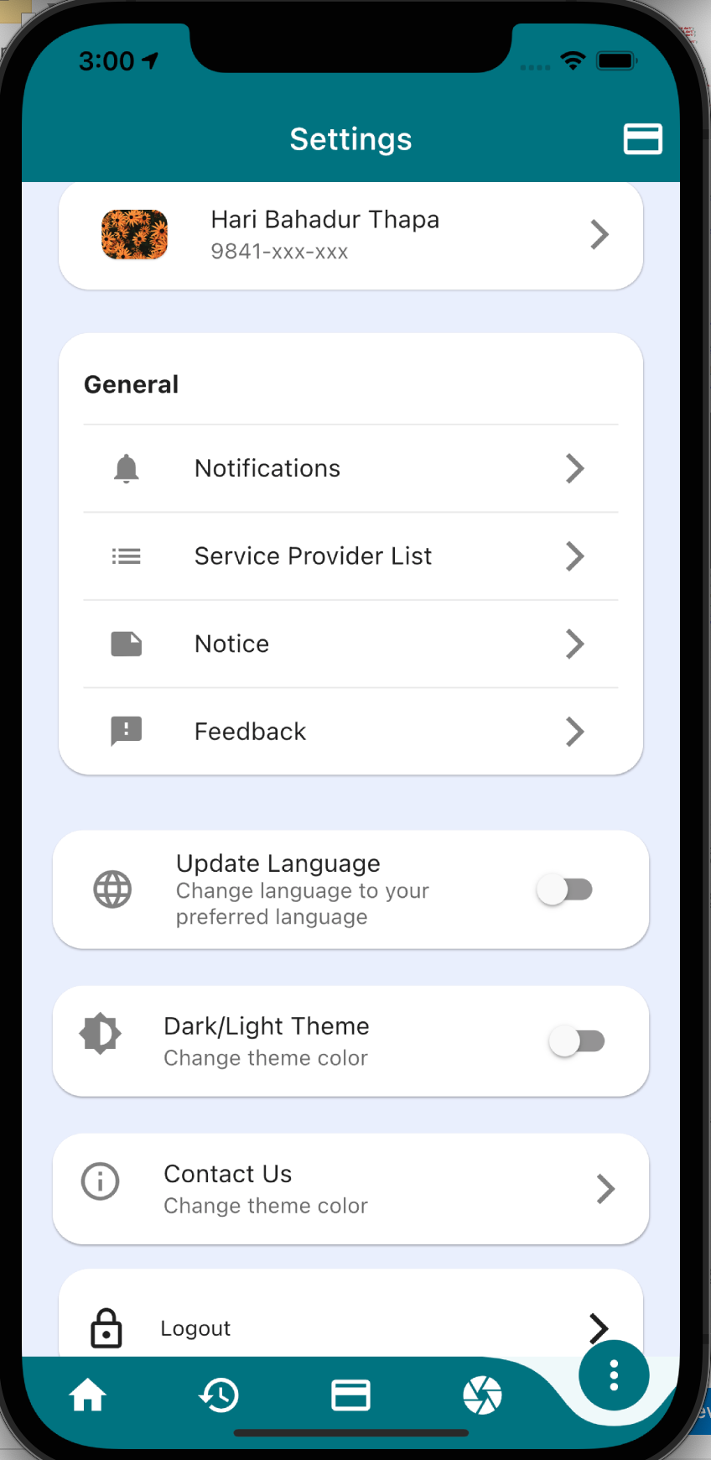
Settings / additional Features
Notifications: The notification sent by HF to insuree, to notify policy renewal or other important events.
Notice from HIB for it’s customer (insuree).(ongoing event, open , close)
Multi Language support (english and Nepali currently)
Feedback : Service feedback from customer to HIB

Slide 12
Settings / additional Features (contd…)
Dark/theme : for personal preferences
Contact Us : page contains contact information of all HF offices around the country

Slide 13
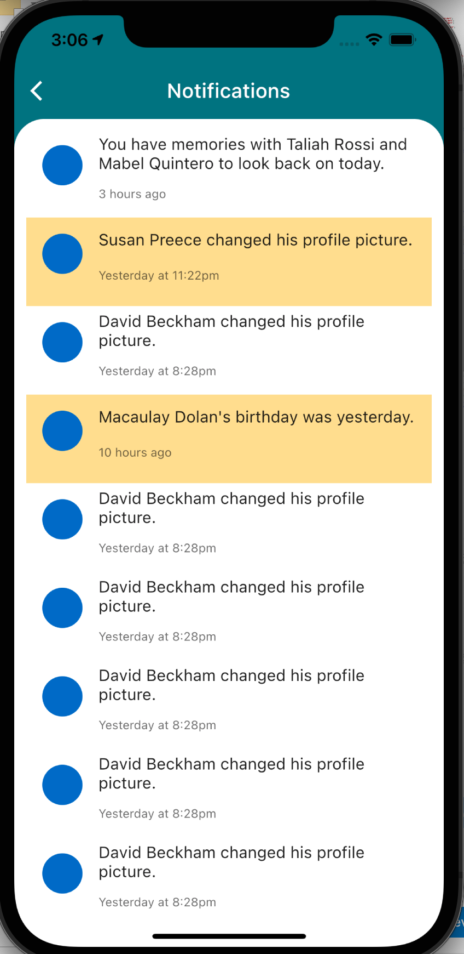
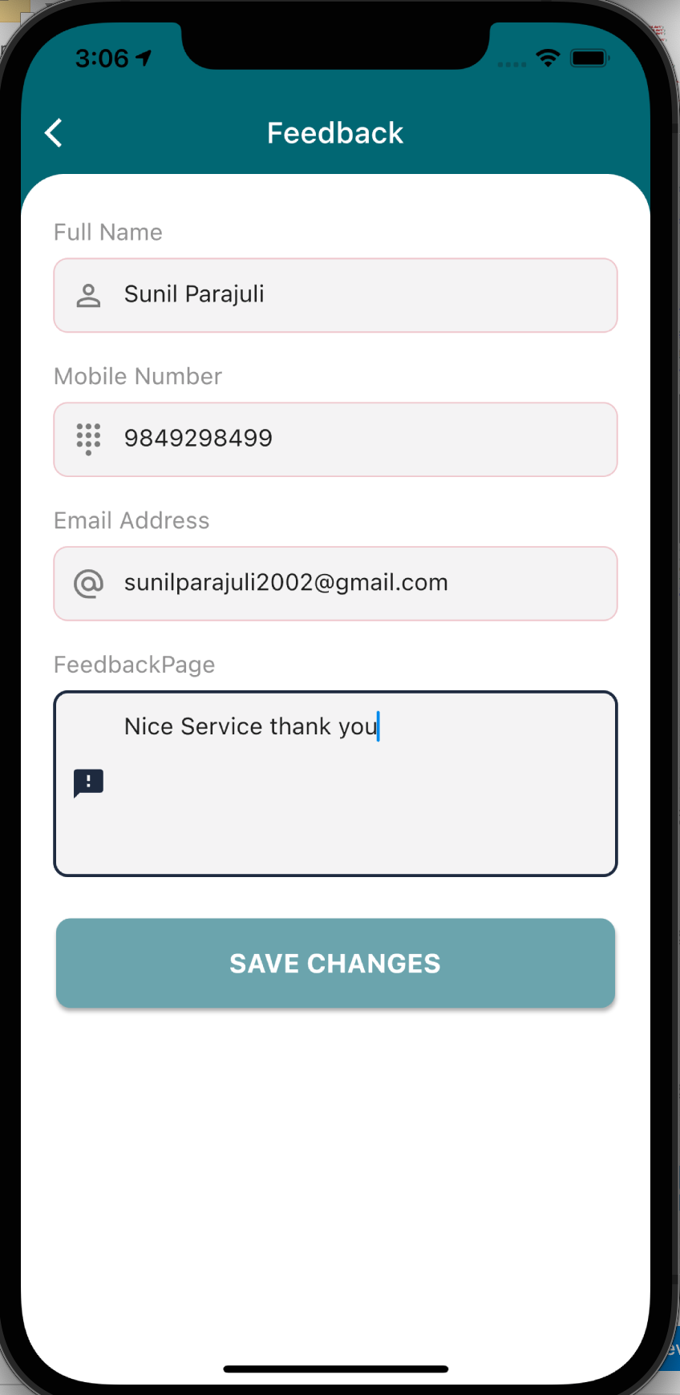
Sample Screen

Slide 14
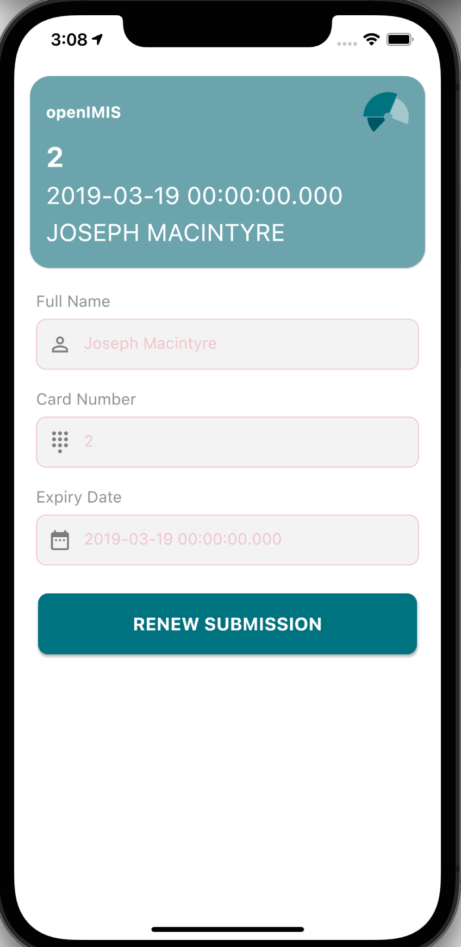
Insuree Card Page (sample)
This page will be responsible for showing service expiration date and service renewal

Slide 15
Insuree Card Page (sample)
This page will be responsible for showing service expiration date and service renewal

Slide 16
Insuree Card Page (sample)
This page will be responsible for showing service expiration date and service renewal.
The submission of the payment (offline) we will be using is multipart form data

Slide 17
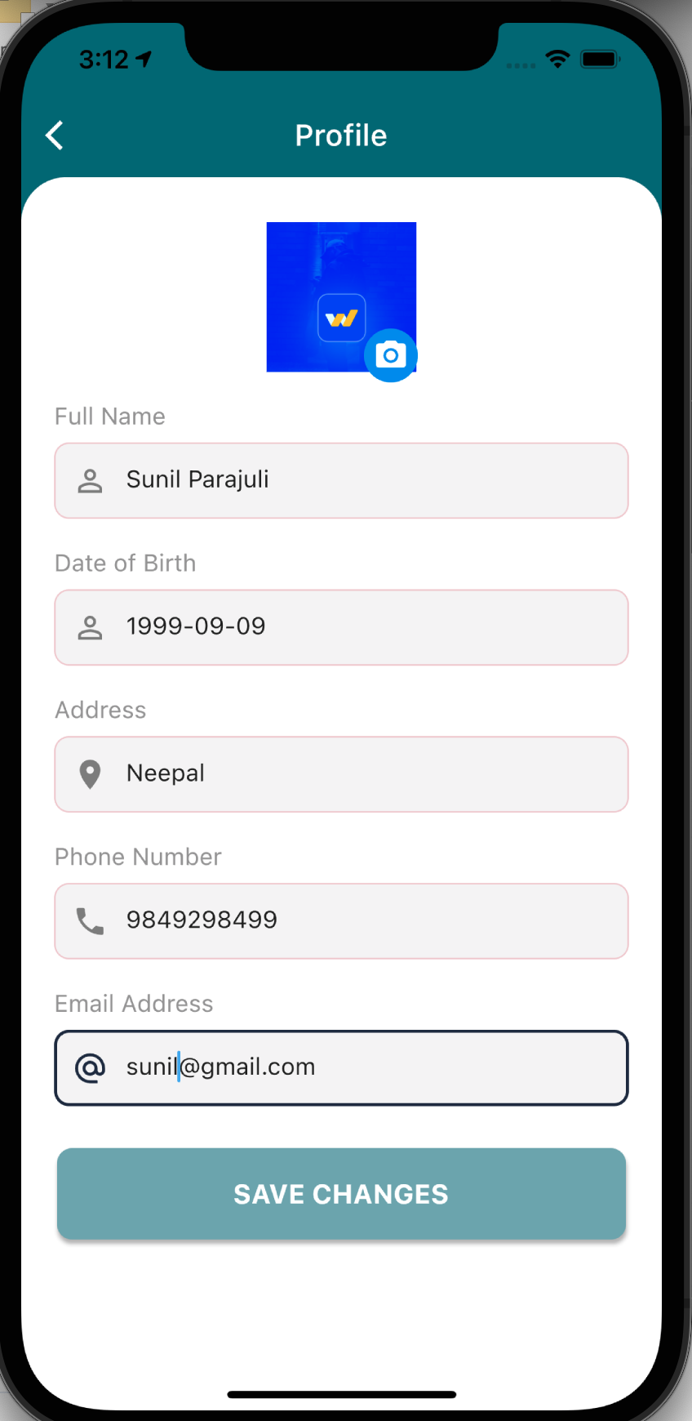
Profile Page
Sample profile page where insuree can change his/her photo and email

Slide 18
Web portal
In planning phase:
Creating new modules for adding few functionality: Notice publication, Payment Acceptance and other simple settings

