Slide 1
Formal sector
3 Mai 2020
Activity Report

Slide 2
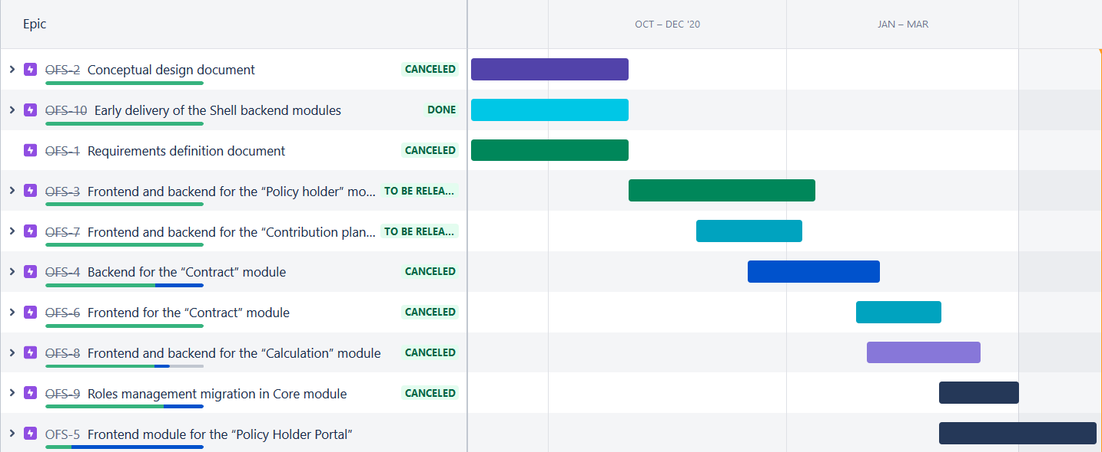
Roadmap

Slide 3
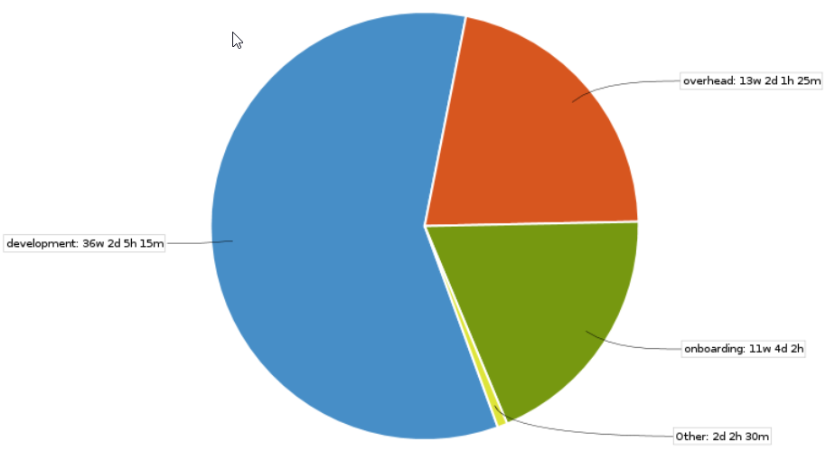
March 2021 activities
Scope activities:
PolicyHolder portal
Final report sent
Time reporting
Soldevelo 330 MD
SwissTPH 70 Days

Slide 4
Future activities for Mai
Contract activities:
None
Development activities:
Integrate user picker in policyholder User
Fix reaming bugs
Pip and npm packages
End user documentation (read the docs)

Slide 5
State of deliverables
Activity | Deliverable | Due Date
0.1 | Requirements definition document | Delivered
0.2 | Conceptual design document | Delivered
1.1 | Frontend and backend for the “Policy holder” module & quarterly narrative report | Delivered
1.2 | Backend for the “Contract” ( previously “Contribution Collection” ) module | Delivered
1.3 | Frontend module for the “Policy Holder Portal” | Delivered
1.4 | Frontend for the “Contract” (previously “Contribution Collection” ) module | Delivered
2.1 | Frontend and backend for the “Contribution plan and Contribution plans bundle” module | Delivered
2.2 | Frontend and backend for the “Calculation” module | Delivered
3 | Frontend and backend the “Profile” module | Delivered
4.1 | Early delivery of the Shell backend modules (“Policy holder”, “Contribution Collection”, “Contribution plans” ), | Delivered
4.2 | reviewed Healthix FIHR documents | Delivered

