Slide 1
openIMIS Nepal Features
Purushottam Sapkota
Technical Advisor
GIZ- S2HSP, Nepal

Slide 2
Nepal Features
Current
Claim Document
Nagarik APP
Select Auto Complete (select2)
Claim Code Auto Generate
Set Insuree Status
Employment Injury Module
Planned
Self Enrolment Web Portal
Insuree Portal Mobile App

Slide 3
Claim Document

Slide 4
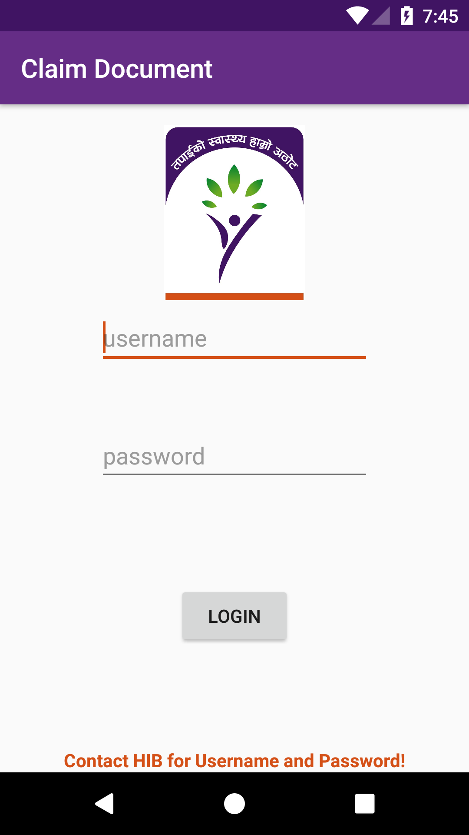
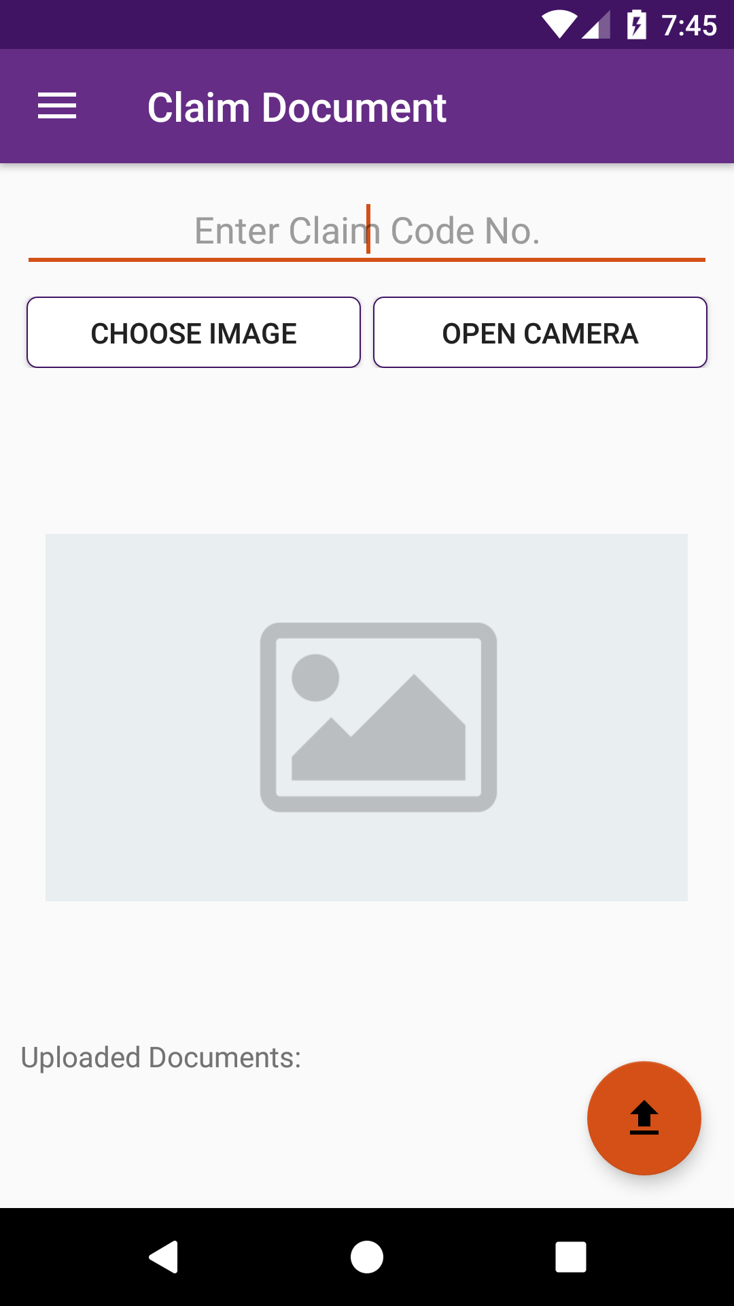
Claim Document

Slide 5
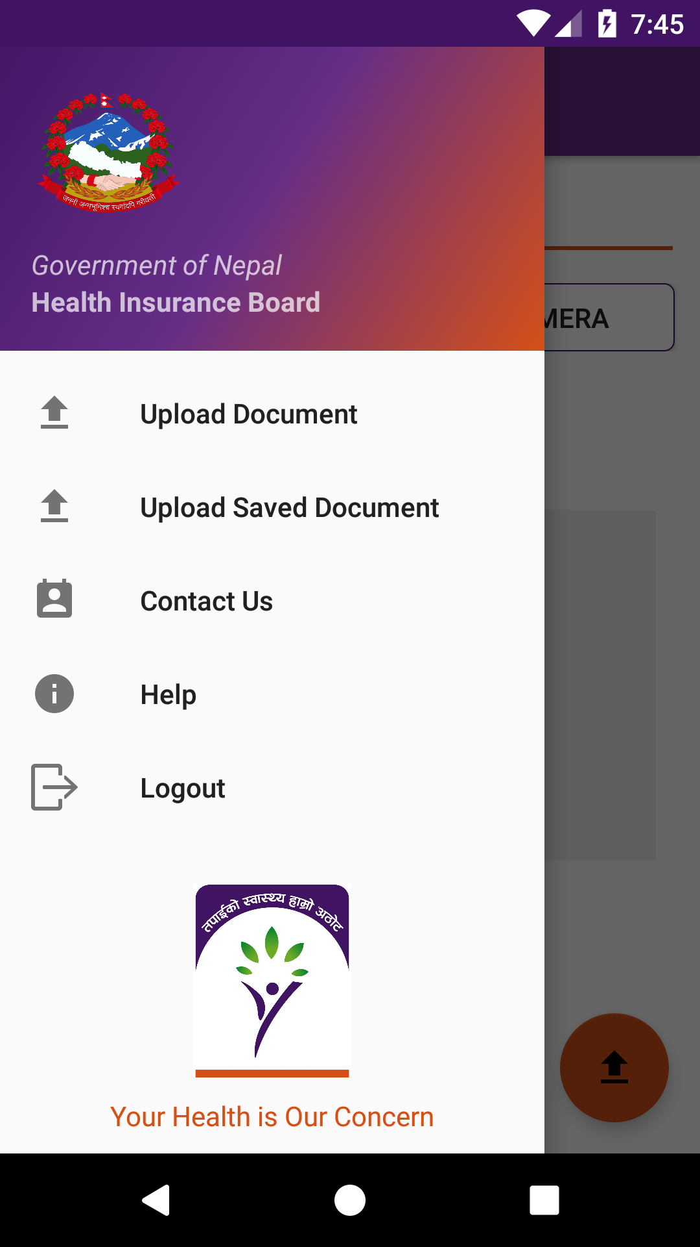
Claim Document

Slide 6
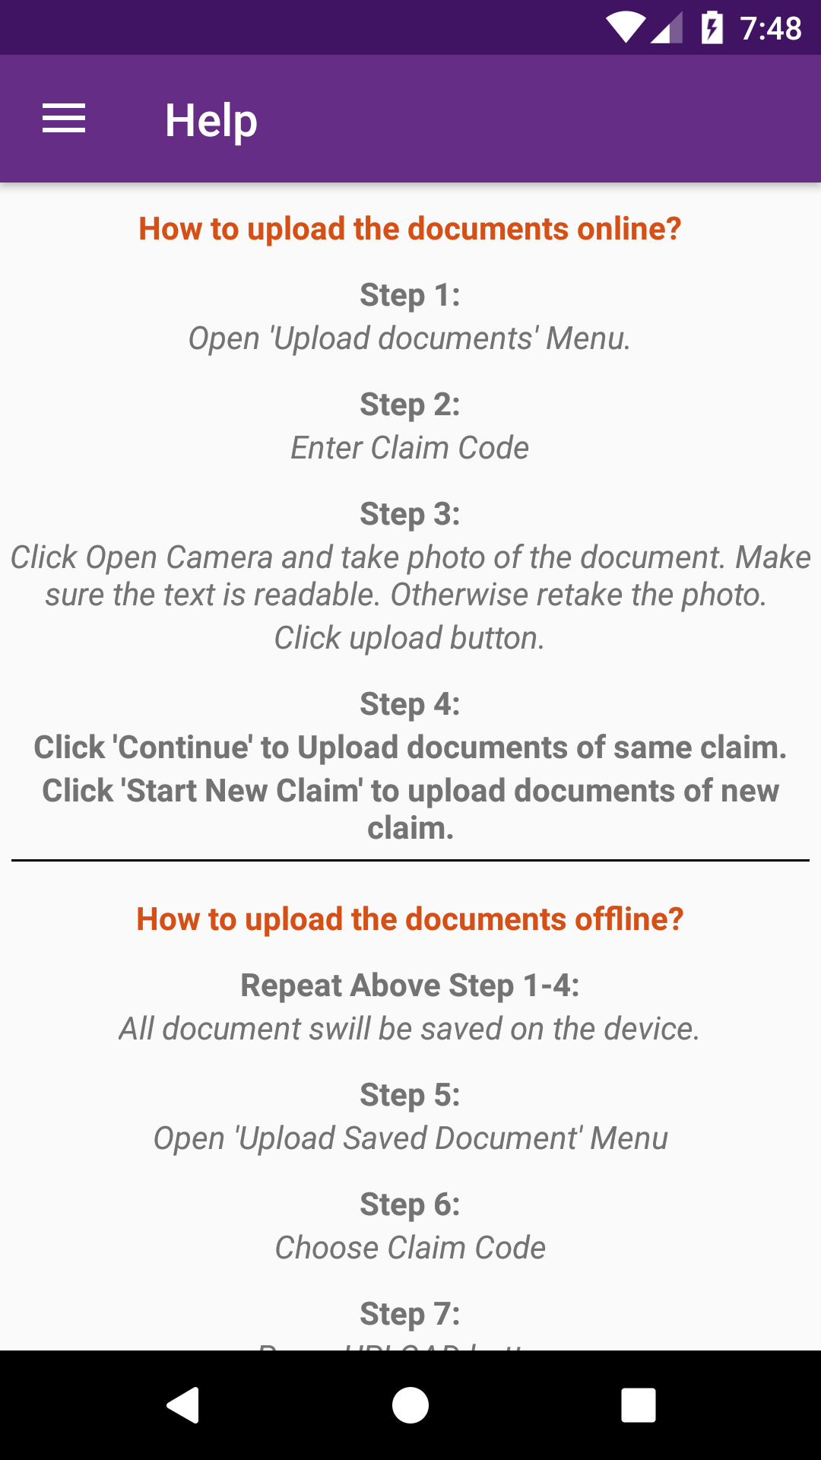
Claim Document

Slide 7
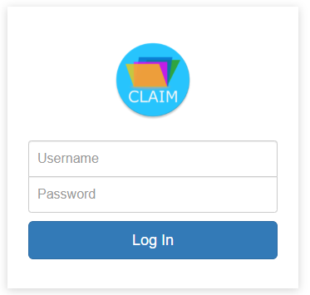
Claim Document - Web

Slide 8
Claim Document - Web

Slide 9
Claim Document - Web

Slide 10
Nagarik App

Slide 11
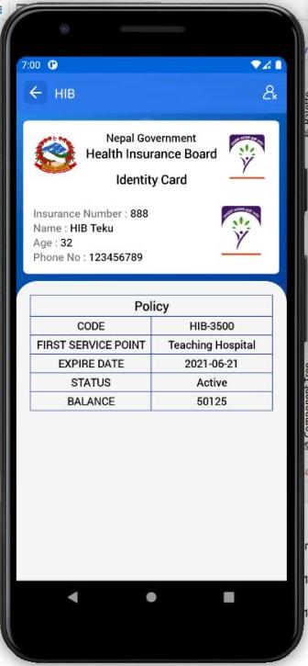

Slide 12
Select Auto Complete

Slide 13
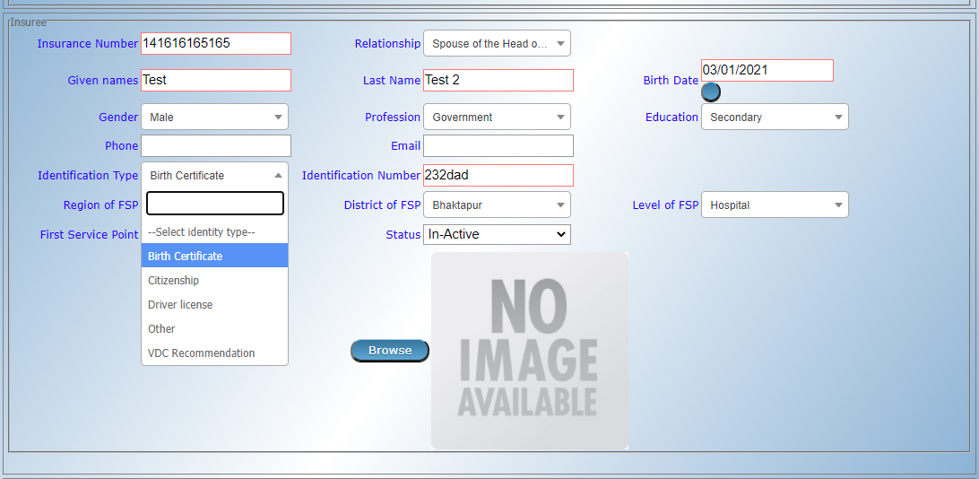

Slide 14
Claim Code Auto Generate

Slide 15
Insuree Status

Slide 16
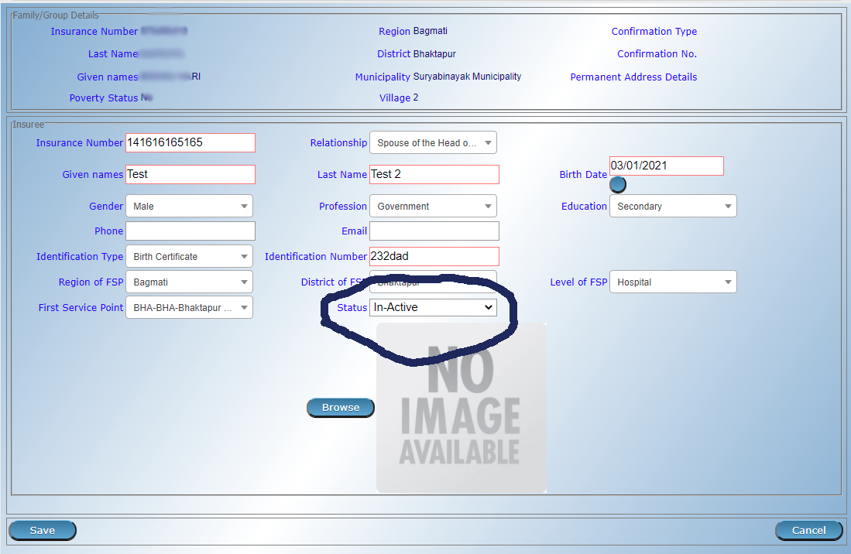

Slide 17
Employment Injury Module

Slide 18
Planned Feature
Self Enrolment Web Portal
Insuree Portal Mobile App

Slide 19
Thank You !

