Slide 1



AI-based Claim Categorization
12 April 2021

Slide 2
Project timeline
Activity |  | Team | 2020 |  |  | 2021
 |  |  | Jun-Jul | Aug-Sep | Oct-Dec | Jan-Mar | April
Data gathering and preparation | AI input data model structure | Swiss TPH | X
 | FHIR claim input data for AI | Swiss TPH | X
 | Sanity check of the database | Swiss TPH |  | X
 | Process categorical data | Swiss TPH |  | X
 | Data normalization | Swiss TPH |  | X
Implementation of the AI algorithm | Al methods, model outputs and evaluation metrics | Swiss TPH |  |  | X
 | Development of the AI model | Swiss TPH |  |  |  | X
AI-based Claim Adjudication Process |  | Swiss TPH |  |  | X
openIMIS Claim-AI module development | Claim-AI module specification | Swiss TPH |  |  | X
 | Claim-AI module development | SolDevelo |  |  |  | X
 | Claim-AI module validation | Swiss TPH |  |  |  | X
openIMIS Claim-AI Quality Monitor module development | Claim-AI Quality Module specification | Swiss TPH |  |  | X
 | Claim-AI Quality Module development | SolDevelo |  |  |  | X
 | Claim-AI Quality Module validation | Swiss TPH |  |  |  | X
Module User Acceptance Testing | Installation of AI-based openIMIS on Nepal server | SolDevelo |  |  |  |  | X
 | Organization of the UAT | GIZ Nepal |  |  |  |  | X

Slide 3
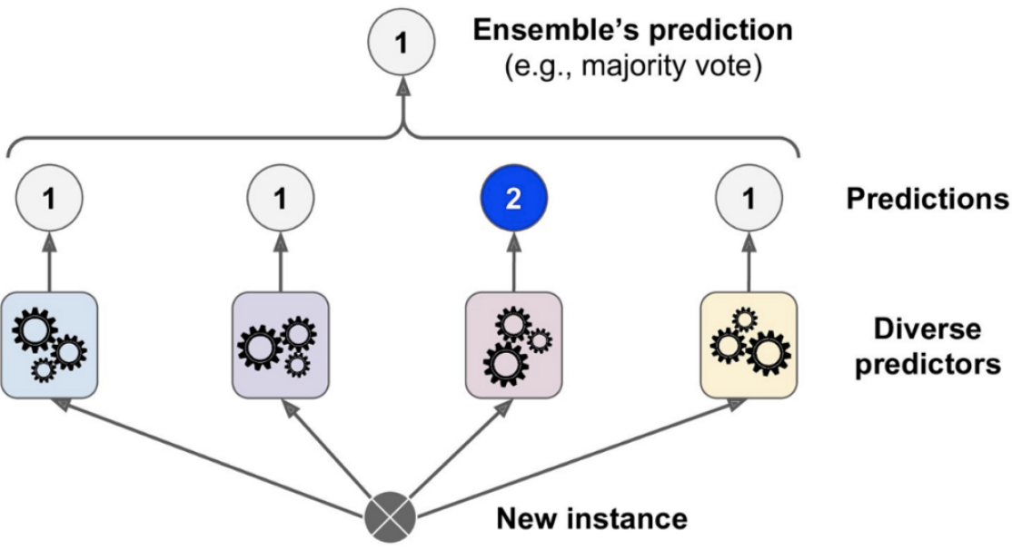
AI model training and evaluation
1
1
1
2
1
Decision
Tree
Random
Forest
Extra
Trees
XGB
Predictions of a hard voting classifier
[Géron, 2019]

Slide 4
Completed Activities
AI algorithm output: Encoder (117 MB), Scaler (2 KB), Voting model (1 053 MB)
Specific for Nepal openIMIS implementation
  Should we publish on public repository?
Claim-AI module:
AI model execution code integrated
  Files path can be configured
FHIR R4 Claim → AI input model → AI model execution → FHIR R4 ClaimResponse
WebSocket server accepts FHIR R4 Claim Bundles (paginated, zip compressed)
Docker package for Claim-AI implementation
  Required if implementation run in Docker
  AI model files loaded from outside container

Slide 5
Completed Activities
Claim-AI Quality module:
Claim transformed to FHIR R4 Claim resource with Contained Resources (Patient, HeathcareService, Condition, Medication and ActivityDefinition)
WebSocket client:
  Sends new Claims when submitted (event-based) or on scheduled task
  Saves the response and makes necessary status changes

Slide 6
Remaining activities
Modules validation:
Anonymized DB backup just received today
User Acceptance Testing:
Waiting for dates (2 half days)
Waiting for testing environment (for demo)
Installation of the demo environment
Insurlab:
Kickoff event on 14.04
  Pitch presentation to be finalized

Slide 7

AI-based Claim Categorization

Slide 8
AI model training and evaluation
 | Support (test set) |  | True Negative | False Positive | False Negative | True Positive | Precision | Recall | F1-score | Accuracy
Classifier | Accepted | Rejected | True Accepted items |  | True Rejected Items
Decision Tree 1 | 659236 | 17809 | 647401 | 11834 | 5538 | 12270 | 0.5090 | 0.6890 | 0.5855 | 0.9743
Decision Tree 2 | 659236 | 17809 | 579307 | 79928 | 3063 | 14745 | 0.1557 | 0.8280 | 0.2622 | 0.8774
Random Forest | 659236 | 17809 | 652650 | 6585 | 4541 | 13267 | 0.6683 | 0.7450 | 0.7046 | 0.9836
Extra Trees | 659236 | 17809 | 647266 | 11969 | 4181 | 13627 | 0.5324 | 0.7652 | 0.6279 | 0.9761
Extra Gradient Boost | 659236 | 17809 | 654712 | 4523 | 5370 | 12200 | 0.7295 | 0.6944 | 0.7115 | 0.9854
VotingClassifier | 659236 | 17809 | 650847 | 8388 | 3853 | 13955 | 0.6246 | 0.7836 | 0.6951 | 0.9819

