Slide 1
AI-based Claim Categorization
25 March 2021

Slide 2
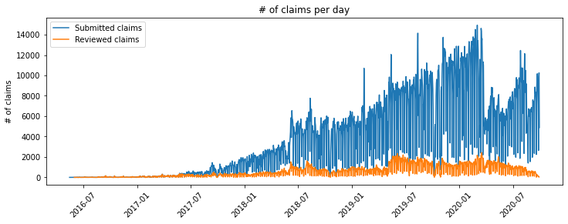
Problem Statement
Up to 14 000 Claims/day in Nepal
Limited number of Medical Officers
Small amount of Claims reviewed
Dataset (2016-05-16 to 2020-09-29):
5 953 640 Claims (12 371 992 Items, 16 655 364 Services), 891 916 reviewed Claims
3 790 789 Insurees
780 Health Facilities
1 959 diagnosis items
Claim Submission
submit
Rules Engine
(partially) accept
Payment
Claim Submission
submit
Rules Engine
(partially) accept
AI-based Claim adjudication
(partially) accept
Payment
(partially) accept
Manual Evaluation
(partially) accept
(partially) accept
Manual QA
(partially) accept
reject
flag
reject
re-submit
reject
(partially) reject
re-submit
reject
(partially) reject
re-train
re-submit negative claims responses
re-submit negative claims responses
Manual Adjudication Workflow
AI-based Claim Adjudication Workflow

Slide 3
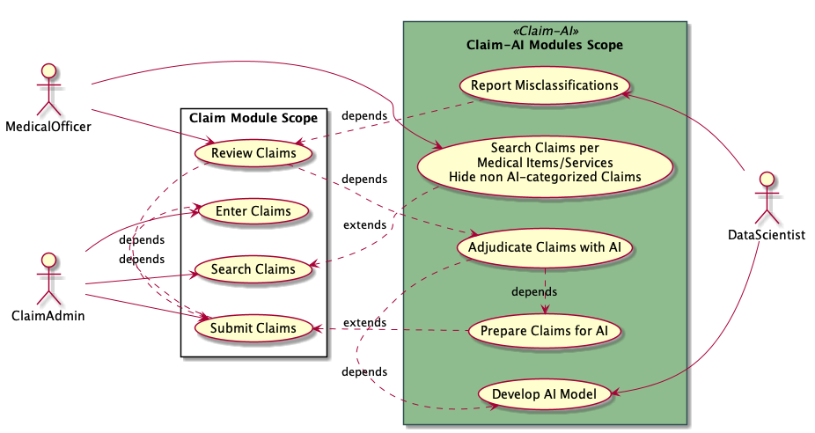
Strategy
Claim-AI Quality Module | Claim-AI Module
Adds Medical Item/Service and AI categorized filters Event-based: listens for SubmitClaimMutation mutation Signal Update Claims to be ‘hidden’ before AI categorization Scheduled-based: transforms and push FHIR R4 Claim to Claim-AI Receives FHIR R4 ClaimResponse and update ClaimStatus and ReviewStatus Reports Claim adjudication misclassifications | Self containing API Accepts FHIR R4 Claim and prepares the data for the AI model Executes the AI model to categorize the Claims Replies with FHIR R4 ClaimResponse

Slide 4
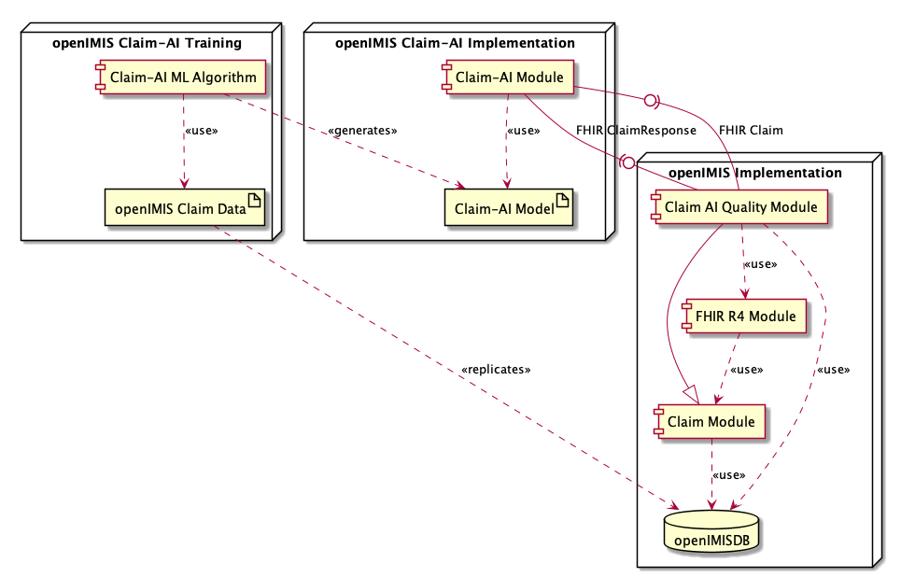
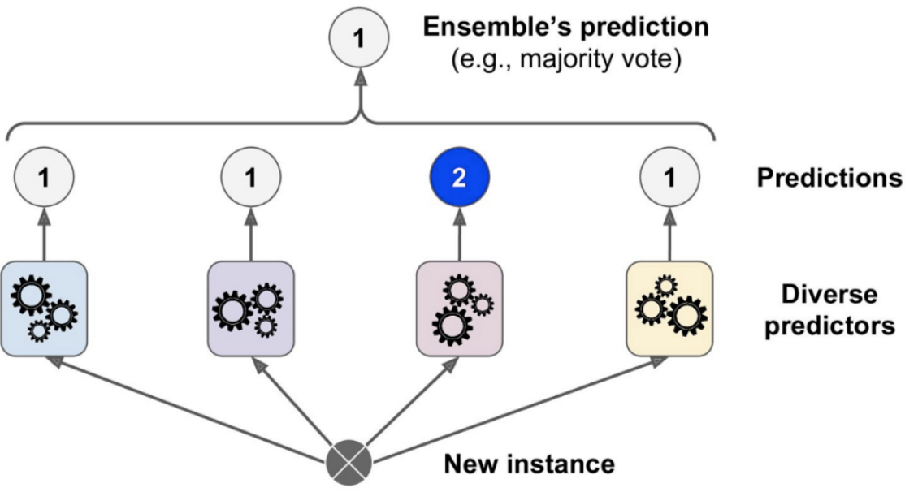
Results
Developed AI voting classifier with four specific predictors:
Decision Tree
Random Forest
Extra Trees
Extra Gradient Boost
Developed Claim-AI and Claim-AI Quality modules
Next steps:
Validation
UAT
Decision
Tree
Random
Forest
Extra
Trees
XGB

Slide 5
AI-based Claim Categorization

