Slide 1


CHF Iliyoboreshwa
Mobile Phone Payment Integration
22th April 2021

Slide 2
CHF-IMIS ePayment
eGA SMS Gateway
GePG ePayment
eGA USSD
Developments started in 2018
Pilot in Schinyanga region
eGA USSD integration
  Enquiring (for HF with no Internet access)
  Renewal (by EO)
  Control Number request for one policy
GePG integration
  Generates and sends control number
  Payment confirmation
  Reconciliation
eGA SMS Gateway integration
  Sends enquire information, control number, policy activation confirmation
CHF-IMIS Policies mobile app
  Control number request for group policies
  Get Commission report
CHF-IMIS REST API
  Manage ePayment services
CHF-IMIS Web Application
  Monitoring, reporting
CHF-IMIS Web Services (deprecated)
  Mobile Applications services
CHF-IMIS Web Application
CHF-IMIS REST API
CHF-IMIS WEB SERVICES
CHF-IMIS Database
CHF-IMIS Policies

Slide 3
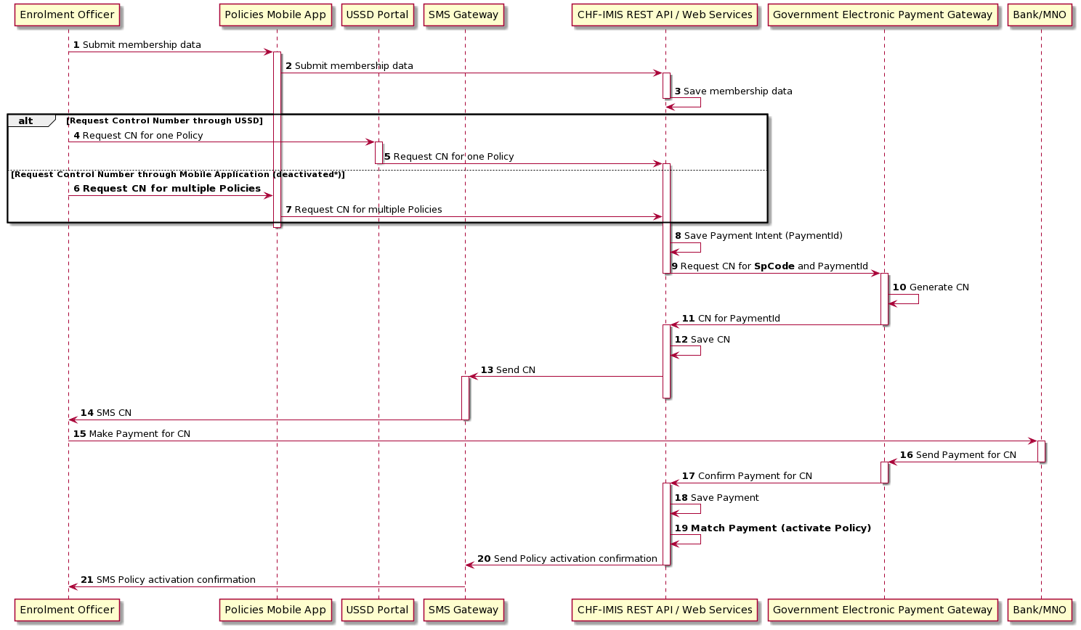
Notes:
MNO – Mobile Network Operator
Complete SQ - http://www.plantuml.com/plantuml/uml/bPD1Zzey48Rl_XMZlInOGdldW9QFBwMe2g1DgvvDF2mHZfqw3Yl-VSScoSRGWdg84zlFE_DwF7cjdR2kAHMhw5taHIMqWwT4MwDAfC_DVb_aQ9z0r91iOcfh57rZ3QdP5GfXNbM1cs-_nU2FBFiVjiOweGBWvp6HfHaiXSCFSGu4pMDWyVNBP9MkCdXBik-KOGKly1DtaA4zaS4wgFnUB5kQ4reTJf8ep9qrkiXXAyv-ASgunEqorludzF4bNM_2DhqP4uqpkYbtQ1bBDfCP7NGAMRCh2mSb-lNwK5GWXHDCvAuuKVnG3KR3PERjFUOznVpG2yG9Rt29iO09vU0DVpLOErWOJITLi0vUmHsiQTuFbx87u_vh-eclOMyi68qGhlJScsabVcpTt159Z6LN1b7L-C3Xe94eed25qJ3w32lv60Q5v_pAIzaeLrIaxngJys7X7z6CePPCOdnpDpVHDSzAE_yQjVEL7BUixwIRR9ndrS98v1o4bj2BRYwod_amxDcFNVfvVjJcG-6xn45uzYmn5Z4_mcG6mGcD6gtVz6nC3g9tHYDd4VoWGttqGG4YjtzqUO7fJwS0gAM7Ue9MRof3QvDPifdwJGzBZF3G6EcQzbDnxA_9docAJ0IZftFfCr-p4YFwJicCtXUslDR_M-4wzT-hruNFB-d2Vn4t9kUfSFcX9qTjokxV77D-NUvs1rgIGiRnxrN_aVQLuZUb-Wq0

Slide 4
Thank you
Mobile Phone Payment Integration
22th April 2021

