Slide 1
Formal sector
March 2020
Activity Report

Slide 2
Roadmap

Slide 3
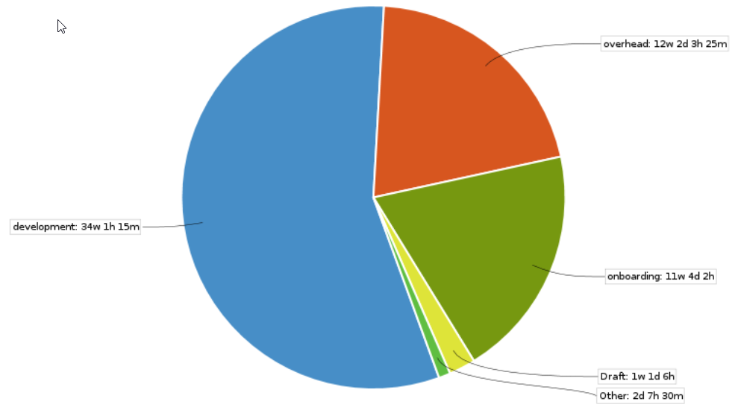
March 2021 activities
Scope activities:
Calculation FE/BE finished
Contract BE/FE finished
Profile BE finished
Profile FE 40% done
Time reporting
Soldevelo 307 MD
SwissTPH 55 Days
Note: Time reporting activation on JIRA

Slide 4
Future activities for April
Contract activities:
Delivery of Profile and Policyholder portal on the 06/05
Development activities:
Backend module development
PolicyHolder Portal
Frontend module development.
PolicyHolder Portal
Profile

Slide 5
State of deliverables
Activity | Deliverable | Due Date | Updated due dates
0.1 | Requirements definition document | Delivered
0.2 | Conceptual design document | Delivered
1.1 | Frontend and backend for the “Policy holder” module & quarterly narrative report | December 31, 2020 | December 31, 2020
1.2 | Backend for the “Contract” ( previously “Contribution Collection” ) module | February 28, 2021 | January 31, 2021
1.3 | Frontend module for the “Policy Holder Portal” | February 28, 2021 | February 28, 2021
1.4 | Frontend for the “Contract” (previously “Contribution Collection” ) module | February 28, 2021 | January 31, 2021
2.1 | Frontend and backend for the “Contribution plan and Contribution plans bundle” module | October 31, 2020 | February 28, 2021
2.2 | Frontend and backend for the “Calculation” module | October 31, 2020 | February 28, 2020
3 | Frontend and backend the “Profile” module | December 31, 2020 | February 28, 2020
4.1 | Early delivery of the Shell backend modules (“Policy holder”, “Contribution Collection”, “Contribution plans” ), | Delivered
4.2 | reviewed Healthix FIHR documents | December 31, 2020 | December 31, 2020

Slide 6
Formal sector
Review meeting
GIZ. 574327-01706501-CRT
14th January 2021

Slide 7
Agenda
Presentation of the contract module (Deliverable 1.4 and 1.2)
Create contract
Copy of the PH Insuree parameter on Contract Details
Edit policy details (create/edit/update/delete)
Submit contract
Approve Contract
See policies
Delete/update contract
Presentation of the Calculation module (Deliverable 2.2)
Assign calculation to contributionPlan
Change calculation parameters in contributionPlan
Change calculation parameters in contractDetails
See impact of calculation on contract value

Slide 8
Presentation of the contract module
https://modular.fs.swisstph-mis.ch/
UC3-10: add Contract
UC3-2: Add contract from PH
UC3-11: Access to contract
UC3-12: Access to a contract via PolicyHolder
UC3-3: Update contract details
UC3-3.1: add contractDetail
UC3-3.2: Update contractDetails
UC3-3.3: Dupdate delete contract detail
UC3-4: Submit contract
UC3-13: Approve Contract
UC3-13.1: see contribution plan details
UC3-6: Counter Contract
UC3-7: Amend contract
UC3-X: Delete contract

Slide 9
Presentation of the Calculation module
UC14-1: add a new Calculation rule (needs to change the openimis.json). UC14-2: be able to select a calculation rule. UC14-3: display in editable mode the parameters required by calculation for an object. UC14-4: replace a calculation rule. (python change) UC14-5: remove a calculation rule. (python change)

Slide 10
Next steps
Even if we ask for the acceptance of the module we will keep working on them:
Fix defect when they will be detected

