Slide 1
openIMIS Dashboards
openIMIS Community Workshop 2021
Day 2, 25.03.2021

Slide 2
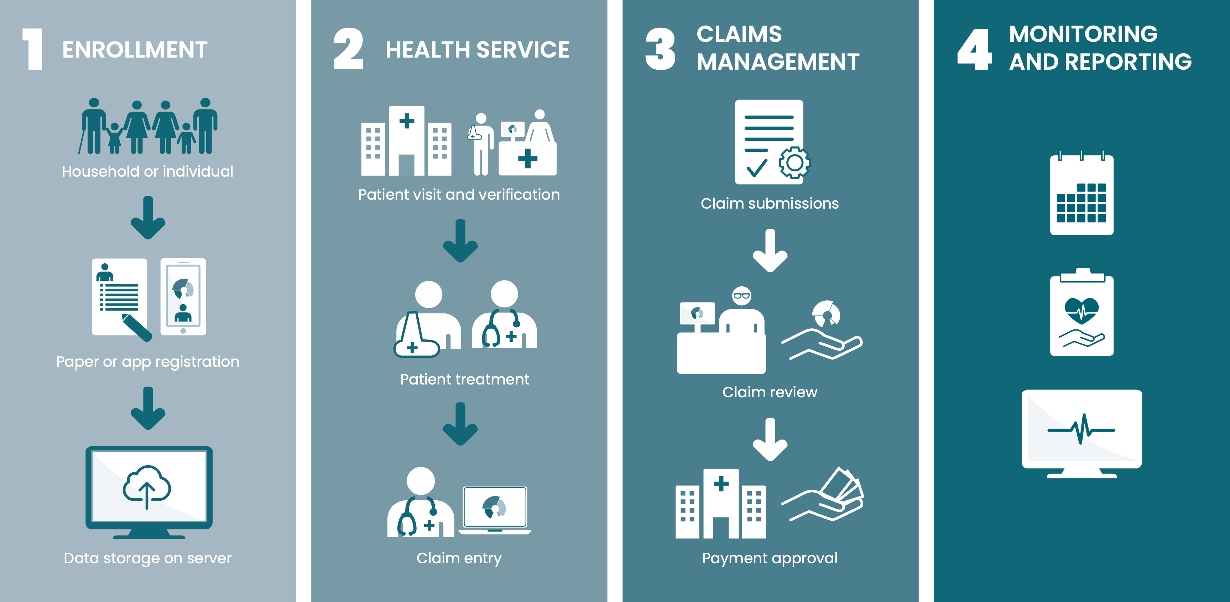
openIMIS Workflows

Slide 3
Global Principles for Digital Development & Investment
The Digital Investment Principles refer as one of the 10 Principles to (endorsed by BMZ): Scalable, sustainable, accessible, interoperable, and evidence-based digital health global goods that meet country priorities.
The Principles for Digital Development contain as one major criteria (endorsed by GIZ): Use Open Standards, Open Data, Open Source, and Open Innovation

Slide 4
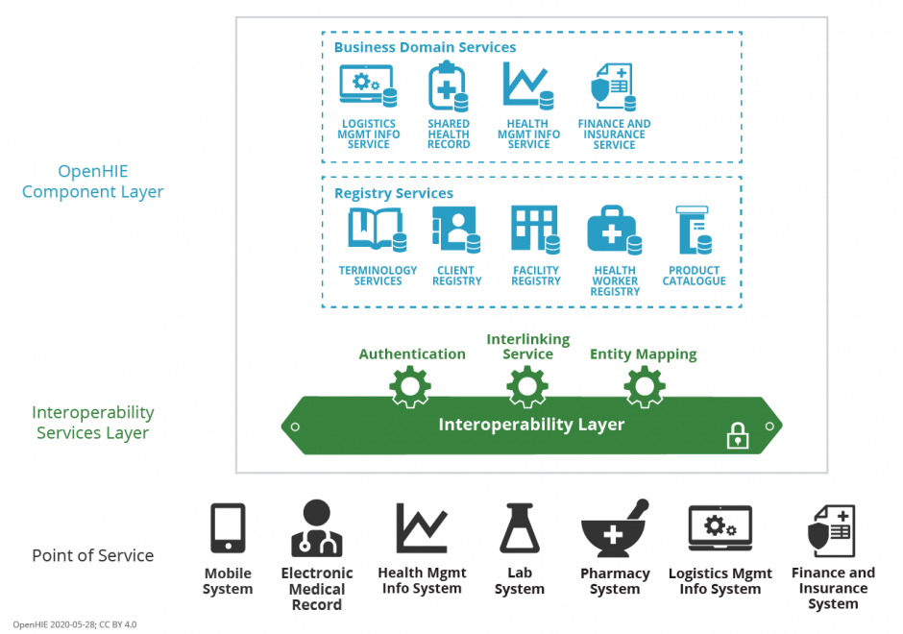
Integrate into OpenHIE
openIMIS
DHIS2

Slide 5
Corporate Architecture
openIMIS
DHIS2

Slide 6
Data Model & Information Flow
openIMIS
DHIS2
Enrollments
Insuree Program
Claims Program
Program Stages
Policy
Claims
Policy (New, Renewals)
Claims (Submissions, Review, Valuation etc.)
Data Base
Data Base

Slide 7
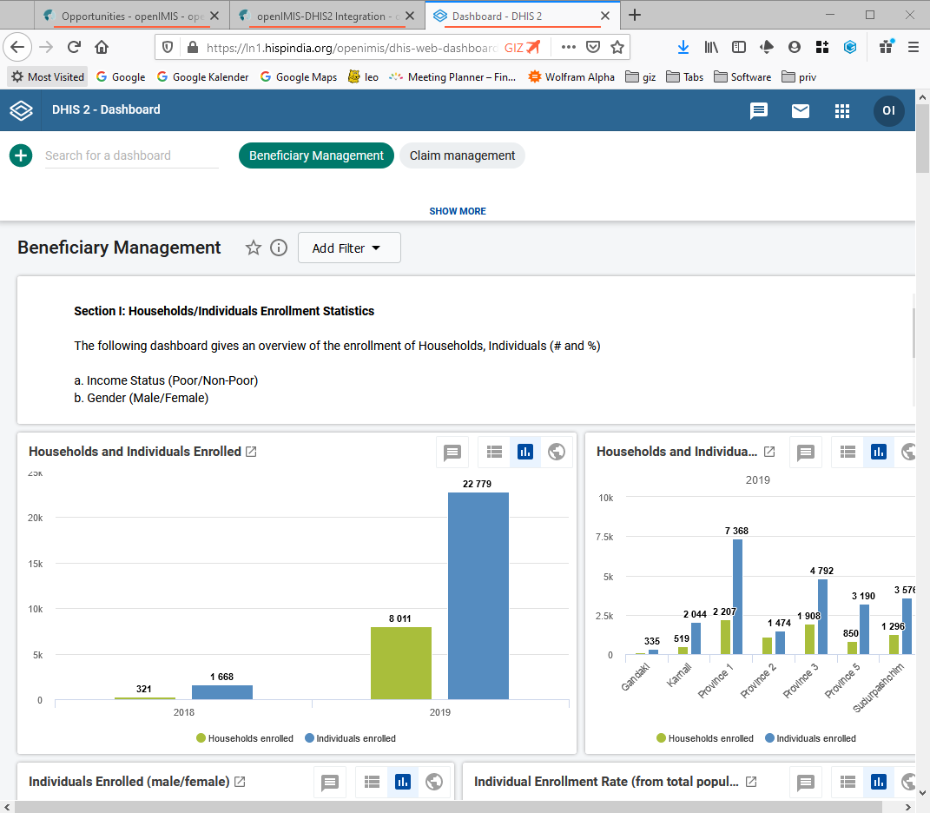
Generic Indicators & Dashboards
Beneficiaries (~ 25 Indicators)
e.g: individuals & households enrolled / covered
Claims (~ 50 Indicators)
e.g.: number & value of submitted/rejected claims; diagnosis trends
Operations (6 Indicators)
E.g.: average processing times

Slide 8
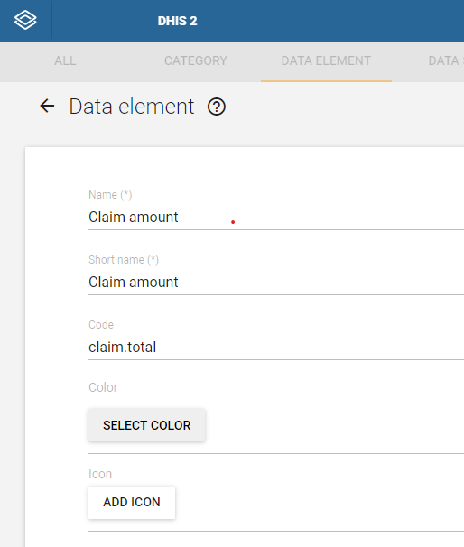
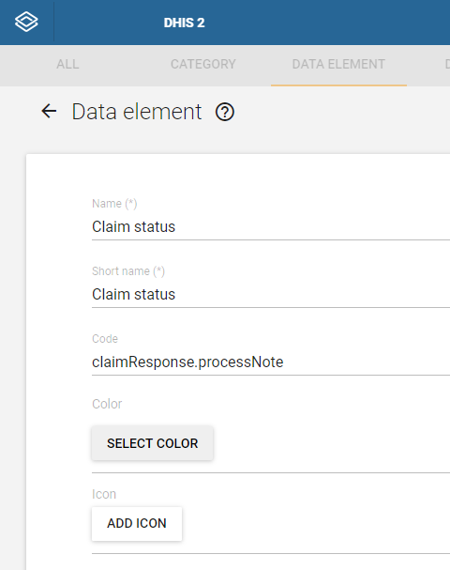
FHIR mapping in DHIS2 Data Elements

Slide 9
openIMIS-DHIS2 Data Exchange Adapter
Technology Framework
Key Functions
Built using JAVA
Utilises Spring framework
Packaged as a .JAR file which can be implemented on server/machine.
Data exchange between openIMIS and DHIS2 for the following data:
Insuree enrolment details
Coverage details
Claim enrolment details
Claim processing, Claim-Services, and Claim-Items details.
Linked with a Cron job, to push latest updates from openIMIS to DHIS2 every 24 hours.
Metadata sync for syncing health facilities & locations with DHIS2
Re-Design ongoing!

Slide 10
Ressources
Demo instance:
https://openimis.atlassian.net/wiki/spaces/OP/pages/900857929/DHIS2+test+instance+for+Indicator+Dashboards
Wiki resource & documentation page:
https://openimis.atlassian.net/wiki/spaces/OP/pages/900825134/openIMIS-DHIS2%2BIntegration
Dashboard Configuration:
https://github.com/openimis/openimis-dhis2-configuration_json
Adaptor:
https://github.com/hispindia/openimis-dhis2integration

Slide 11
Outlook
Implementation & roll-out project starting in Nepal
Implementation for Tanzania under review
Options towards an official DHIS2 content package welcome (compare WHO content packages)

