Slide 1
Formal sector
March 2021
Activity Report

Slide 2
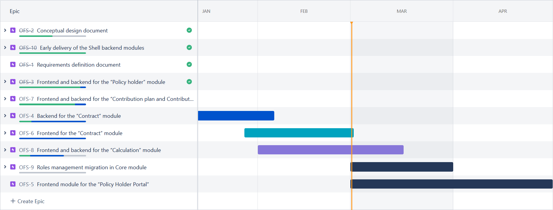
Roadmap

Slide 3
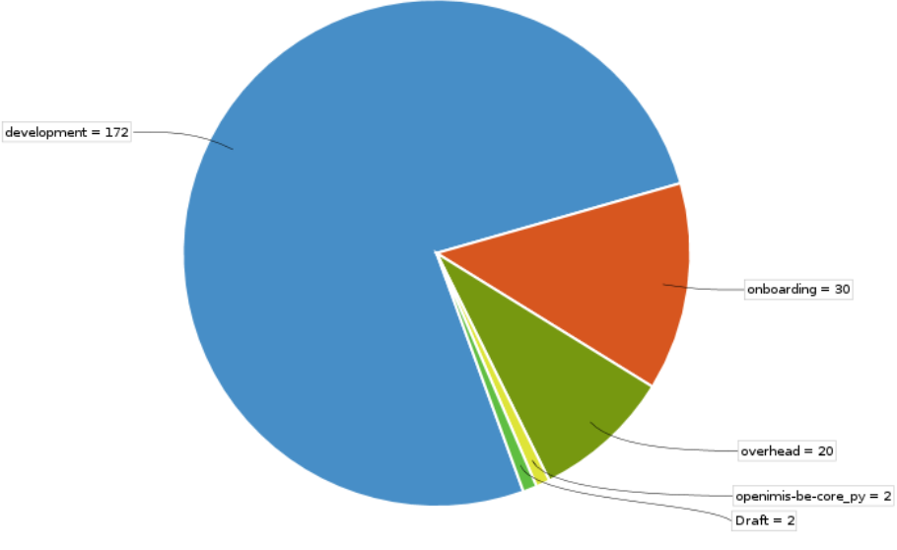
February 2021 activities
Scope activities:
Contract BE 100 % done
Contract FE 100 % done
Calculation BE 90% done
Calculation rule 1: 90 % Done
Time reporting
Soldevelo 259 MD
SwissTPH 50 Days

Slide 4
Future activities for March
Contract activities:
Review meeting for contract and calculation (week of the 18/03)
Development activities:
Backend module development
Calculation
Profile
Frontend module development.
Calculation
Profile

Slide 5
Formal Sector

Slide 6
Demo
https://modular.fs.swisstph-mis.ch

