Slide 1
OpenIMIS modular architecture March 2021

Slide 2
What has been done so far
Modular architecture setup: Python/Django, proxy, GraphQL
2020: Claim module rewrite (+ locations and limited modules)
2021: Beneficiary enrolment
Insuree & family
Policy
Contribution
Payment

Slide 3
Tender 3
Limited to existing functionality for time constraints
FHIR API will not be covered, required resources can easily be added
Reuse existing software or modules where possible
PostgreSQL migration planned but support for both requested

Slide 4
Codebase migration: Users
1-Jun-2021
Users are currently logged on the
Legacy via proxy
User and rights management partly implemented by SolDevelo => deadline will be moved earlier

Slide 5
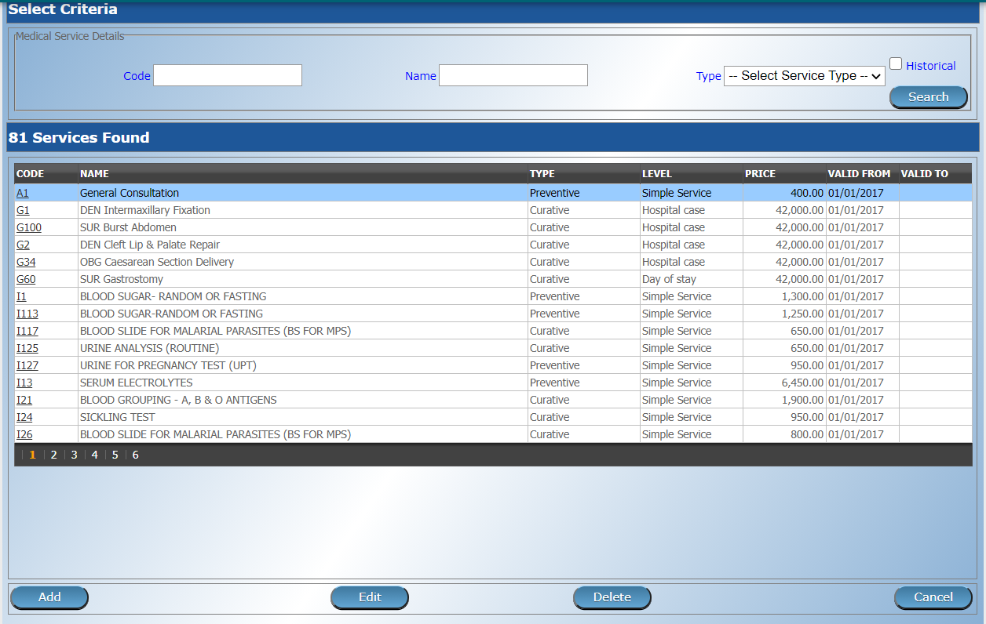
Codebase migration: Medical services/items
Services and items: 1-Jul-2021
Price lists: 1-Aug-2021
Pretty simple forms, required for Product

Slide 6
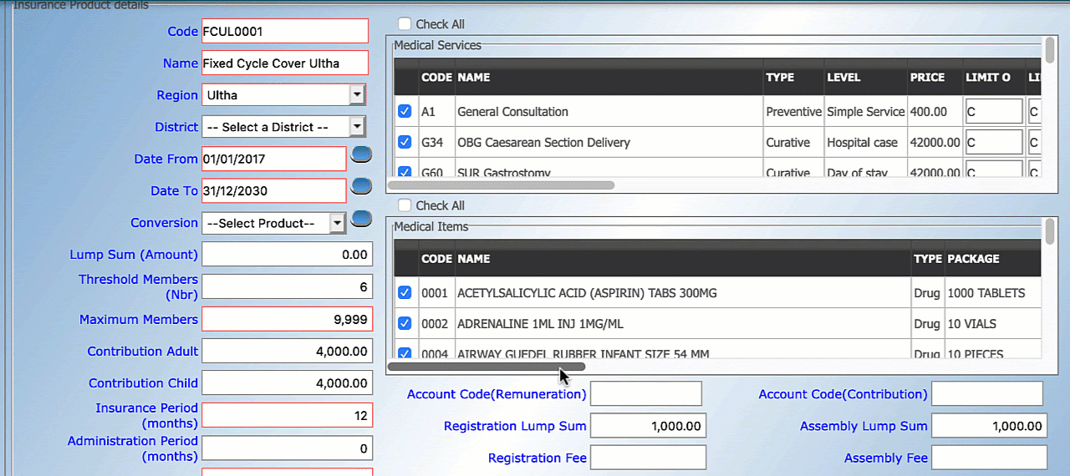
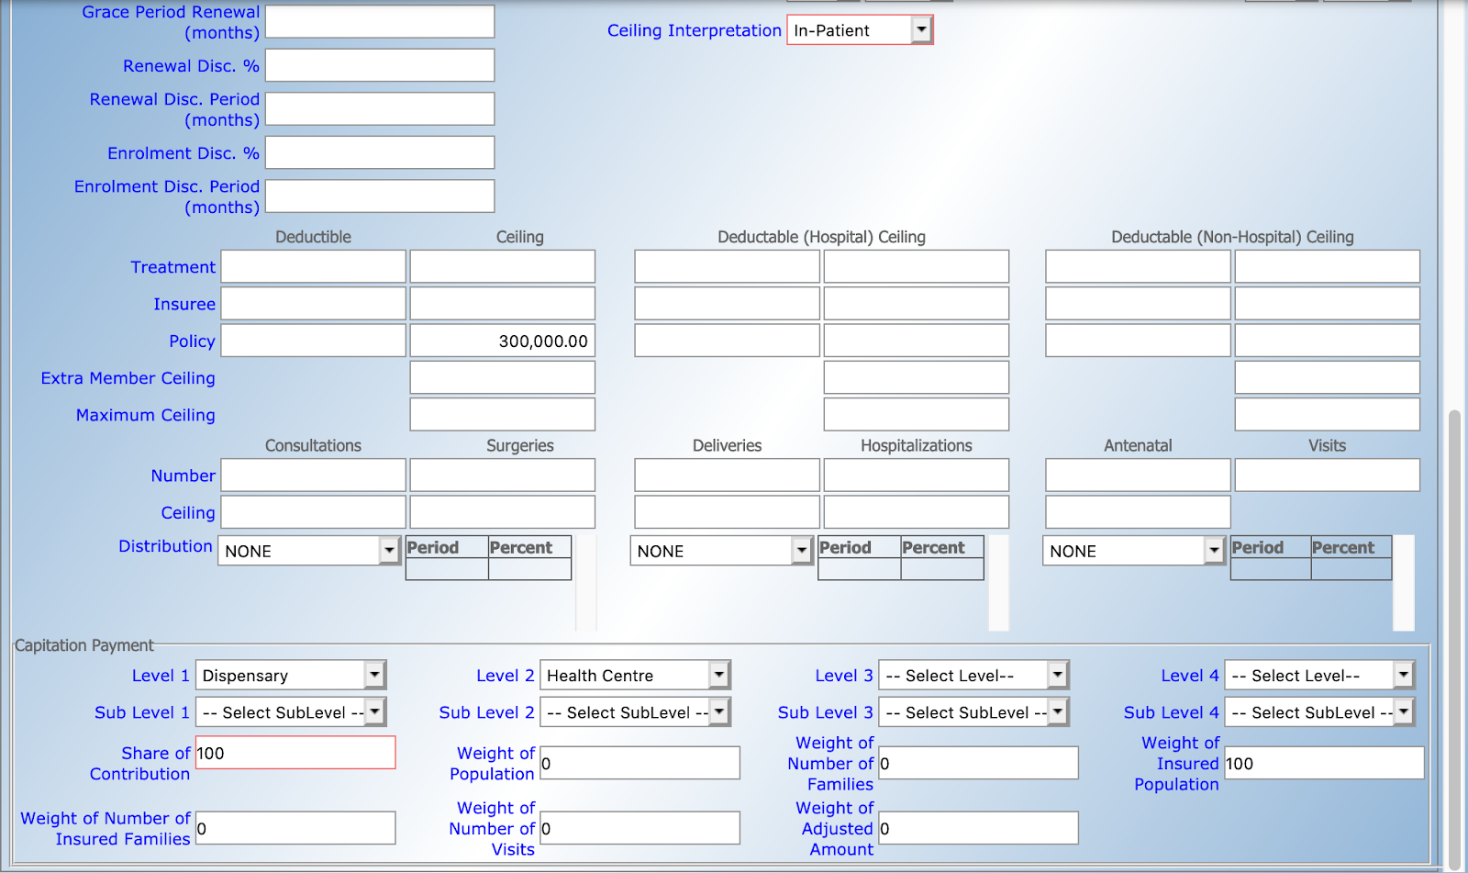
Codebase migration: Product

Slide 7
Codebase migration: Product
1-Oct-2021
Current screen is very complex, dynamic price list loading
Use tabs for each concern. Formal sector will add tabs
Hide irrelevant parts of product based on configuration
Limited extraction of product management code

Slide 8
Codebase migration: Payers & Funding
1-Nov-2021
Implement a generic approach, country specific “hacks” will be left to implement as a dedicated module

Slide 9
Codebase migration: User utilities
1-Dec-2021
Password change, reset, settings update
Probably be integrated into 1-Jun-2020 delivery

Slide 10
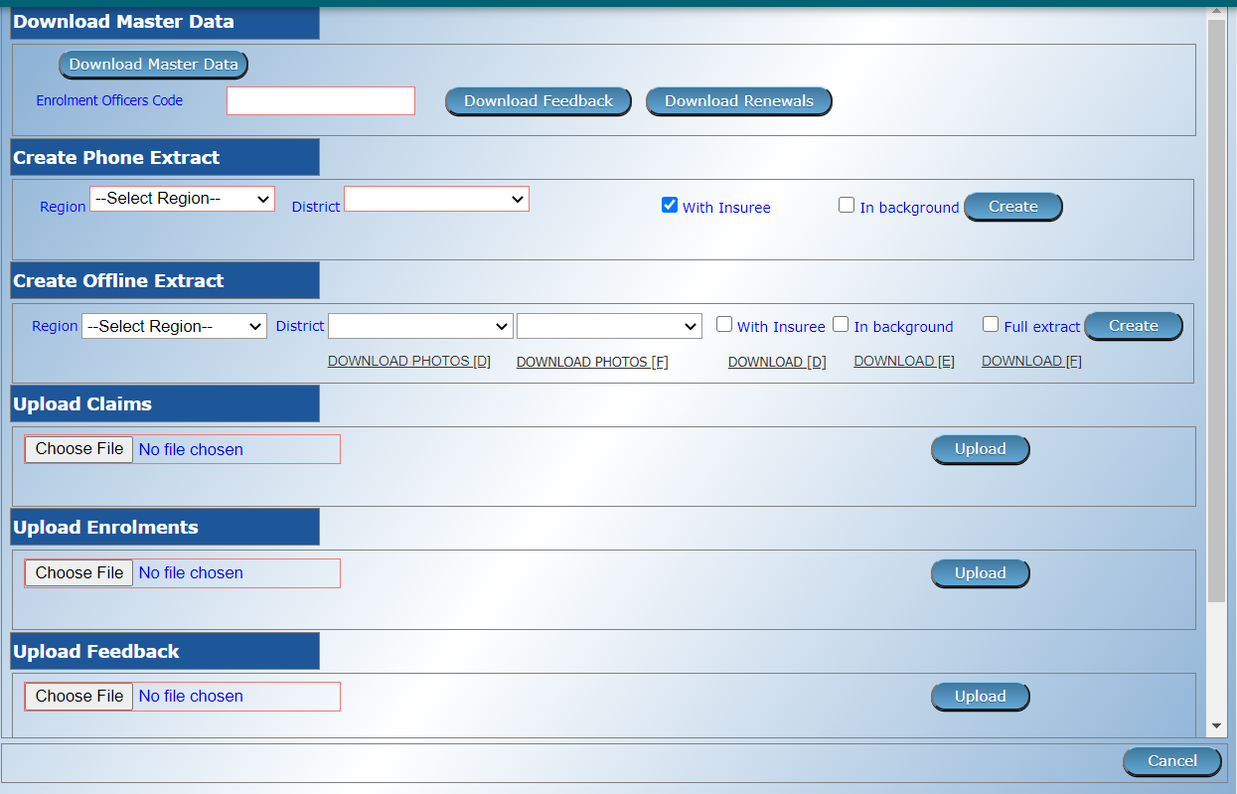
Codebase migration: Admin utilities
1-Feb-2022

Slide 11
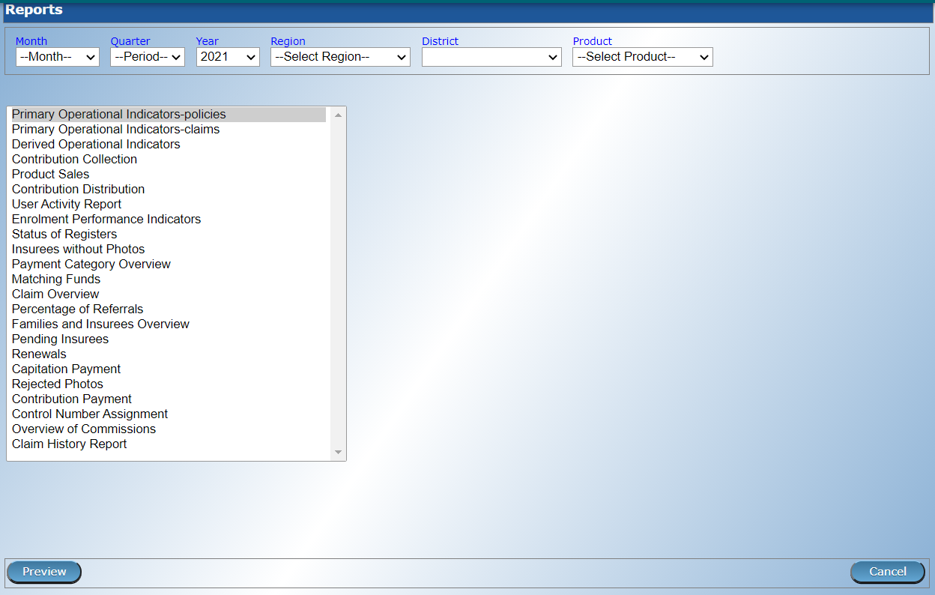
Codebase migration: Admin utilities
Report system will be setup, reports will be migrated depending on time available

