Slide 1
openIMIS Roadmap
openIMIS Community Workshop 2021
Day 2, 25.03.2021

Slide 2
The openIMIS Value Chain
Community Management
Fundraising
Support Processes
Margin
Capacity Building & Service
Networking, Advocacy & Public Relations
Technical Platforms
Development
Implementation
Operation
Impact
Core Processes

Slide 3
openIMIS Core Process Cycles
Development
Implementation
Operation
project
pilot
training
opportunity
product
selection
rollout
installation
operation
incubator
specification
analysis
monitoring
pioritization
evaluation
maintenance

Slide 4
openIMIS Development Process
Development
Implementation
Operation
incubator
ideas
prioritization
wishlist
opportunities
tenders
project
doing
product
release

Slide 5
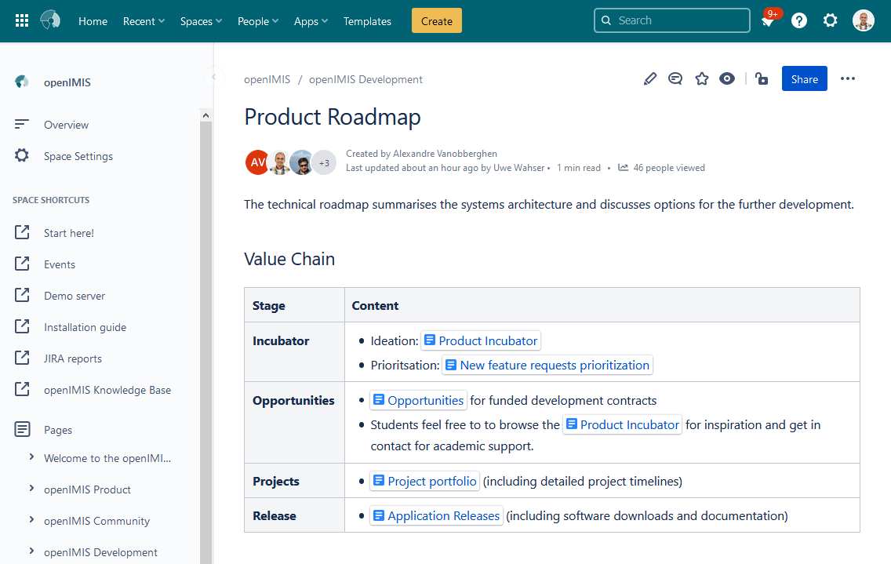
RoadMap - Wiki Page
https://openimis.atlassian.net/wiki/spaces/OP/pages/40763442/Product+Roadmap

Slide 6
Current Focus Areas
Continuity
Re-Architecture
Further Dev.
Shelf Readiness
Maintenance & Support
Modular Transformation
Digital Square Notice D1
Digital Square Notice E0
SwissTPH
SwissTPH
SwissTPH
SwissTPH
BlueSquare
SolDevelo
SolDevelo
Healthix
BlueSquare
BlueSquare
Coordination
GIZ
Consultants

Slide 7
Progress Modular Re-architecture
Aim:
Pure open source software stack
Scope:
Modules needed for new implementations
Migration of special local features might still be needed
Targets:
Database switch mid 2022
Release in October 2022

Slide 8
Slow Transition (2021 roadmap)
Framework
openIMIS
MS IMIS
Claiming, Locations
Enrollment, Policy, Contributions
Everything else
openHIE Integration, Indicator Dashboard
Claims Adjudication - AI
Formal Sector Schemes & APIs
new
Accident Insurance
Releases:
April 2019
Oct. 2019
April 2020
Oct. 2020
April 2021
Oct. 2021
April 2022
Oct. 2022

Slide 9
Developers Committee (2021)
SwissTPH
Exact
GIZ S2HS (NP)
GIZ (DE)
funded
BlueSquare
unfunded
SolDevelo
new
HISP (IN)
alumni
Possible H
Healthix
PCS
2012
2013
2014
2015
2016
2017
2018
2019
2020
2021
2022
Notice D
Tenders 2020

Slide 10
Additional Developers
Developers from countries piloting openIMIS
Djibouti, Gambia, Zanzibar
Student projects
Database migration to PostgreSQL
Upgrade FHIR STU3 to FHIR R4
Google Summer of Code (next year ;-) )
Projects in Nepal
Accident Insurance, Formal Sector, Dashboards
New Tenders
Open tenders

Slide 11
Co-ordination: Calls and Events
Weekly calls (Thursdays)
Daily business, troubleshooting, kitchen talk
Minutes
Gumzo ya mwezi = Monthly calls (1st Monday every month)
Project progress
Minutes
Ad-Hoc calls
Events
New: Developers Training

Slide 12
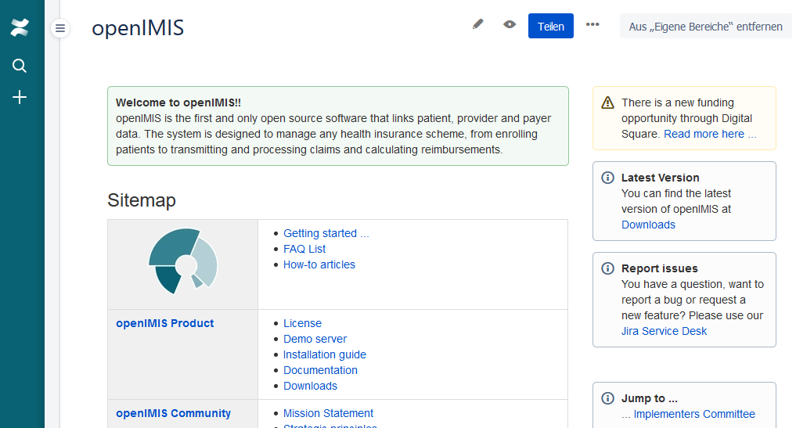
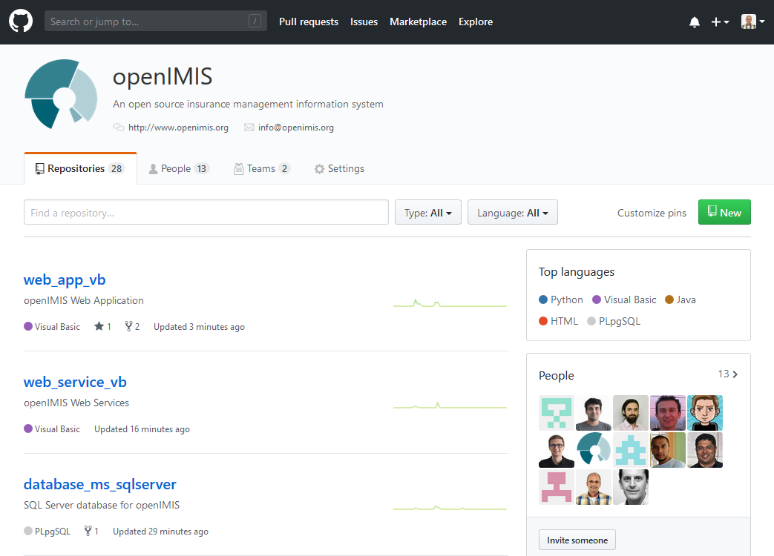
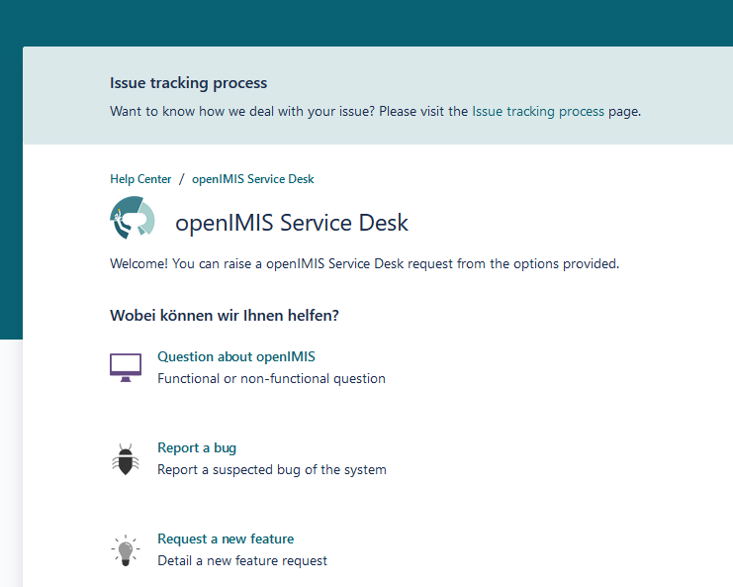
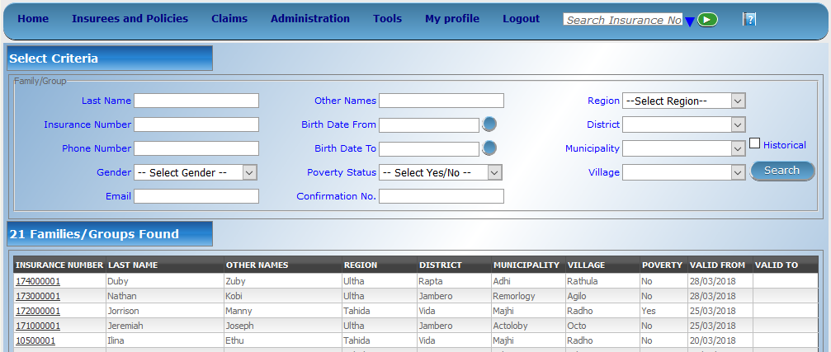
Community Tools
Homepage
Wiki
Forum
Document Share
Service Desk / Issue Tracker
Code repository
Demo Server
Documentation

