Slide 1
Formal sector
February 2021
Activity Report

Slide 2
Roadmap

Slide 3
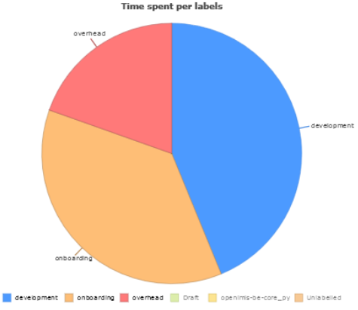
January 2021 activities
Scope activities:
PolicyHolder & Contribution plan fixes
Contract BE 90 % Done
Contract FR 10 % done
Time reporting
Soldevelo 220 MD
SwissTPH 45 Days

Slide 4
Future activities for December
Contract activities:
Delivery of contract and calculation on the 28/02
Development activities:
Backend module development
Contract
Calculation
Frontend module development.
Contract
Calculation

Slide 5
Formal Sector

Slide 6
Demo
https://modular.fs.swisstph-mis.ch

