Slide 1



AI-based Claim Categorization
01 February 2021
Dragos Dobre, Simona Dobre, Siddharth Srivastava

Slide 2
Project timeline
Activity |  | Team | 2020 |  |  | 2021
 |  |  | Jun-Jul | Aug-Sep | Oct-Dec | Jan-Mar | April
Data gathering and preparation | AI input data model structure | Swiss TPH | X
 | FHIR claim input data for AI | Swiss TPH | X
 | Sanity check of the database | Swiss TPH |  | X
 | Process categorical data | Swiss TPH |  | X
 | Data normalization | Swiss TPH |  | X
Implementation of the AI algorithm | Al methods, model outputs and evaluation metrics | Swiss TPH |  |  | X
 | Development of the AI model | Swiss TPH |  |  |  | X
AI-based Claim Adjudication Process |  | Swiss TPH |  |  | X
openIMIS Claim-AI module development | Claim-AI module specification | Swiss TPH |  |  | X
 | Claim-AI module development | SolDevelo |  |  |  | X
 | Claim-AI module validation | Swiss TPH |  |  |  | X
openIMIS Claim-AI Quality Monitor module development | Claim-AI Quality Module specification | Swiss TPH |  |  | X
 | Claim-AI Quality Module development | SolDevelo |  |  |  | X
 | Claim-AI Quality Module validation | Swiss TPH |  |  |  | X
Module User Acceptance Testing | Installation of AI-based openIMIS on Nepal server | SolDevelo |  |  |  |  | X
 | Organization of the UAT | GIZ Nepal |  |  |  |  | X

Slide 3
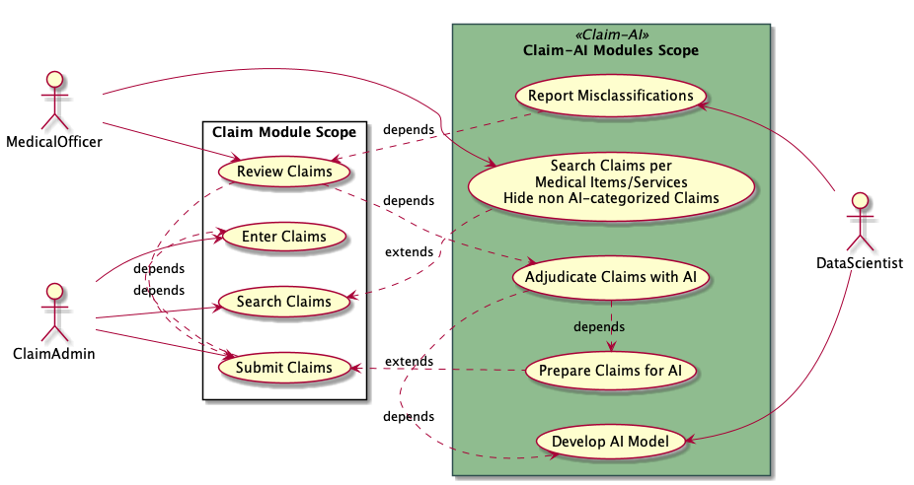
Use cases

Slide 4
Claim-AI modules responsibilities
Claim-AI Quality Module | Claim-AI Module
Adds Medical Item/Service filter Listening for SubmitClaimMutation mutation Signal Update Claim to not be selected by reviewers Push FHIR R4 Claim to Claim-AI Receive FHIR R4 ClaimResponse Update Claim Status and ReviewStatus Reports claim adjudication misclassifications | Self containing API Accepts FHIR R4 Claim Bundle Replies with FHIR R4 ClaimResponse Bundle Prepares the data for the AI model Categorize the Claims (AI model execution)

Slide 5
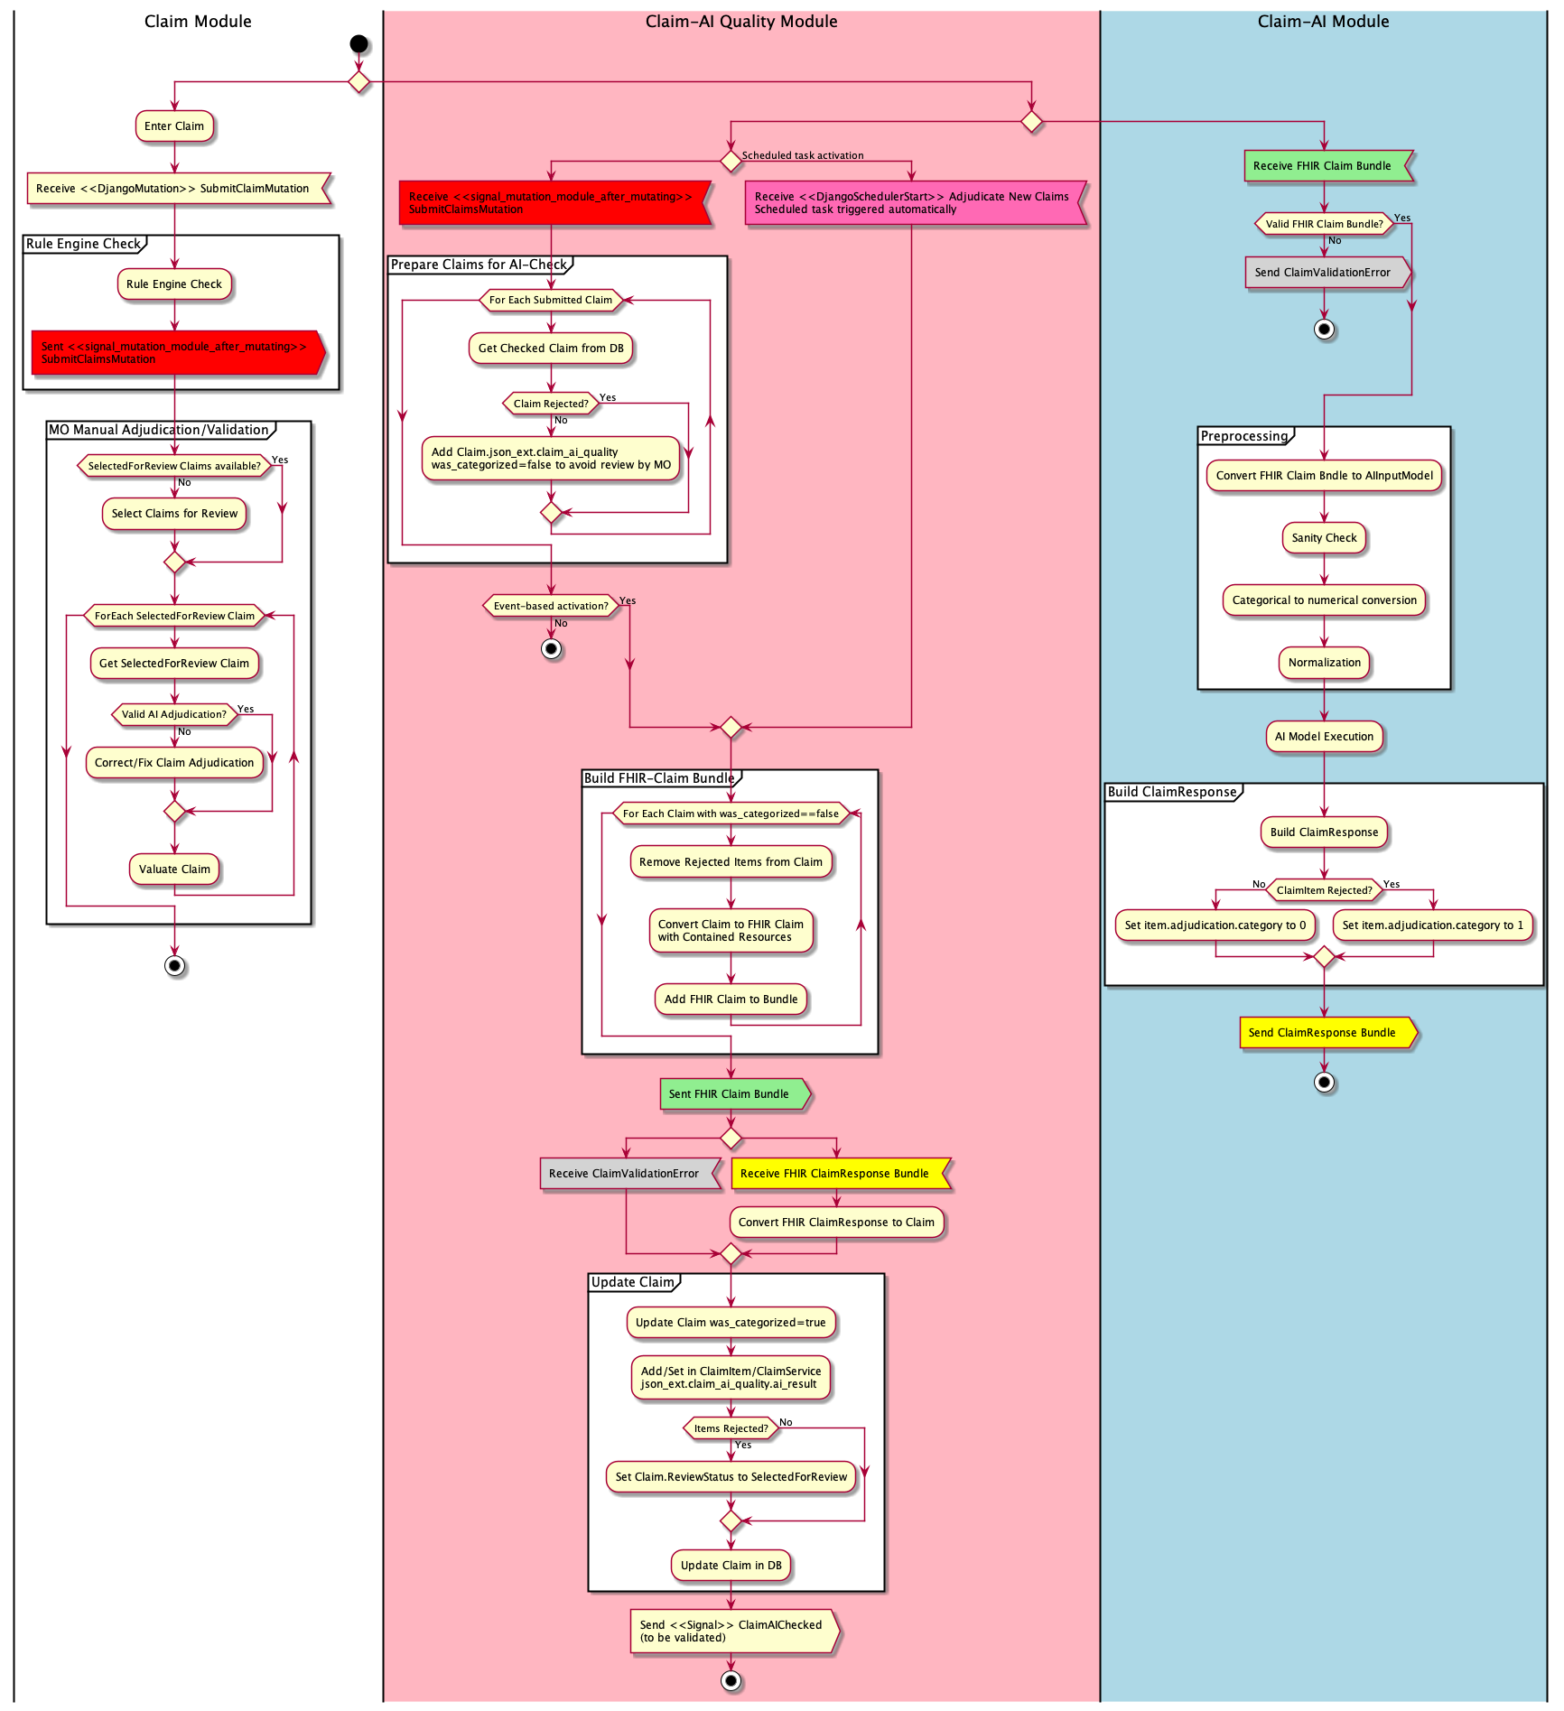

Slide 7
AI Categorisation Misclassification Report
total number of Claims
accuracy score ( Accuracy = (TP+TN)/(TP+TN+FP+FN) )
number of True Positives results
number of True Negative results
number of False Positive results
number of False Negative results
Table with Claim that were fixed
  same format as Claim Overview report with Scope as ‘Claim and All Details’
  with additional json_ext.claim_ai_quality.ai_result column for each Item and Service

Slide 8
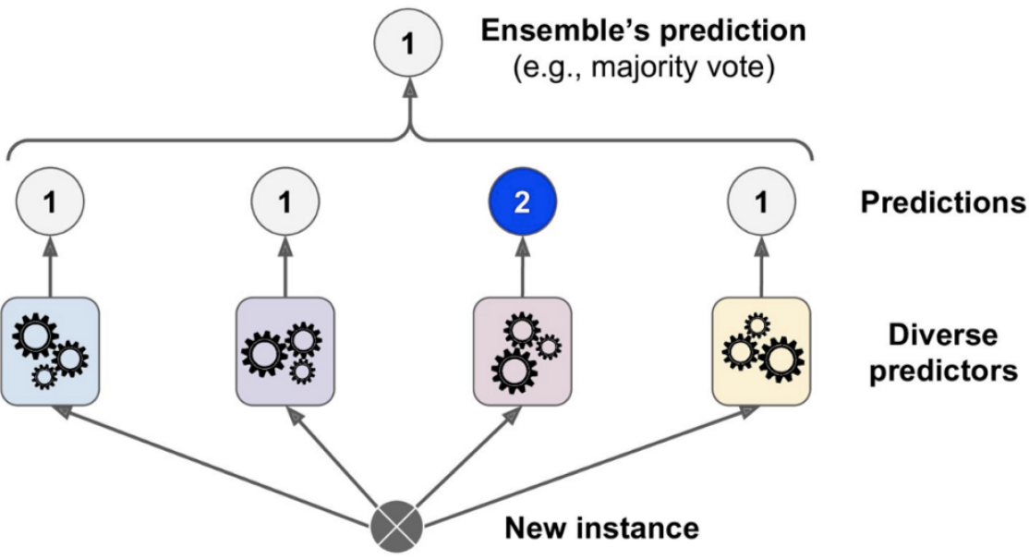
AI model training and evaluation
1
1
1
2
1
Decision
Tree
Random
Forest
Extra
Trees
XGB
Predictions of a hard voting classifier
[Géron, 2019]

Slide 9
AI model training and evaluation
 | Support (test set) |  | True Negative | False Positive | False Negative | True Positive | Precision | Recall | F1-score | Accuracy
Classifier | Accepted | Rejected | True Accepted items |  | True Rejected Items
Decision Tree 1 | 659236 | 17809 | 647401 | 11834 | 5538 | 12270 | 0.5090 | 0.6890 | 0.5855 | 0.9743
Decision Tree 2 | 659236 | 17809 | 579307 | 79928 | 3063 | 14745 | 0.1557 | 0.8280 | 0.2622 | 0.8774
Random Forest | 659236 | 17809 | 652650 | 6585 | 4541 | 13267 | 0.6683 | 0.7450 | 0.7046 | 0.9836
Extra Trees | 659236 | 17809 | 647266 | 11969 | 4181 | 13627 | 0.5324 | 0.7652 | 0.6279 | 0.9761
Extra Gradient Boost | 659236 | 17809 | 654712 | 4523 | 5370 | 12200 | 0.7295 | 0.6944 | 0.7115 | 0.9854
VotingClassifier | 659236 | 17809 | 650847 | 8388 | 3853 | 13955 | 0.6246 | 0.7836 | 0.6951 | 0.9819

Slide 10

AI-based Claim Categorization
Dragos Dobre, Simona Dobre, Siddharth Srivastava

