Slide 1






A Generic and Interoperable
UHC Reporting Platform under DHIS2
Yogita Thakral, Saurabh Leekha, Saurav Bhattarai, Uwe Wahser
DHIS2 Annual Conference, 24.09.2020

Slide 2




Presenters
Yogita Thakral
HISP India
Saurabh Leekha
HISP India
Saurav Bhattarai
GIZ – openIMIS Initiative
Uwe Wahser
GIZ – openIMIS Initiative

Slide 3
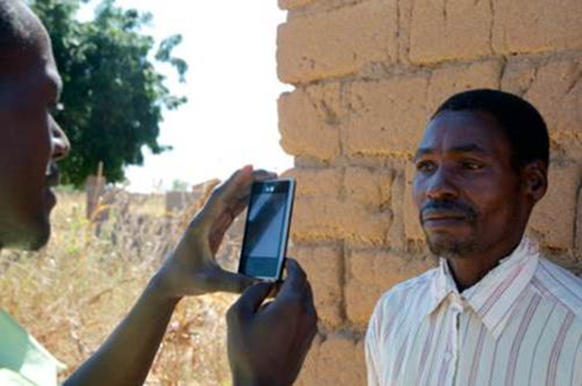
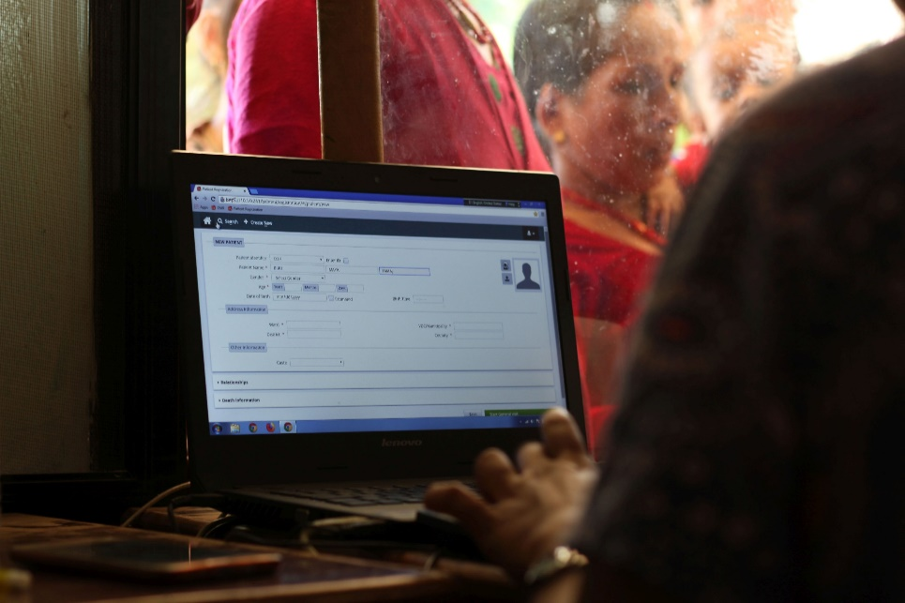
What is openIMIS?
openIMIS is an
open source software for improving health financing operations by digitalizing the link between patients, providers and payers
based on a
community of developers, users and implementers
with the joint mission to
increase and improve universal health coverage (UHC)

Slide 4
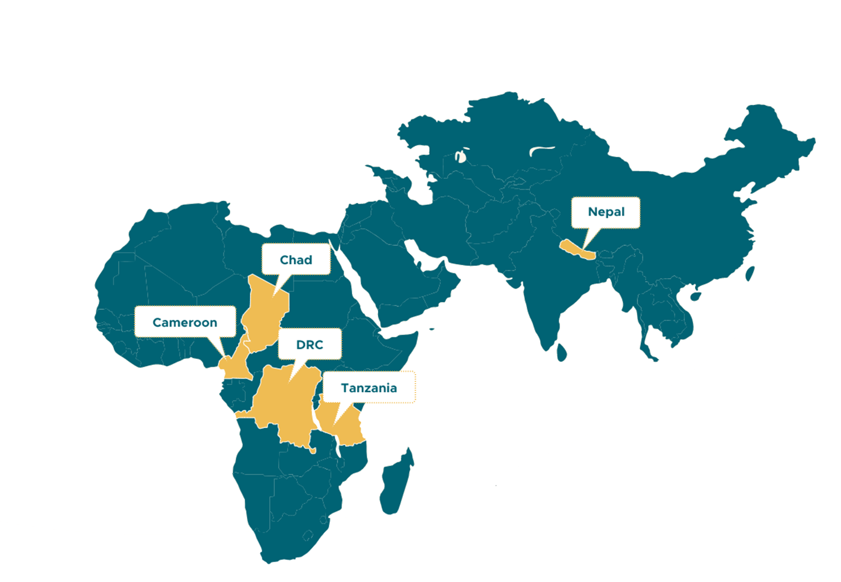
openIMIS Implementations
Coming up:
Djibouti
Zanzibar
Gambia
Country assessments:
Rwanda
Malawi
Madagascar
Nigeria
…
New catalytic fund for implementation support starting

Slide 5
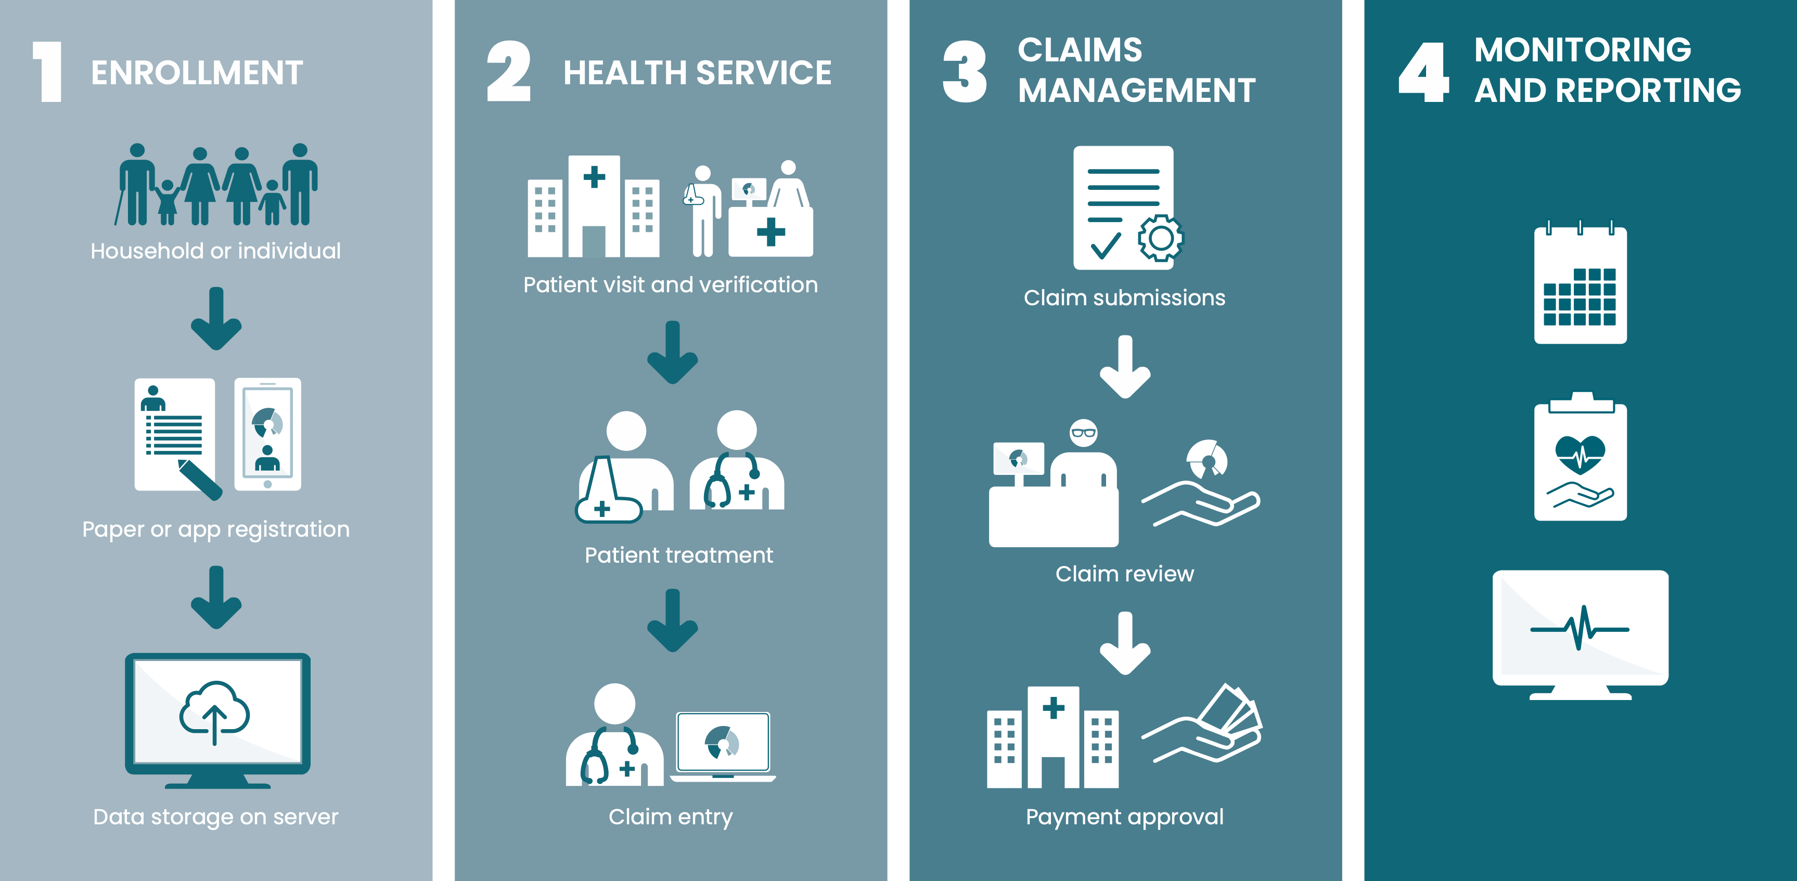
openIMIS Workflows

Slide 6
Integration into OpenHIE
Digital Square Notice C1 (2019)
DHIS2
BAHMNI
FHIR STU 3 (v3.0.0)
Going to FHIR R4 …
Odoo
OpenELIS
openIMIS
OpenMRS
OpenMRS
OpenHIM
BlueSquare
SolDevelo
Possible Health
HISP India

Slide 7
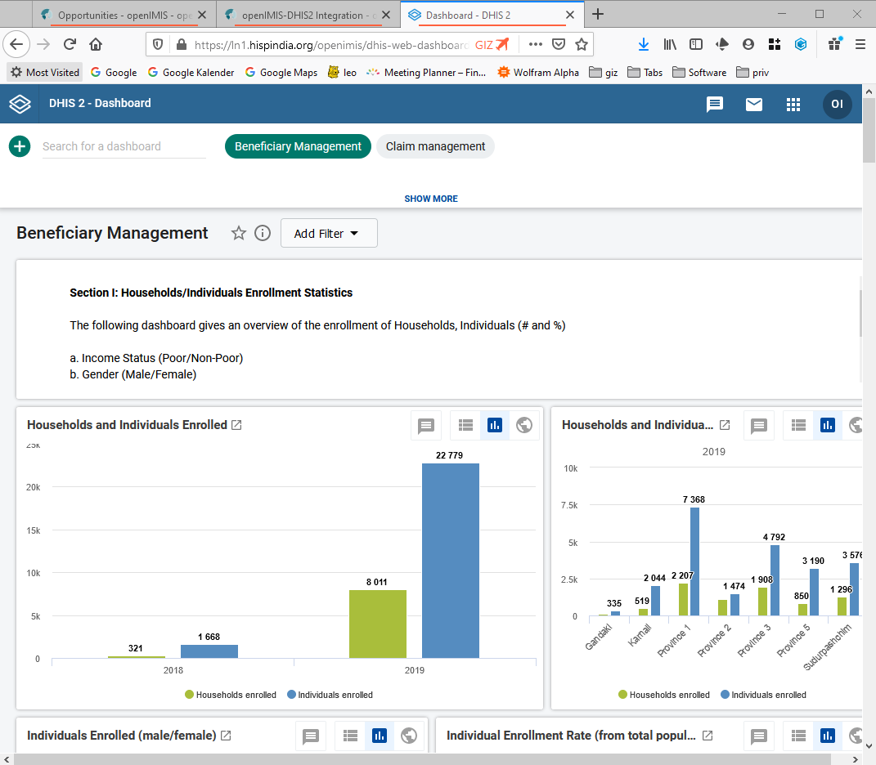
Generic Indicators & Dashboards
Beneficiaries (~ 25 Indicators)
  e.g: individuals & households enrolled / covered
Claims (~ 50 Indicators)
  e.g.: number & value of submitted/rejected claims; diagnosis trends
Operations (6 Indicators)
  E.g.: average processing times

Slide 8


Data Model & Information Flow
openIMIS
DHIS2
Enrollments
Insuree Program
Claims Program
Program Stages
Policy
Claims
Policy (New, Renewals)
Claims (Submissions, Review, Valuation etc.)
Data Base
Data Base

Slide 9
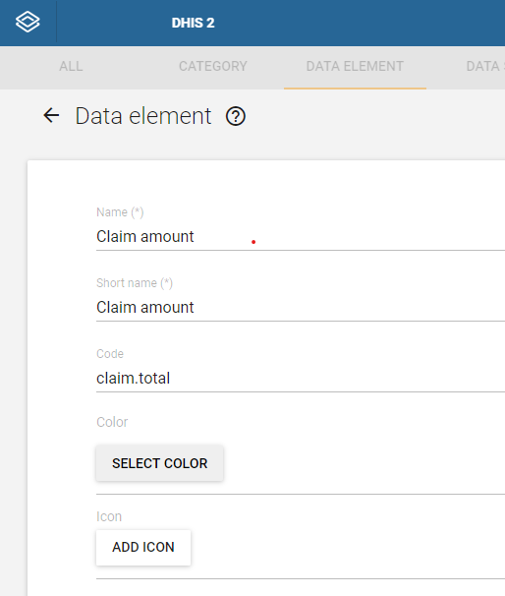
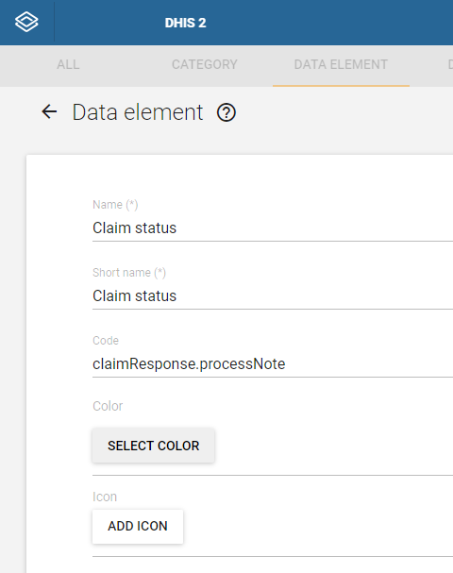
FHIR mapping in DHIS2 Data Elements

Slide 10
openIMIS-DHIS2 Data Exchange Adapter
Technology Framework
Key Functions
Built using JAVA
Utilises Spring framework
Packaged as a .JAR file which can be implemented on server/machine.
Data exchange between openIMIS and DHIS2 for the following data:
Insuree enrolment details
Coverage details
Claim enrolment details
Claim processing, Claim-Services, and Claim-Items details.
Linked with a Cron job, to push latest updates from openIMIS to DHIS2 every 24 hours.
Metadata sync for syncing health facilities & locations with DHIS2

Slide 11
Ressources
Demo instance:
  https://openimis.atlassian.net/wiki/spaces/OP/pages/900857929/DHIS2+test+instance+for+Indicator+Dashboards
Wiki resource & documentation page:
  https://openimis.atlassian.net/wiki/spaces/OP/pages/900825134/openIMIS-DHIS2%2BIntegration
Dashboard Configuration:
  https://github.com/openimis/openimis-dhis2-configuration_json
Adaptor:
  https://github.com/hispindia/openimis-dhis2integration

Slide 12
Outlook
Implementation & roll-out project starting in Nepal
Implementation for Tanzania under review
Options towards an official DHIS2 content package welcome (compare WHO content packages)

Slide 13
















13
25.09.2020

Slide 14

Thank you!
May the source be with you.

