Slide 1
Maintenance and Support
11 January 2020
Activity Report

Slide 2
December 2020 activities
Support:
OSD-112: Legacy openIMIS Installation default username and password doesn't work - Waiting for customer
OSD-113: Bulk imports of images - Waiting for customer
OSD-115: email sending issue – Waiting for customer
OSD-120: Question about the translation system on OpenIMIS – Waiting for customer
OSD-122: Possibilité de personnalisation avancées – Waiting for customer
OSD-123: Demo server: Gateway time-out – Closed
Maintenance/Development:
New servers configuration
DHIS2 integration module contribution (not on T1)

Slide 3
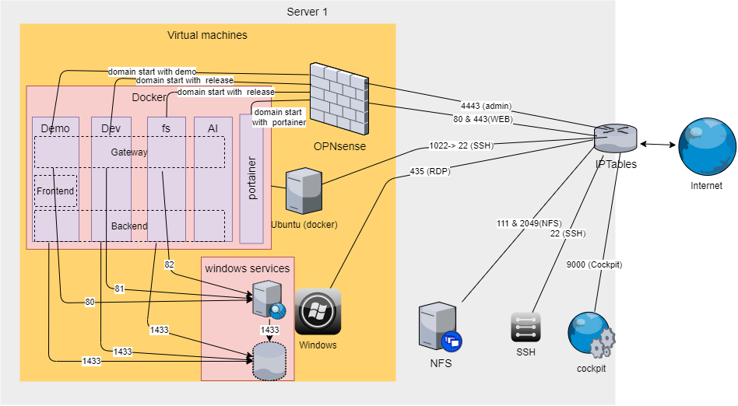
New servers configuration
Server 1 configuration
Cent OS base system
VMs:
OPNsense for firewall
Windows for DB and legacy openIMIS
Linux Ubuntu with Docker for modular openIMIS
Server 2 configuration to do
Same as S1 with replication?
+ Trainings, tests, project UAT?
Demo instance migrated
REST API still to be migrated
DB restore to be scheduled

Slide 4
Time budget available
Total days | Remaining days | Remaining percentage
240 | 219 | 91%

Slide 5
Future activities
Support:
Wiki and video preparation for openIMIS Installation and Country Localization
REST API and Mobile Application installation
Maintenance and development:
Servers configuration
Integrate Nepal features into legacy openIMIS (PR reviewed)
Bug fixes

Slide 6
Maintenance and Support

