Slide 1
AI-based Claim Categorization
11 January 2020
Dragos Dobre, Simona Dobre, Siddharth Srivastava

Slide 2
Project timeline
Activity |  | Team | 2020 |  |  | 2021
 |  |  | Jun-Jul | Aug-Sep | Oct-Dec | Jan-Feb
Data gathering and preparation | AI input data model structure | Swiss TPH | X
 | FHIR claim input data for AI | Swiss TPH | X
 | Sanity check of the database | Swiss TPH |  | X
 | Process categorical data | Swiss TPH |  | X
 | Data normalization | Swiss TPH |  | X
Implementation of the AI algorithm | Al methods, model outputs and evaluation metrics | Swiss TPH |  |  | X
 | Development of the AI model | Swiss TPH |  |  |  | X
AI-based Claim Adjudication Process |  | Swiss TPH |  |  | X
openIMIS Claim-AI module development | Claim-AI module specification | Swiss TPH |  |  | X
 | Claim-AI module development | SolDevelo |  |  |  | X
 | Claim-AI module validation | Swiss TPH |  |  |  | X
openIMIS Claim-AI Quality Monitor module development | Claim-AI Quality Module specification | Swiss TPH |  |  | X
 | Claim-AI Quality Module development | SolDevelo |  |  |  | X
 | Claim-AI Quality Module validation | Swiss TPH |  |  |  | X
Module User Acceptance Testing | Installation of AI-based openIMIS on Nepal server | SolDevelo |  |  |  | X
 | Organization of the UAT | GIZ Nepal |  |  |  | X
Adjudication workflow
Data gathering and preparation
Implementation of the AI algorithm
openIMIS AI module development
openIMIS AI Claim Quality Monitor module development
openIMIS AI module User Acceptance Testing

Slide 3
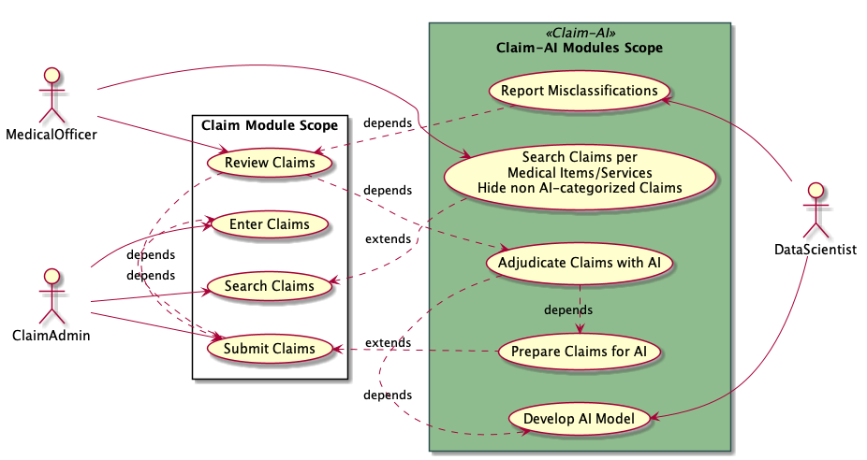
Use cases

Slide 4
Claim-AI modules responsibilities
Claim-AI Quality Module | Claim-AI Module
Adds Medical Item/Service filter Listening for SubmitClaimMutation mutation Signal Update Claim to not be selected by reviewers Push FHIR R4 Claim to Claim-AI Receive FHIR R4 ClaimResponse Update Claim Status and ReviewStatus Reports claim adjudication misclassifications | Self containing API Accepts FHIR R4 Claim Bundle Replies with FHIR R4 ClaimResponse Bundle Prepares the data for the AI model Categorize the Claims (AI model execution)

Slide 5
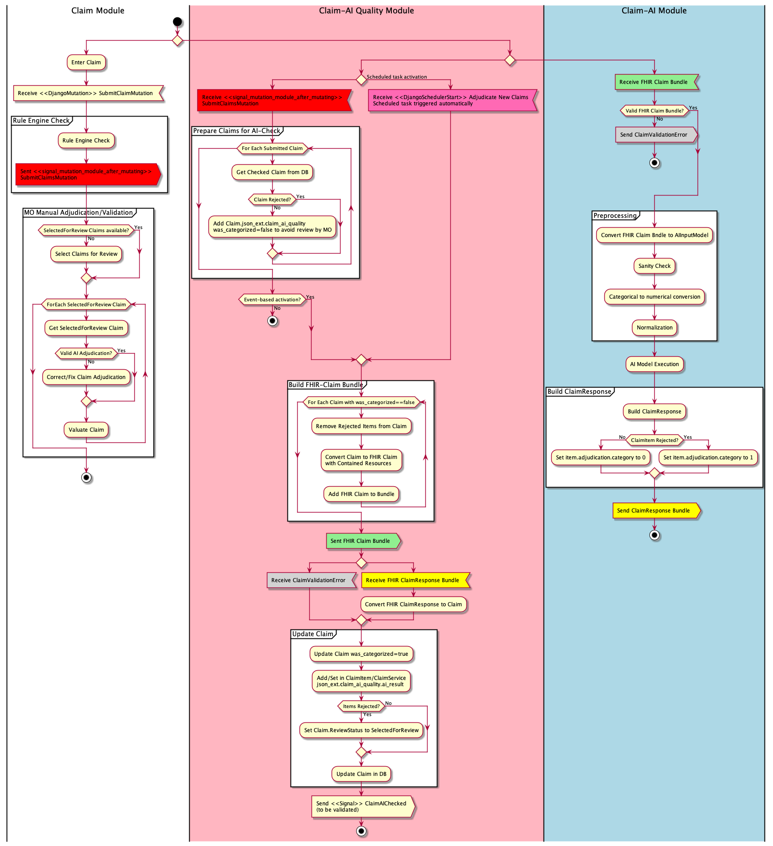

Slide 7
Activation methods
Event-based activation
Based on signal_mutation_module_after_mutating on SubmitClaimMutation mutation
Prepares the Claims for the Claim-AI adjudication processing (init json_ext)
Push the Claims to Claim-AI module for the actual adjudication
Schedule Task activation
Push the Claims prepared during Event-based activation to Claim-AI module
Based on module configuration

Slide 8
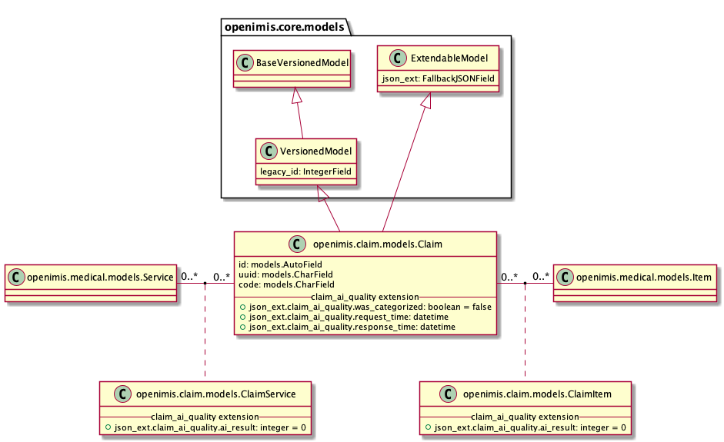
Claim Review Search filters
Filter on Medical Item and/or Service
Based on Medical Items/Service FE contribution
Will be moved to Claim module
Filter on AI adjudicated claims
Based on json_ext field
Hide Claims not already categorized by AI (prepared Claims)
Query search on json_ext developed in Core module

Slide 9
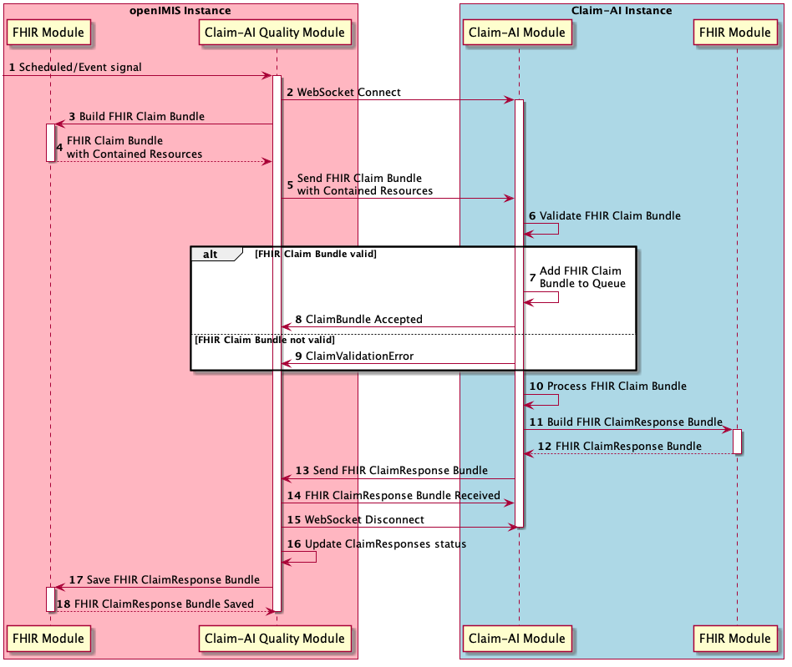
Claim-AI Communication Protocol
WebSocket API
Request: FHIR R4 Claim Bundle with Contained Resources
Response: FHIR R4 ClaimResponse Bundle
Contained Resources developed in FHIR R4 module

Slide 10
Claim-AI modules configuration
Claim-AI Quality module
claim_ai_url: string
URL of the openIMIS instance running Claim-AI module. Default: ""
event_based_activation: boolean
True if the checked Claims are sent to Claim-AI module immediately after check. Default: False
page_limit: integer
Maximum number of claims to be sent to Claim AI module (0: unlimited). Default: 0
zip: boolean
Whether the communication payload is compressed or not. Default: False
Claim-AI module
authentication: [string]
Authentication key list. Default: []
zip: boolean
Whether the communication payload is compressed or not. Default: False
ai_model_file: string
AI Model file name with full path. Default: ./ai_model.pkl

Slide 11
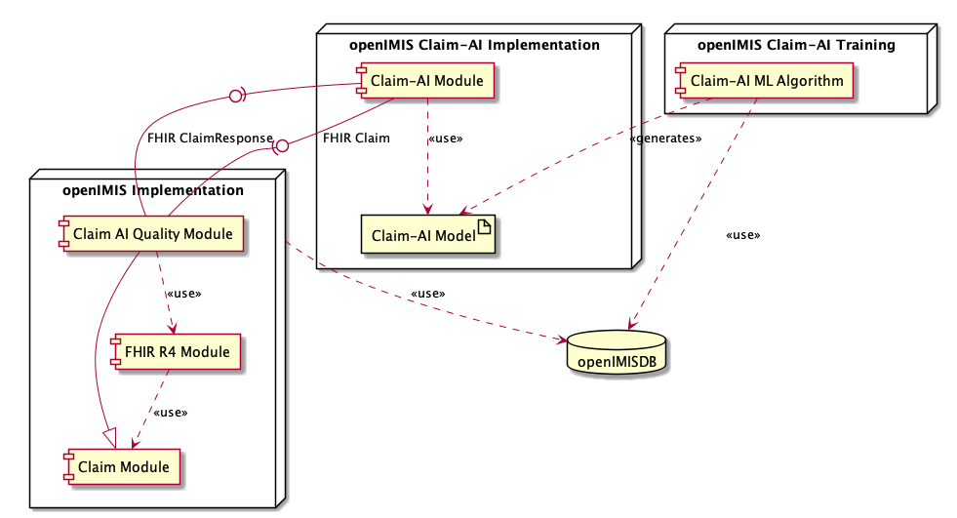
Deployment architecture

Slide 12
AI-based Claim Categorization
Dragos Dobre, Simona Dobre, Siddharth Srivastava

