Slide 1
Formal sector
December 2020
Activity Report

Slide 2
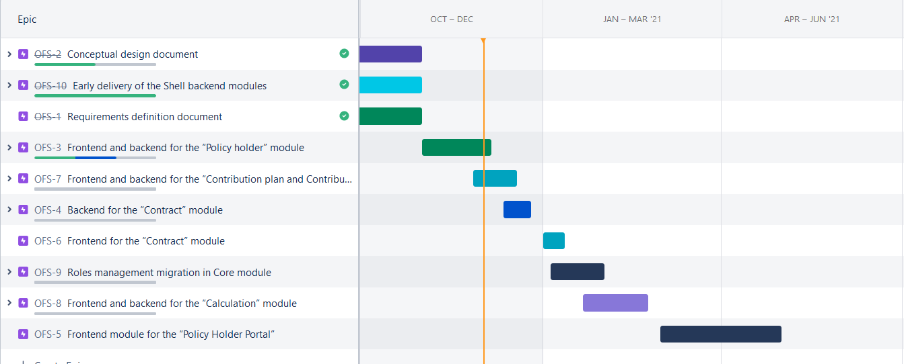
Roadmap

Slide 3
November 2020 activities
Scope activities:
PolicyHolder be module done
PolicyHolder fe module 70% done
Contribution plan module details design finished
Other activities
On-boarding of new members
Defining some of the overall “tools” like Models , standard mutations took time

Slide 4
Future activities for December
Contract activities:
Next due date on 31/12
Development activities:
Backend module development
Contribution plan and bundle (finishing mutation, implementing authorities)
Contract (finishing graphQL, mutations and authorities) (at risk)
Frontend module development.
PolicyHolder*
Contribution plan and bundle
Contract (at risk)

Slide 5
State of deliverables
Activity | Deliverable | Due Date | Updated due dates
0.1 | Requirements definition document | Delivered
0.2 | Conceptual design document | Delivered
1.1 | Frontend and backend for the “Policy holder” module & quarterly narrative report | December 31, 2020 | December 31, 2020
1.2 | Backend for the “Contract” ( previously “Contribution Collection” ) module | February 28, 2021 | December 31, 2020
1.3 | Frontend module for the “Policy Holder Portal” | February 28, 2021 | February 28, 2021
1.4 | Frontend for the “Contract” (previously “Contribution Collection” ) module | February 28, 2021 | December 31, 2020
2.1 | Frontend and backend for the “Contribution plan and Contribution plans bundle” module | October 31, 2020 | February 28, 2021
2.2 | Frontend and backend for the “Calculation” module | October 31, 2020 | February 28, 2020
3 | Frontend and backend the “Profile” module | December 31, 2020 | February 28, 2020
4.1 | Early delivery of the Shell backend modules (“Policy holder”, “Contribution Collection”, “Contribution plans” ), | Delivered
4.2 | reviewed Healthix FIHR documents | December 31, 2020 | December 31, 2020

Slide 6
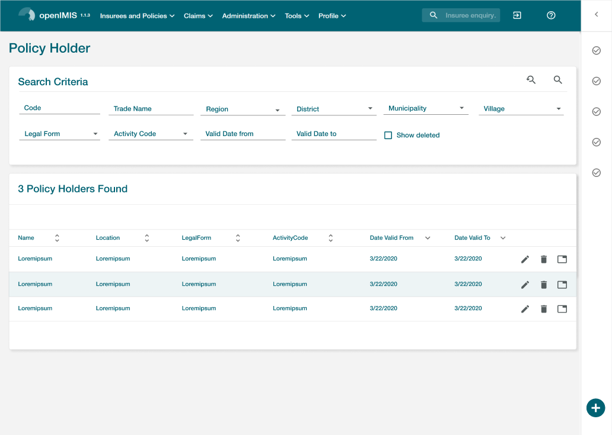
PolicyHolder Screens: Search

Slide 7
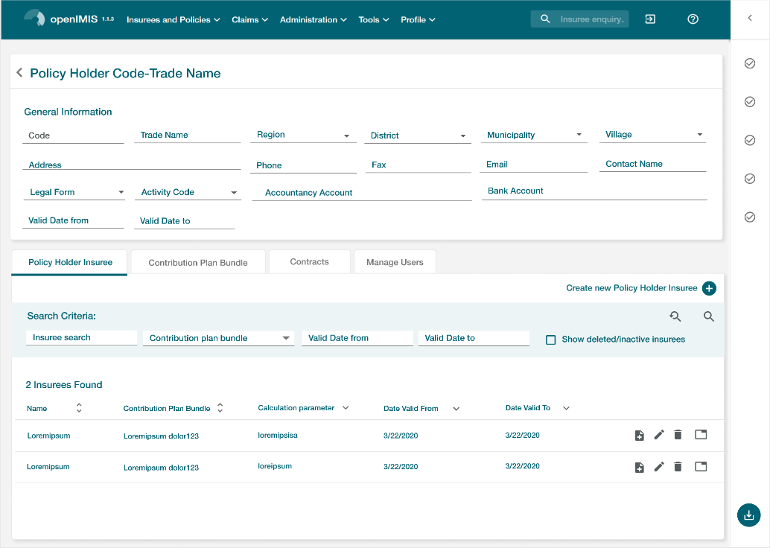
PolicyHolder Screens: Card

Slide 8
PolicyHolder Screens: Insuree

Slide 9
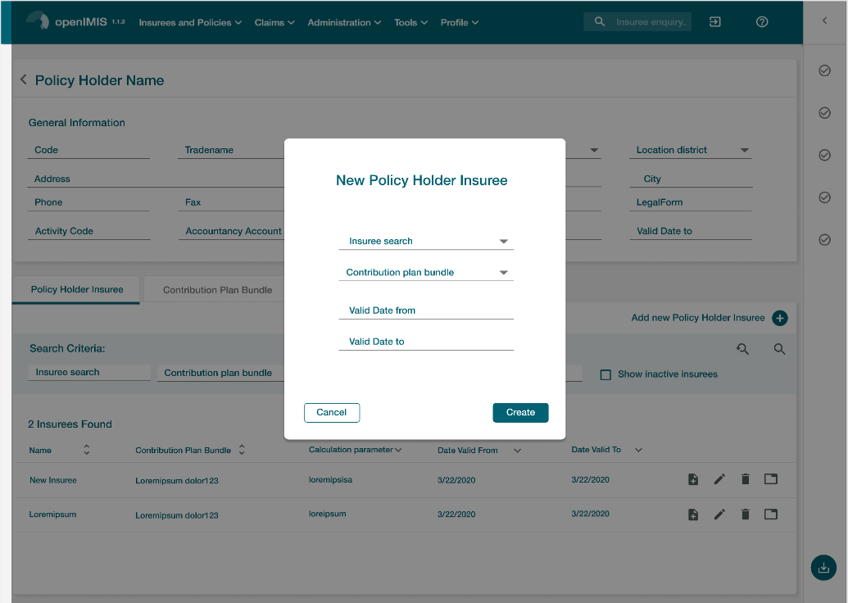
PolicyHolder Screens: add Insuree

Slide 10
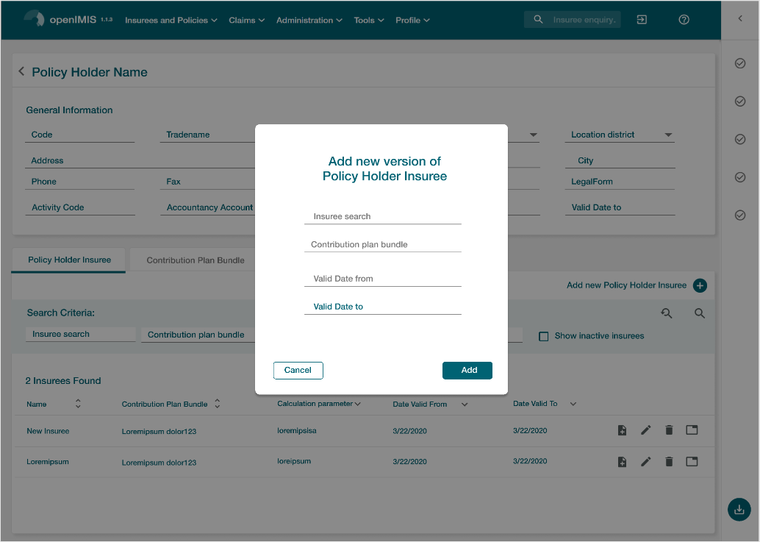
PolicyHolder Screens: Edit Insuree

Slide 11
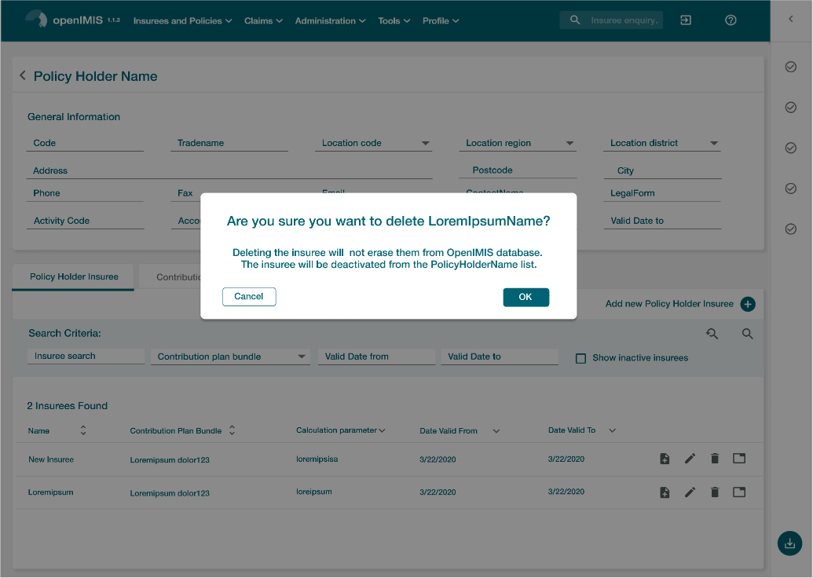
PolicyHolder Screens: Delete Insuree

Slide 12
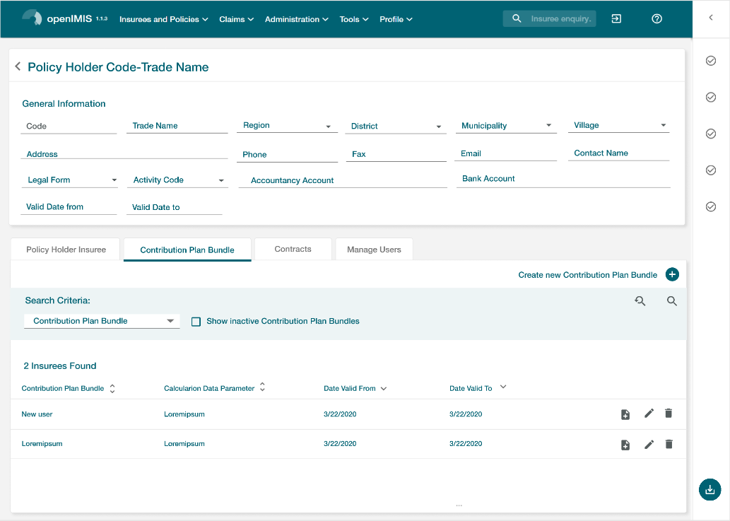
PolicyHolder Screens: Contribution Plan Bundle

Slide 13
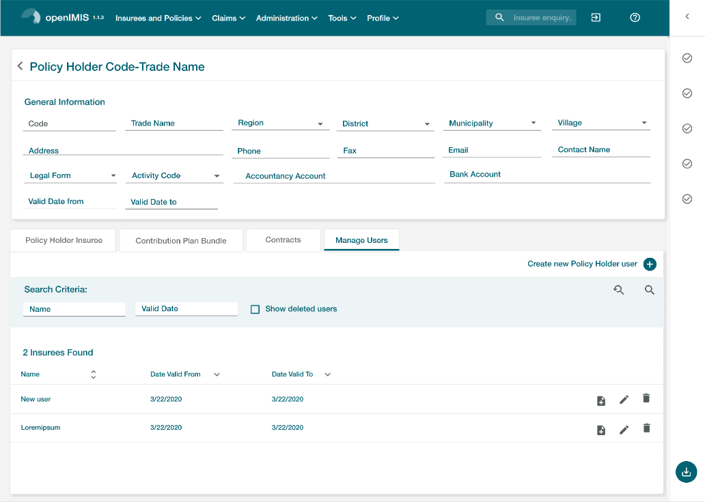
PolicyHolder Screens: User

Slide 14
Formal Sector

