Slide 1
Maintenance and Support
7 December 2020
Activity Report

Slide 2
November 2020 activities (I)
Support:
OSD-112: Legacy openIMIS Installation default username and password doesn't work - Waiting for customer
OSD-113: Bulk imports of images - Waiting for customer
OSD-115: email sending issue – Waiting for customer
OSD-118: Pilote CNSS Djibouti > Impossible de générer une demande de remboursement – Closed
OSD-120: Question about the translation system on OpenIMIS – Waiting for customer

Slide 3
November 2020 activities (II)
Maintenance/Development:
PR on Legacy Components
Bug fixes on both legacy and modular openIMIS
Jira projects configuration
Claim Attachments in Claim resource in FHIR R4 module
DHIS2 integration developments
Release:
October 2020 Release finalized
Policies Demo Mobile Application published on Google Play

Slide 4
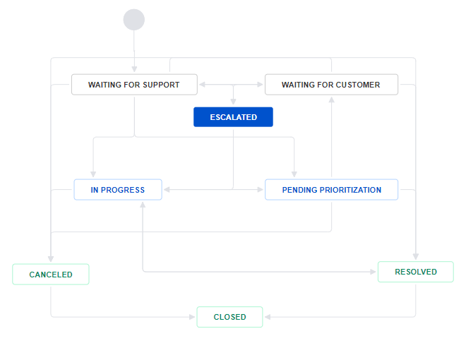
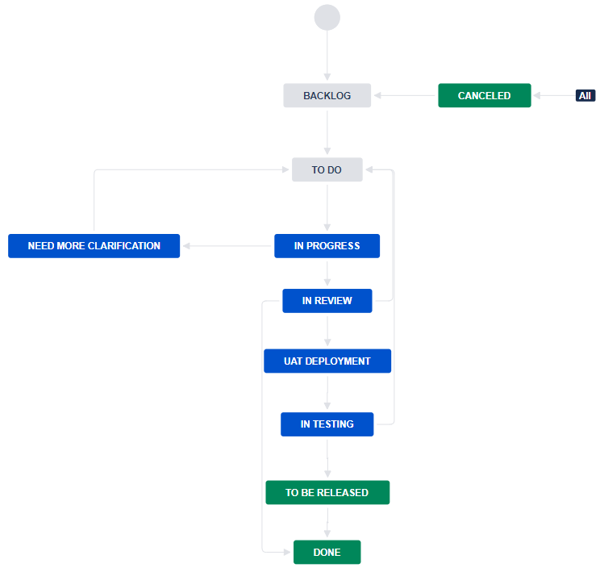
Jira Projects Configuration
Service Desk Workflow
Activated new Software Development Workflow on openIMIS Jira project
Clear states and transitions
Improve communication
Facilitates releases
Created automations:
Cloning Escalated issues to openIMIS project
Updating statuses on Service Desk issues
Applying issue description templates
openIMIS Project Workflow

Slide 5
Claim Attachments in FHIR R4 Claim resource
OP-285: Add Claim attachments through FHIR R4 module
3days
POST /api_fhir_r4/Claim/
Available on https://release.openimis.org/api/api_fhir_r4/Claim/
"supportingInfo": [
{
"category": {
"coding": [
{
"code": "attachment",
"display": "Attachment"
}
],
"text": "attachment"
},
"valueAttachment": {
"contentType": "image/png",
"creation": "2020-12-01",
"data": "iVBORw0KGgoAAAAN...",
"hash": "852D99C...",
"title": "logo.png"
}
}
]

Slide 6
Time budget available
Total days | Remaining days | Remaining percentage
240 | 224 | 93%

Slide 7
Future activities
Support:
Wiki and video preparation for openIMIS Installation and Country Localization
REST API and Mobile Application installation
Maintenance and development:
Integrate Nepal features into legacy openIMIS (PR reviewed)
Bug fixes

Slide 8
Maintenance and Support

