Slide 1
AI-based Claim Categorization
7 December 2020
Dragos Dobre, Simona Dobre, Siddharth Srivastava

Slide 2
Project timeline
Activity |  | Team | 2020 |  |  |  | 2021
 |  |  | Jun-Jul | Aug-Sep | Oct-Nov | Dec | Jan-Feb
Data gathering and preparation | AI input data model structure | Swiss TPH | X
 | FHIR claim input data for AI | Swiss TPH | X
 | Sanity check of the database | Swiss TPH |  | X
 | Process categorical data | Swiss TPH |  | X
 | Data normalization | Swiss TPH |  | X
Implementation of the AI algorithm | Al methods, model outputs and evaluation metrics | Swiss TPH |  |  | ➺ | X
 | Development of the AI model | Swiss TPH |  |  |  |  | X
openIMIS Claim-AI module development | AI module specification | Swiss TPH |  |  |  | X
 | AI module development | SolDevelo |  |  |  |  | X
 | AI module validation | Swiss TPH |  |  |  |  | X
openIMIS Claim-AI Quality Monitor module development | Module specification | Swiss TPH |  |  | ➺ | X
 | Module development | SolDevelo |  |  | ➺ |  | X
 | Module validation | Swiss TPH |  |  |  |  | X
Module User Acceptance Testing | Installation of AI-based openIMIS on Nepal server | SolDevelo |  |  |  |  | X
 | Organization of the UAT | GIZ Nepal |  |  |  |  | X
Adjudication workflow
Data gathering and preparation
Implementation of the AI algorithm
openIMIS AI module development
openIMIS AI Claim Quality Monitor module development
openIMIS AI module User Acceptance Testing

Slide 3
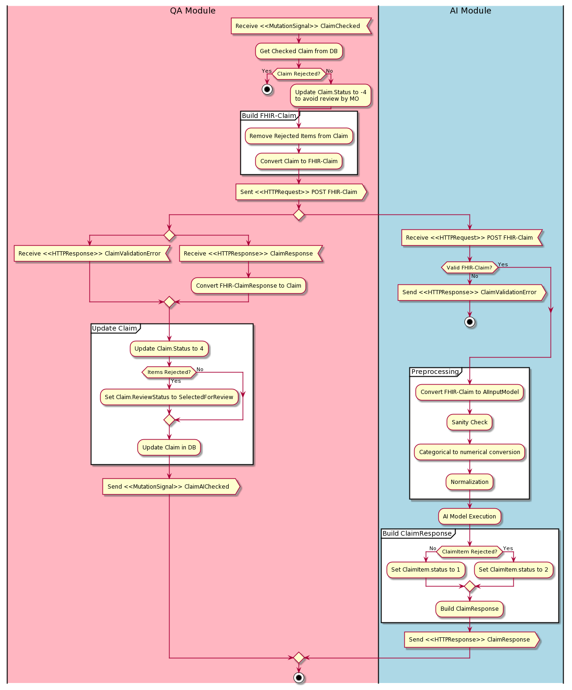
QA&AI modules
Claim-QA responsabilities:
Adds Medical Item/Service filter
Listening for “ClaimChecked” Mutation Signal
Update checked claim status (not to be selected by reviewers)
Convert to FHIR Claim and POST to Claim-AI
Receive FHIR ClaimResponse
Update Claim Status and ReviewStatus
Reports claim adjudication misclassifications
Claim-AI responsabilities:
Self containing REST API
Accepts FHIR R4 Claim and reply with FHIR R4 ClaimResponse
Clean the data and prepare it for the AI model
Categorize the claim (AI model execution)

Slide 4
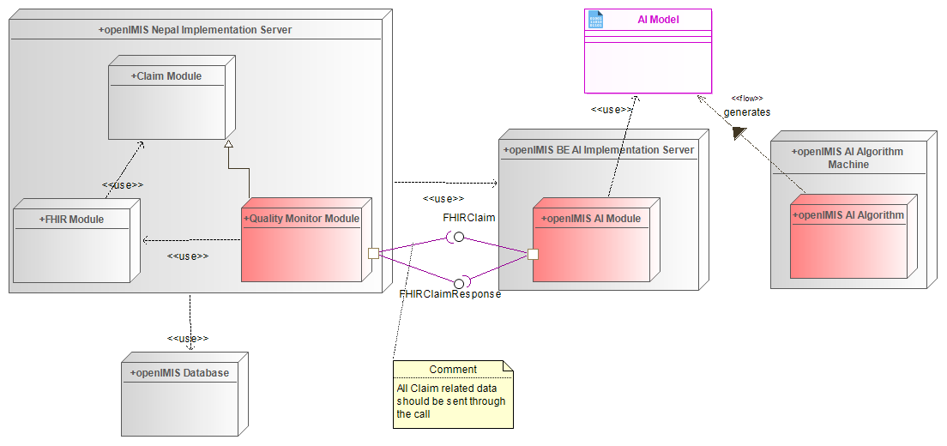
Deployment architecture

Slide 5
openIMIS AI modules development
Claim adjudication process update
openIMIS Claim-AI Quality module
Activation:
Event-based, Scheduled task, Manual?
openIMIS Claim-AI module development
Self containing module:
Retrive Claim's associated resources through FHIR Contained Resources
AI model parameters storage:
File
Scikit-learn, TensorFlow, Keras, ...
FHIR ClaimResponse
Finalizing metrics and acceptance criteria
Data analysis and visualization
Evaluation metrics and acceptance criteria
Training and evaluating ML model
openIMIS-AI module development
Quality monitor module development
Module user acceptance testing
Gathering Data
Cleaning Data

Slide 6
AI-based Claim Categorization
Dragos Dobre, Simona Dobre, Siddharth Srivastava

Slide 7
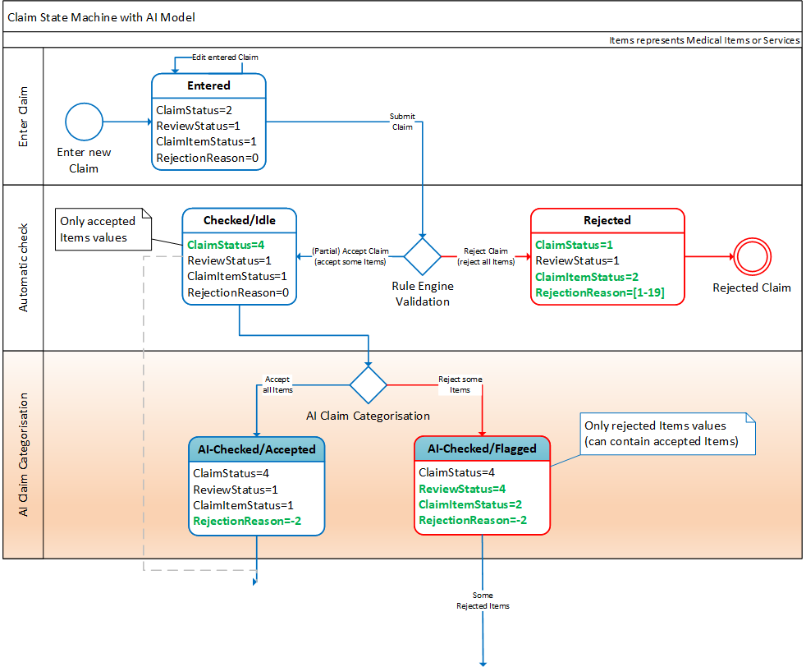
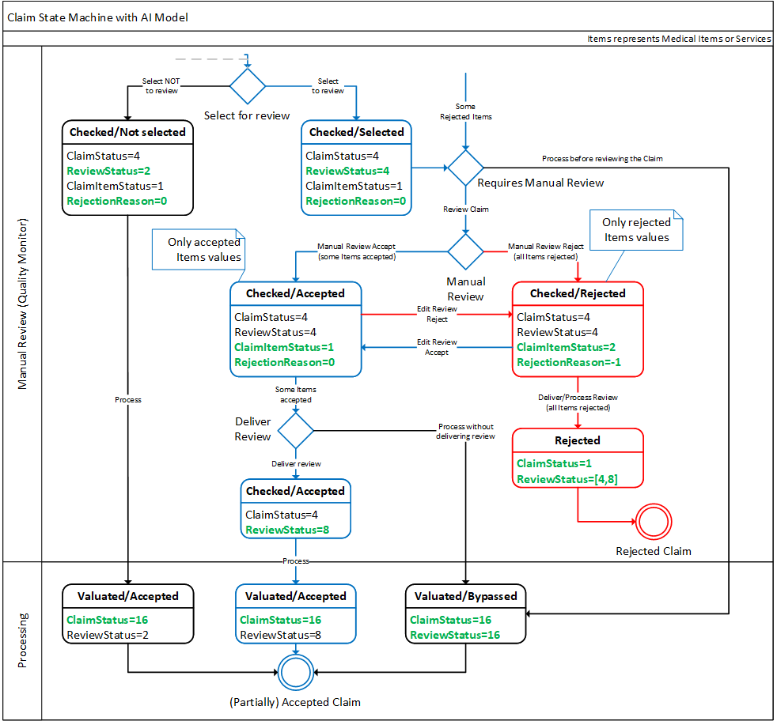
AI-based Claim Adjudication Process

