Slide 1


AI-based Claim Categorization
Updated on 02 November 2020
Dragos Dobre, Simona Dobre, Siddharth Srivastava

Slide 2
Project timeline
Activity |  | Team | June-July | Aug-Sept | Oct-Dec | Jan-Feb
Data gathering and preparation | AI input data model structure | Swiss TPH | X
 | FHIR claim input data for AI | Swiss TPH | X
 | Sanity check of the database | Swiss TPH |  | X
 | Process categorical data | Swiss TPH |  | X
 | Data normalization | Swiss TPH |  | X
Implementation of the AI algorithm | Al methods, model outputs and evaluation metrics | Swiss TPH |  | X →
 | Development of the AI model | Swiss TPH |  |  | X
openIMIS AI module development | AI module specification | Swiss TPH |  |  | X
 | AI module development | SolDevelo |  |  | X
 | AI module validation | Swiss TPH |  |  | X
openIMIS AI Claim Quality Monitor module development | Module specification | Swiss TPH |  | X →
 | Module development | SolDevelo |  | X →
 | Module validation | Swiss TPH |  |  | X
Module User Acceptance Testing | Installation of AI-based openIMIS on Nepal server | SolDevelo |  |  |  | X
 | Organization of the UAT | GIZ Nepal |  |  |  | X
Adjudication workflow
Data gathering and preparation
Implementation of the AI algorithm
openIMIS AI module development
openIMIS AI Claim Quality Monitor module development
openIMIS AI module User Acceptance Testing

Slide 3
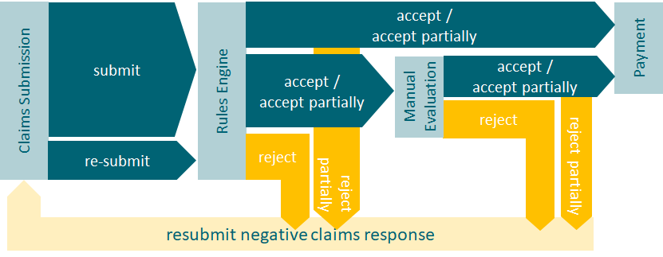
1. Adjudication workflow
Manual claim adjudication workflow

Slide 4
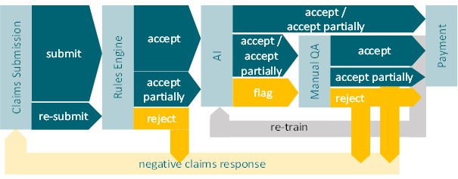
1. Adjudication workflow
Claim adjudication workflow with AI algorithm

Slide 5
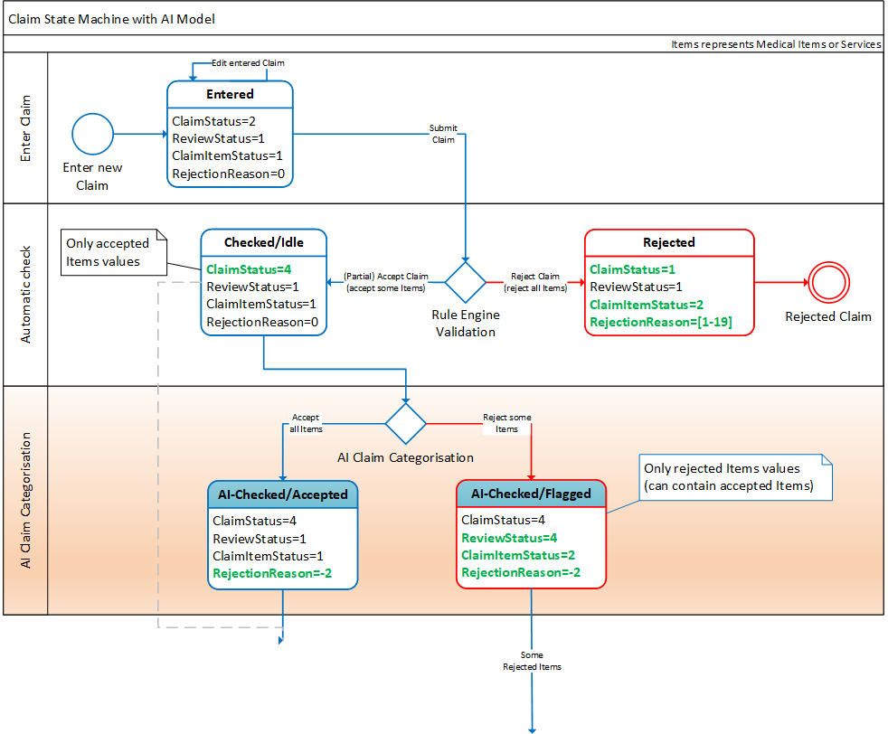
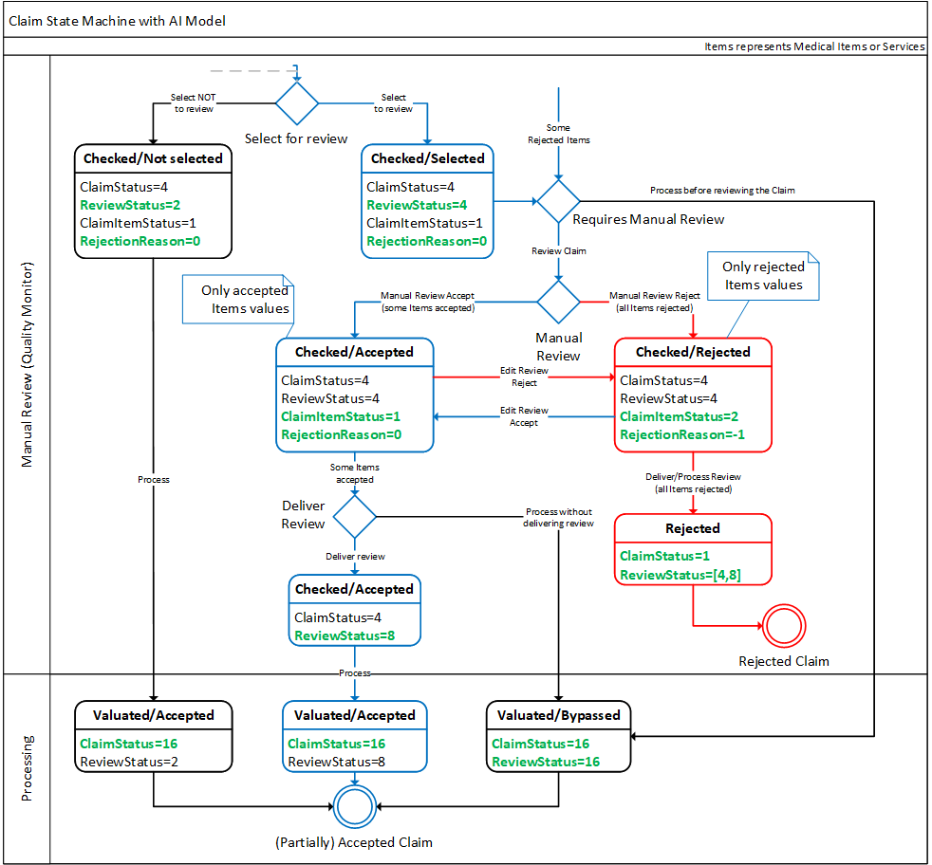
1. Adjudication workflow
Claim adjudication process update

Slide 6
2. Data gathering and preparation
Input data model: FHIR ClaimResponse
Mapping of openIMIS database to FHIR R4 data structure
Data source: openIMIS Nepal implementation
Skewed database, 0.197% of Claims are labeled as manually rejected
FHIR R4 Resource (AI algorithm input data model) | openIMIS Database Tables (mapped entities) | Entity
ClaimResponse | tblClaim tblClaim → tblClaimServices tblClaim → tblClaimItems | Claim
ClaimResponse → Condition | tblClaim → tblICDCodes | Diagnosis
ClaimResponse → HealthcareService | tblClaim → tblHF | Health Facility
ClaimResponse → Patient | tblClaim → tblInsurees tblClaim → tblInsurees → tblFamilies | Insuree
ClaimResponse → ActivityDefinition | tblClaim → tblClaimServices → tblServices | Medical Service
ClaimResponse → Medication | tblClaim → tblClaimItems→ tblItems | Medical Item
ClaimResponse → Practitioner | tblClaim → tblClaimAdmin | Claim Administrator

Slide 7
2. Data gathering and preparation
Data preparation : done
  Data visualization
  Sanity check of the database
  Selection of the data fields

Slide 8
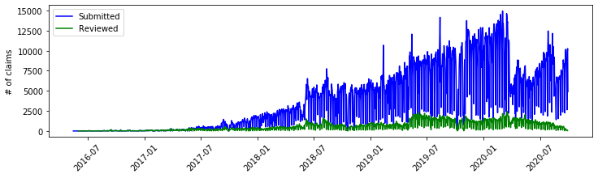
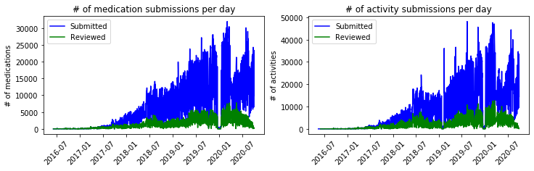
2. Data gathering and preparation
Database backup from openIMIS system in Nepal
  Extracted in 09-2020
  DateClaimed between 2016-05-16 to 2020-09-29

Slide 9
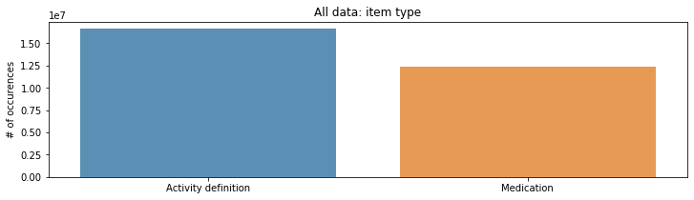
2. Data gathering and preparation
Database backup from openIMIS system in Nepal
  Extracted in 09-2020
  DateClaimed between 2016-05-16 to 2020-09-29
  General information about the data:
  5 953 640 claims:
    12 371 992 medication (medical items)
    16 655 364 activity definition (medical services)
    3 790 789 insurees
    780 health facilities
    1 959 diagnosis items

Slide 10
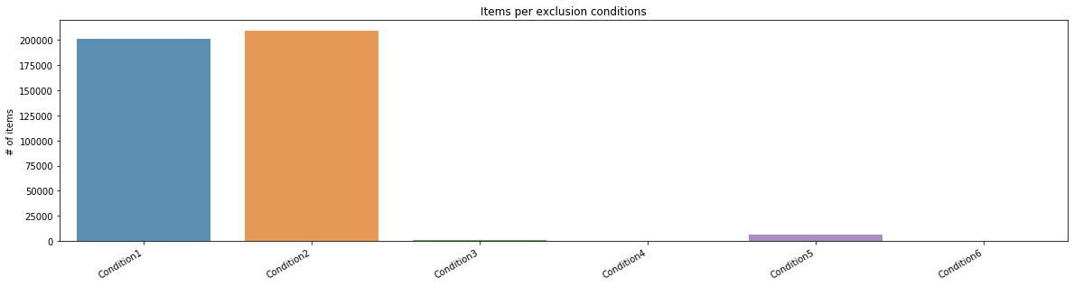
2. Data gathering and preparation
Exclusion conditions :
  Condition 1: ClaimStatus == ‘Entered’: 209 402 items (40 393 claims)
  Condition 2: Items rejected by the Rule Engine: 209 210 items (78 289 claims)
  Condition 3: Missing values in the ClaimAdminId, PolicyID,ProdID, VisitType: 1 451 items (578 claims)
  Condition 4: Inconsistency wrt status values: 145 items (74 claims)
  Condition 5: Inconsistency in terms of status and valuated price: 33 items (24 claims)
  Condition 6: Inconsistency in terms of dates (DateFrom, DateTo, DateClaimed): 6199 items (1 340 claims)

Slide 11
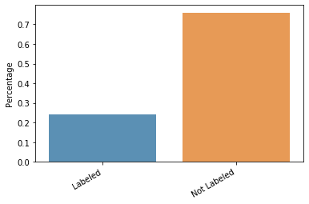
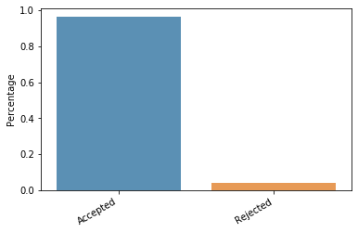
2. Data gathering and preparation
Clean dataset:
  28 553 825 items (418 440 items excluded)
  21 702 401 items (76.01%) is not labeled
  (not reviewed by a Medical Officer)
  6 851 424 items (23.99%) is labeled data
  (reviewed by a Medical Officer)
    6 592 349 items (96.22%) are accepted
    259 075 items (3.78%) are rejected

Slide 12
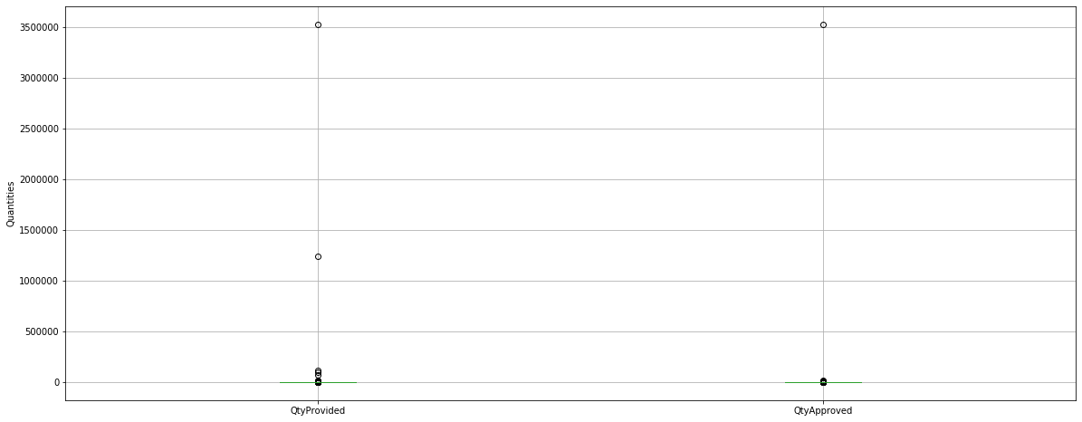
2. Data gathering and preparation
Filling missing values:
  missing values in QtyApproved
    if item is rejected
    QtyApproved = 0
    if item is accepted
    QtyApproved = QtyAsked
  missing values in PriceApproved:
    if item is rejected
    PriceApproved = 0
    if item is accepted
    QtyApproved = PriceAsked
  missing values in ICDID1:
    copy values from ICDID

Slide 13
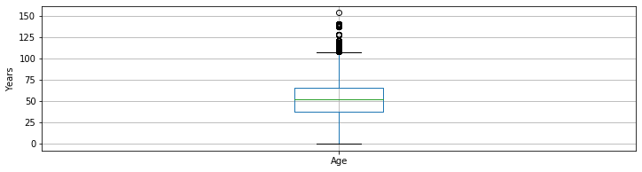
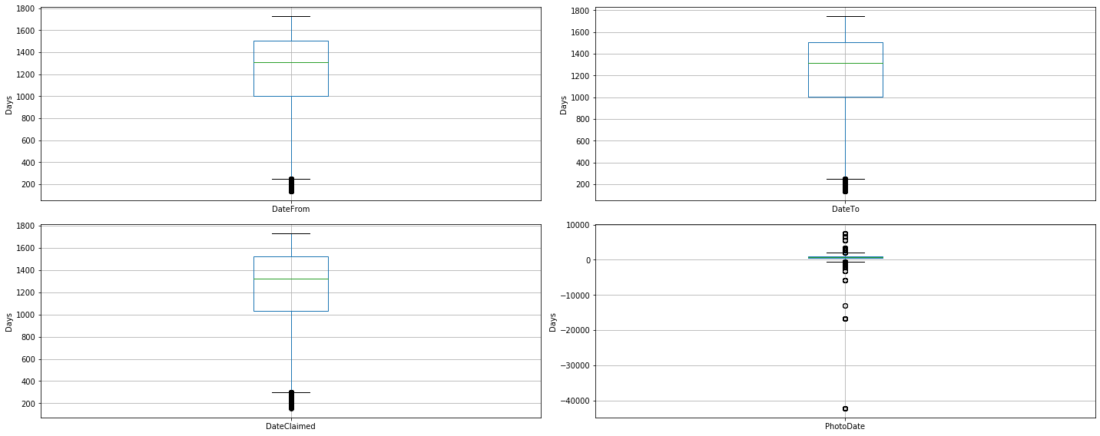
2. Data gathering and preparation
Converting dates to numeric:
  'DOB' was replace by 'Age:
  Diff_seconds = (DateFrom – DOB) converted in seconds
  Age = Diff_seconds/(60*60*24*365.25)
  Other fields like DateFrom, DateTo, DateClaimed, DateProcessed, PhotoDate were converted to:
  number of days from 01-01-2016
Converting text to numeric:
  using LabelEncoding in python

Slide 14
2. Data gathering and preparation
Normalization methods
  Minimum and maximum normalization (Min-Max): each column x is trasformed as follows
  (x-min(x))/(max(x)-min(x))
  where min(x) and max(x) are respectively the minimum and maximum values of the x.
  Mean and standard deviation normalization (Mean-SD): each column x is transformed as follows
  (x-min(x))/sd(x)
  where mean(x) and sd(x) represent respectively te mean and the standard deviation of the values in x
  Median and the IQR normalization (Median-IQR): each column x is transformed as follows
  (x-median(x))/IQR(x)
  where median(x) and IQR(x) represents the median and the IQR (InterQuantile Range) of the values in x
  Median and median absolute deviation normalization : each column x is transformed as follows
  (x - median(x))/MAD(x)
  where MAD(x) = median(|x - median(x)|) is tha median absolute deviation

Slide 15
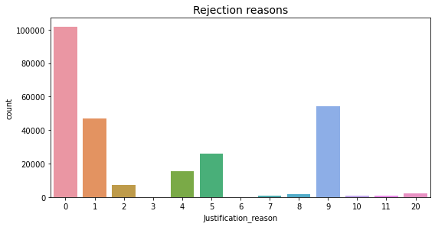
Rejection reasons
Rejection reasons:
0: no justification
1: missing docs
2: according to doc
3: dosage related issues
4: time related issue
5: multiple submissions
6: free item
7: large quantities
8: incoherent ICD/item
9: included in package
10: lack of coherence/inactive
11: missing values
20: other reasons

Slide 16
2. Data gathering and preparation
Data preparation: currently ongoing
  Data visualization
  Sanity check of the database
  Selection of the data fields
  Definition of the model output and evaluation metrics

Slide 17
2. Al methods, model outputs and evaluation metrics
Four scenarios may occur:
  True Positive (TP): model predicts 1 & actual class is 1
  True Negative (TN): model predicts 0 & actual class is 0
  False Positive (FP): model predicts 1, but actual class is 0
  False Negative (FN): model predicts 0, but actual is 1
Evaluation metrics:
  Precision: P = TP/(TP+FP)
  Recall: R = TP/(TP+FN)
  F score: F = 2*(P*R)/(P+R)
  Specificity: SPC=TN/(TN+FP)

Slide 18
3. Implementation of the AI algorithm
Algorithm selection
Building the AI model
Analyzing the obtained results
K-nearest neighbor
Multivariate Gaussian
Local Outlier Factor
K-means
Isolation Forest
Robust covariance
Autoencoders

Slide 19
3. Implementation of the AI algorithm
Algorithm selection
Building the AI model
Analyzing the obtained results
K-nearest neighbor
Multivariate Gaussian
Local Outlier Factor
K-means
Isolation Forest
Robust covariance
Autoencoders

Slide 20
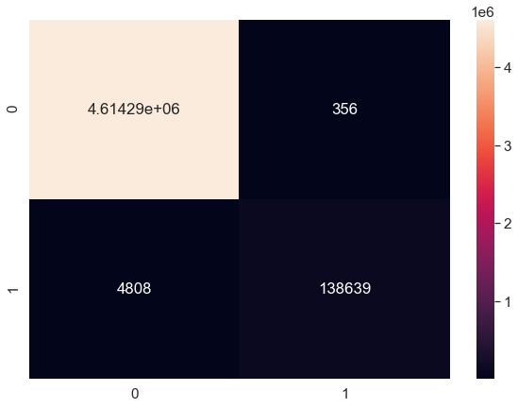
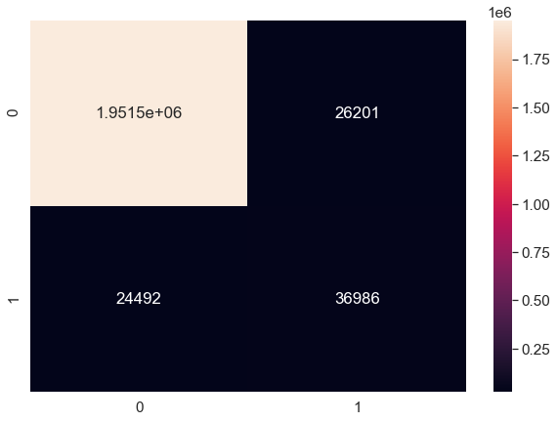
3. Implementation of the AI algorithm
Confusion matrix: train set
Algorithm selection
Building the AI model
Analyzing the obtained results
Scenarios :
  True Positive (TP): model predicts 1 & actual class is 1
  True Negative (TN): model predicts 0 & actual class is 0
  False Positive (FP): model predicts 1, but actual class is 0
  False Negative (FN): model predicts 0, but actual is 1
Confusion matrix: test set
Evaluation metrics:
  Precision: P = TP/(TP+FP)
  Recall: R = TP/(TP+FN)
  F score: F = 2*(P*R)/(P+R)
  Specificity: SPC=TN/(TN+FP)

Slide 21
4. openIMIS AI module development
Claim adjudication process update
openIMIS AI module development
  Activation: Event-based, Scheduled task, Manual?
  Self containing module: how to retrive Claim's associated resources?
  AI model parameters storage: DB, file?
  Integrated with openIMIS FHIR module

Slide 22
5. openIMIS AI Claim Quality Monitor module
Additional Claim filtering mechanism
  Specific Item or Services included in the Claim
  Age group
Allows to check manually the results of AI-based categorization
  Detect False Positive and False Negative results
  Manually fix the categorization output
AI model retraining based on updated Claims
  Schedule task that checks procentage of False Positive and False Negative results
  If above threshold then automatically retrain the model

Slide 23
6. openIMIS AI module User Acceptance Testing
Installation of AI module in Nepal implementation
Participation of Medical Officers
Feed the instance with Claims and check the results

Slide 24
AI-based Claim Categorization
Dragos Dobre, Simona Dobre, Siddharth Srivastava

Slide 26
Rejection reason: multiple submissions
Examples of rejection reasons found in the 'Adjustment' field
- services entered twice
- services entered multiple times
- items entered twice
- items entered multiple times
- services and items entered multiple times
- duplication in claimed services
--> Reject all duplicated medicine/services submitted or the entire claim?
Can we

Slide 27
Rejection reason: hospitalization related
Examples of rejection reasons found in the 'Adjustment' field
- routine diagnostics IV fluids and surgical items covered in hospitalization cost
- please don't claim the routine tests and medicines used during hospitalisation. They are included in the package
- all investigations and items used during the hospital stay are included in package
- all pre-OP investigations are included in surgical package
- IPD pkg covers all cost during hospitalization
--> reject all medicines/services already included in the package

Slide 28
Rejection reason: general screening limitations
Examples of rejection reasons found in the 'Adjustment' field
- Plz claim for general screening in pkg code GS01 (2000/pkg for general screening of patients without complaints allowed once a year for one member)
- Amount adjusted for general screening allowed in pkg code GS01 (2000/pkg for a general screening of patients without complaints allowed once a year for one member)
- for health screening please provide only up to Rs 2000 services
--> reject multiple submission of claim related to general screening for a member in a year and limit the valuated amount to 2000/pkg?

Slide 29
Rejection reason: incompatibilities between diagnosis and item/services
Examples of rejection reasons found in the 'Adjustment' field
- icd and tests/medicines incompatible, reclaim with supporting documents
- icd and service type incompatible
- icd and package claimed incompatible
- icd and tests/medicines incompatible
--> medicines and/or services rejected

Slide 30
Rejection reason: effective from date
Examples of rejection reasons found in the 'Adjustment' field
- medicine effective only from Aug 17
- some claimed medicines were effective only from Aug 17, the claimed date was 11 Aug
- claimed medicines were effective only from 17 Aug 2017
- entered service type is effective only from feb 12 2017
--> medicines/services rejected

Slide 31
Rejection reason: large quantities
Examples of rejection reasons found in the 'Adjustment' field
- too large injections prescribed for opd patients
- too large doses of injections claimed for opd patient
- injections prescribed in large quantities
- too large injections prescribed for emergency patients
--> medicines rejected

Slide 32
Rejection reasons: summary
Several reasons can be found in the dataset:
  14048 Items/Services with rejection justification, from 26983 rejected items/services
Reasons:
  Multiple submission: 3161 items and services (related to 501 claims)
  Hospitalization related: 4810 items and services (related to 749 claims)
  Related to general screening limitations: 1310 items and services (related to 110 claims)
  Diagnosis incompatible with medicine or services: 967 items and services (related to 138 claims)
  Large quantities prescribed: 841 item or services (related to 85 claims)
  Services/Items valid only from date: 173 items and services

Slide 33
Resubmitted claims
ClaimCode for resubmitted claims contains different characters
  re%, %re, spaces, a, b, c, ., :, etc.
Found resubmitted claims without initial claim
Resubmitted three time: 'a', 'b', 'c'
Missing standardisation
Taken all claims as new claims

