Slide 1
Maintenance and Support
2 November 2020
Activity Report

Slide 2
October 2020 activities (I)
Support:
OSD-104: French version of demo – Resolved
OSD-111: Standardized claims justification during review – Pending prioritization
OSD-112: Legacy openIMIS Installation default username and password doesn't work - Waiting for customer
OSD-113: Bulk imports of images - Waiting for customer
OSD-114: [JIRA] 📩 support@openimis.atlassian.net is ready - Closed
OSD-115: email sending issue – Waiting for customer
OSD-116: Spanish translation - Closed

Slide 3
October 2020 activities (II)
Support:
Support call with Acadys for Djibouti implementation
Maintenance/Development:
PR on Legacy Components
Bug fixes
Software Development Workflow
Improvement of FHIR R4 module
Release:
DHIS2 integration test
Database release
User documentation update

Slide 4
October 2020 Release
New features:
Claim History report
New Ready state of policies (linked to ePayment)
Claim restore/resubmit
Bugs and improvements:
See October 2020: Legacy version features and fixes epic
Database maintainability improved

Slide 5
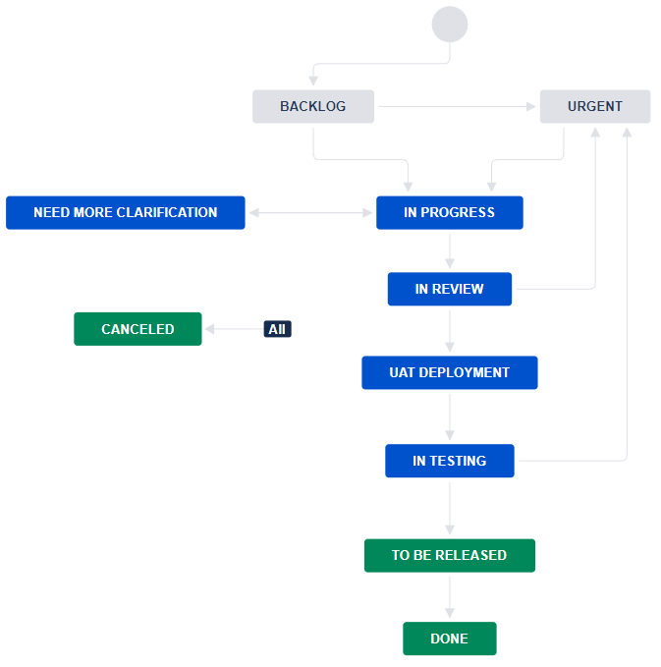
Software Development Workflow
Clear states and transitions
Improve communication
Facilitates releases

Slide 6
Time budget available
Total days | Remaining days | Remaining percentage
240 | 240 | 100%

Slide 7
Future activities
Support:
Wiki and video preparation for openIMIS Installation and Country Localization
Mobile Application installation
Web Application Template customization (email and reports)
Maintenance and development:
Integrate Nepal features into legacy openIMIS (PR reviewed)
Bug fixes
Release management:
October release
Finalize User Documentation
Release Web Application

Slide 8
Maintenance and Support

