Slide 1
Social Security Fund (SSF): Overview
Formed under Ministry of Labour, Employment and Social Security (MOLESS)
Contribution based Social Security Scheme for formal sector
Schemes
Medical, health and maternity benefit
Accidental and disability benefits
Benefits for dependent family members
Old-age benefits
Contribution 31% (20% from Employer + 11% from Employee)

Slide 2
Functional Overview: Insurance System
Scheme Management
Employer Registration
Contributor Registration
Contribution Registration
Claim Management
Investment Management
Office Automation System
Account
payroll
Inventory
Fixed Assets
Social Security Program
Internal Business Processes

Slide 3
SOSYS Registration Process
Note for Employer Portal
Step 7: By using employer username, password and SSID you can login to employer portal
Step 8: if Employer username and password is same you must have to change password
Step 9: By Using Employer portal you can register the contributor.
Step 10: SSF verify this record after verification you will get every contributor username, password and SSID
Step 11: After contributor verification login to employer portal with employee username, password and SSID then fill the collections.
Show Mandatory Fields
Note for Employer Registration
Step1:Move Cursor on Employer Registration then Click on New Registration for Employer Registration.
Step 2: You need submission no to register employer to get submission no enter the required information.
Step 3: Then Click on Submit and OK.
Step 4: Fill all information related to Employer.
Step 5: If you want to Change filled record click on save button. Save this, when you require to change log in with employer registration Login form change record, after finalising you have to click on submit button. After Submit, you cannot change filled record.
Step 6: SSF verify this record. After Verification, employer will get username, Password and SSID on alert Source.
Note for Contributor Portal
Step 12: By using contributor username, password and SSID you can login to contributor portal.
Step 13: If contributor username and password is same you must have to change password

Slide 4
Current Systems Context overview
Employer
SOSYS
SYSTEM
MOLESS
Third Party
Contributor

Slide 5
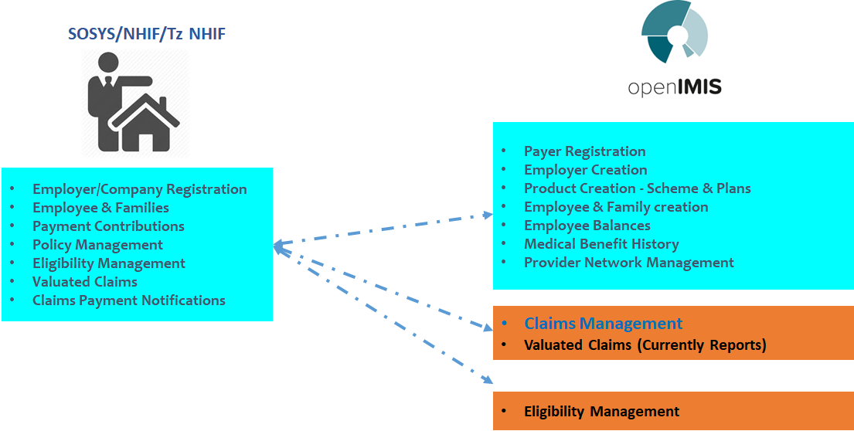
SOSYS and OpenIMIS Task Management
healthix single/batch registration API

Slide 6
SOSY-OpenIMIS Registration API Mapping
API Parameters | Remarks | openIMIS Mapping
SSF Number | Unique | CHFID
First Name | Optional | OtherNames
Last Name | Required | LastName
DOB | Required | DOB
Gender | M/F/O | Gender
ID Number | Government ID Number | passport
ID Type | ID Type | TypeOfId
Location | Ward ID | LocationID
Enroll date | SSF Enroll date | EnrollDate
Policy start Date | Insurance Start Date | StartDate
Policy Expiry Date | Insurance Expiry Date | ExpiryDate
Policy Stage | New/Renew | PolicyStage
Table Affected
tblInsuree
tblFamily
tblPolicy
tblContribution

Slide 7
Registration Schema: Mandatory Fields
Contributor Entity
Employer Entity
SSID No.
Employee Name
Address/es
DOB
Gender
Nationality
Phone
Email
Blood Group
Employment Type (Permanent/Contract/Wages)
Position
Employment Start Date
Documents(Passport/PAN/Citizenship)
Relationships + Nominee Details
Employer Name
Business Type
Business Category
Documents (VAT/PAN/Company Registration)
Address/es
Details of Chairperson
Details of CEO

Slide 8
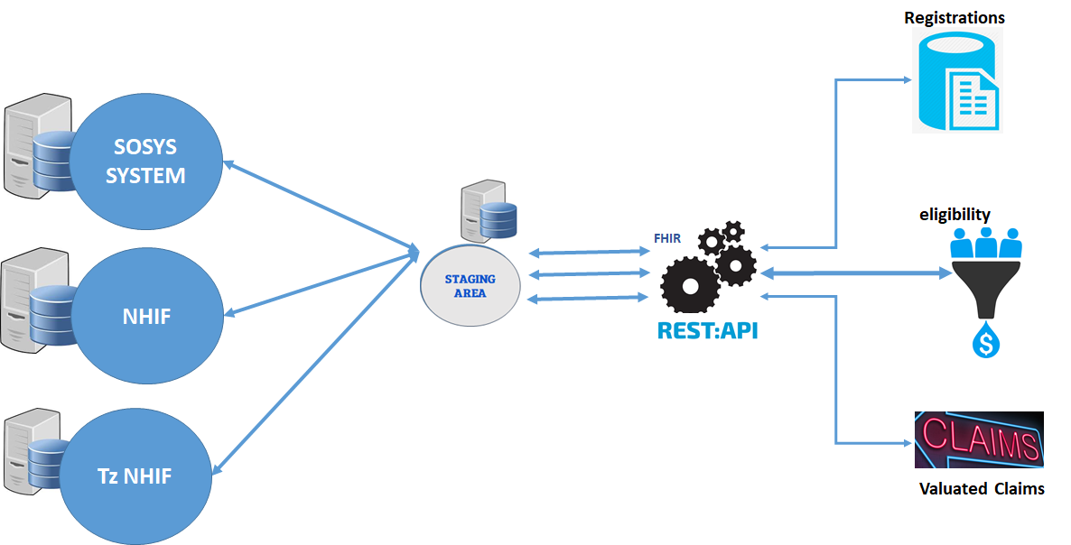
Standard Architecture
HEALTHIX SINGLE/BATCH REGISTRATION APIs

Slide 9
Standard Interface - FHIRBox Broker
The standard interface (FIREBox) is a Broker (interswitch) that uses FHIR-REST to integrate growing number of data sources, systems, devices, facilities and organizations
The purpose of the FIREBox Staging Area is to resolve semantic and syntactic differences from received code systems (SNOMED, LOINC) and metadata before transforming the resource into FHIR

Slide 10
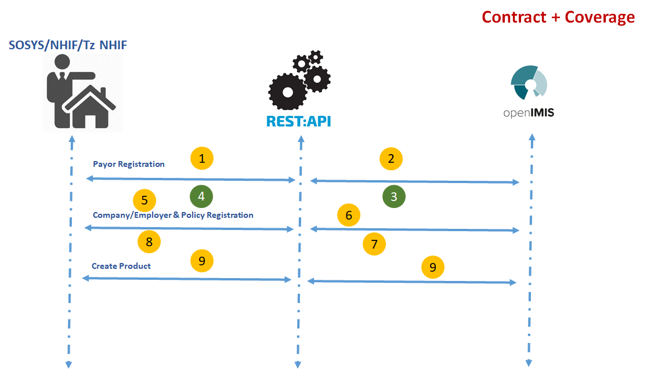
HEALTHIX SINGLE/BATCH REGISTRATION APIs

Slide 11
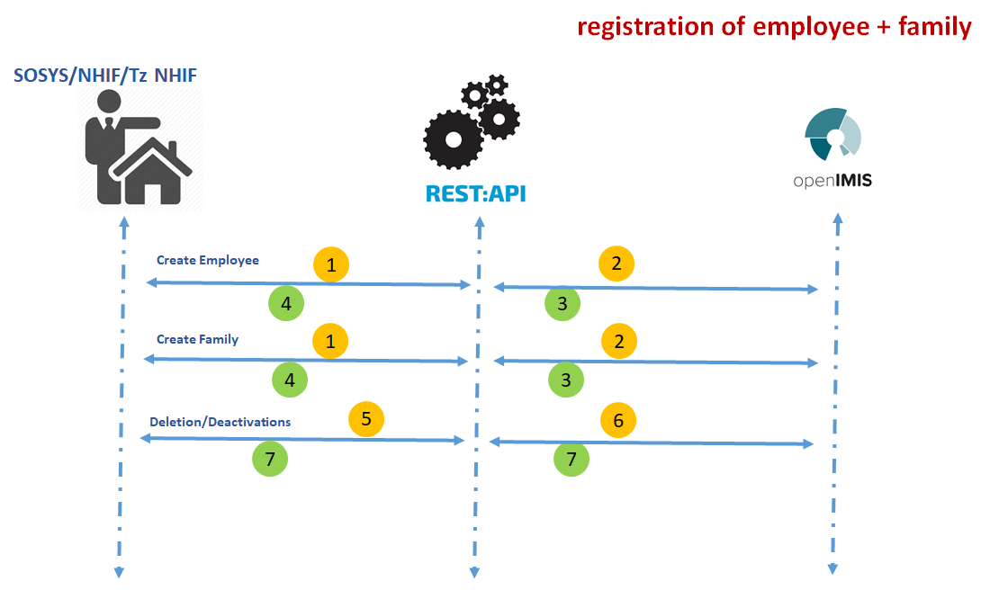
HEALTHIX SINGLE/BATCH REGISTRATION APIs

Slide 12
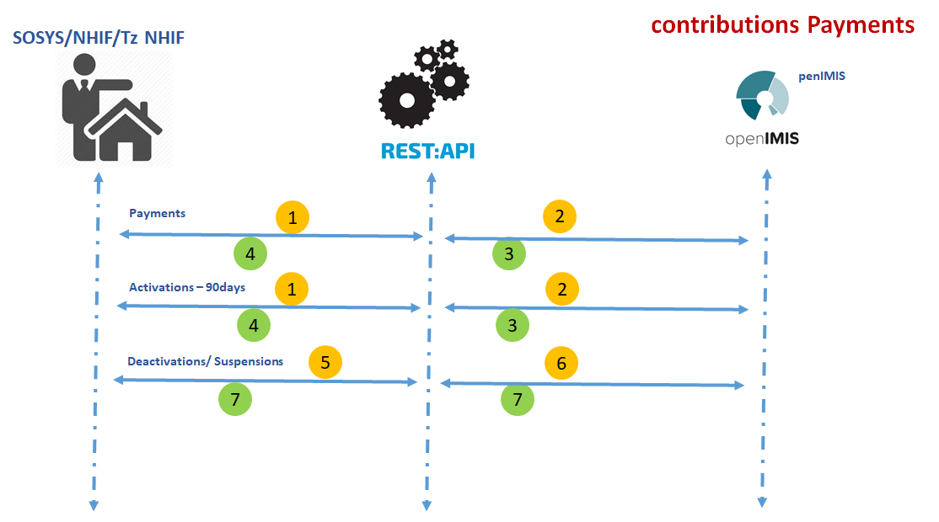
HEALTHIX SINGLE/BATCH REGISTRATION APIs

Slide 13
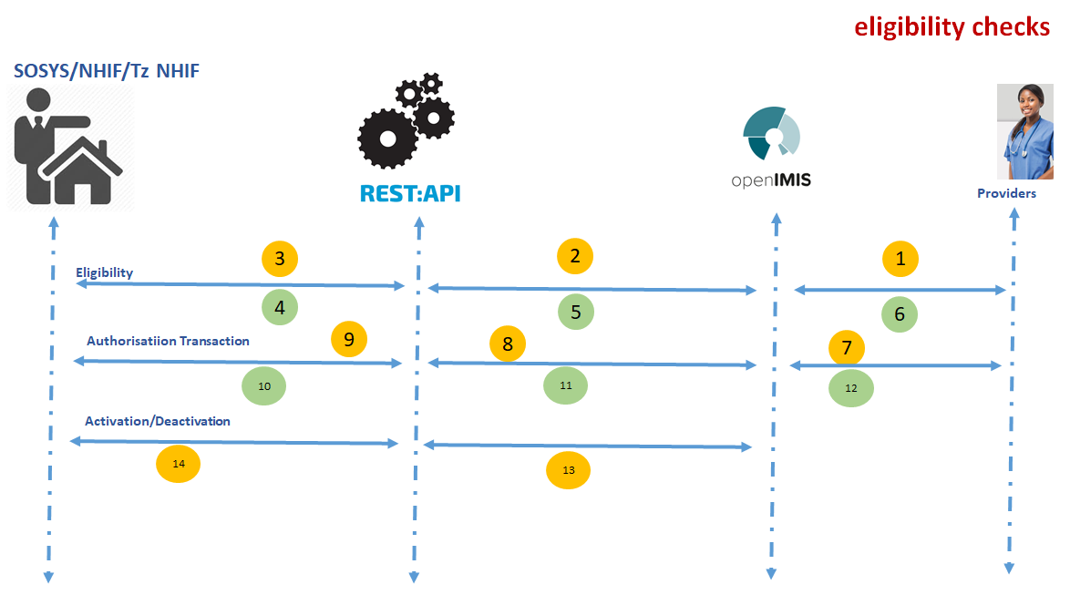
HEALTHIX SINGLE/BATCH REGISTRATION APIs

Slide 14
FHIR Resources Dependencies
To implement standard interface for enrolment, eligibilityrequest and valuated claims, FHIR resources required include:
FHIR RESOURCE | IMPLEMENTATION DETAILS
Patient
Claim
Coverage
Contract
InsurancePlan
Payment

Slide 15
Thank You
Questions?
healthix single/batch registration API

