Slide 1
openIMIS FOR ZANZIBAR MINISTRY OF HEALTH

Slide 2
BACKGROUND
The Zanzibar government has consistently shown a strong political commitment to provide quality health care for all citizen with the goal of achieving UHC. Currently, healthcare in Zanzibar’s is 100% subsidized by government (and donors), with clients accessing for free at public healthcare facilities. Public healthcare facilities provide care for more than 90% of all healthcare users in Zanzibar. Due to limited resources, the island struggles with poor clinical indicators due to inadequate funding and inefficient resource allocation.
The Zanzibari government has requested PharmAccess International to support them to in efforts to obtain timely and reliable service utilization data that will form key input in the process of reviewing the health financing system to a more sustainable model that still enables citizens to access quality services.

Slide 3
Use of OpenIMIS
Registering members
Collect utilization data on the health facilities
Data will be analyzed to uncover inefficiencies and facilitate informed decision making for the new government Health Financing Strategy, as well as provide digital infrastructure for the envisioned health insurance scheme.

Slide 4
Changes made on openIMIS
ENROLMENT APP
Policy automation
Survey questions
Photo taking during enrolment
CLAIM APP
Claim code automation
Insurance question
Explanation in items

Slide 5
MOH ENROLMENT & CLAIMING SYSTEM

Slide 6
Enrolment system
Family information
Region
District
Ward
Street/Village
Survey questions

Slide 7
Enrolment system Cont..
Personal information
ID Number
Names(First, Middle and Last Name)
Picture
DOB
Gender
Marital status
Phone number
Identification Type
Identification Number
Relationship

Slide 8
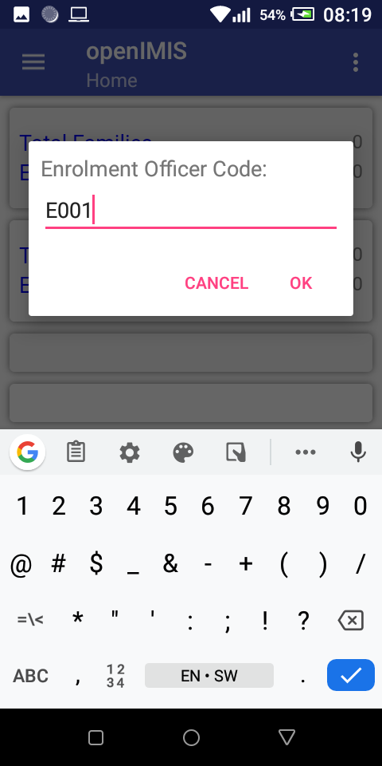
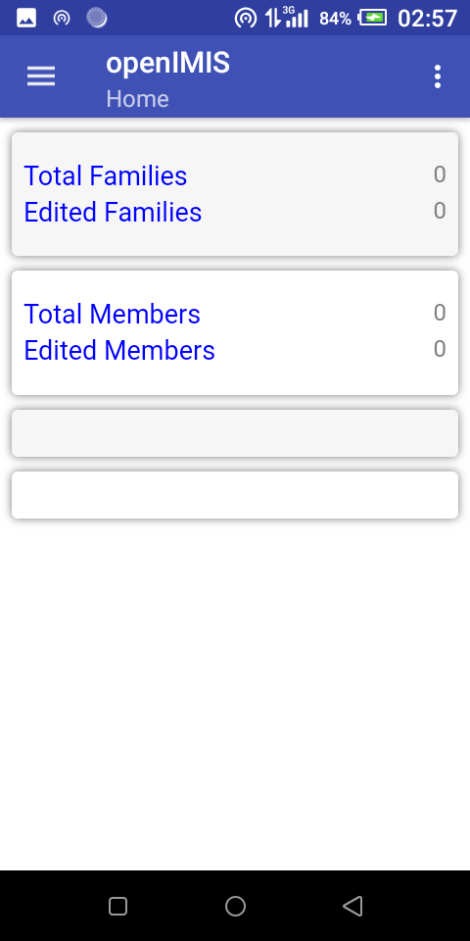
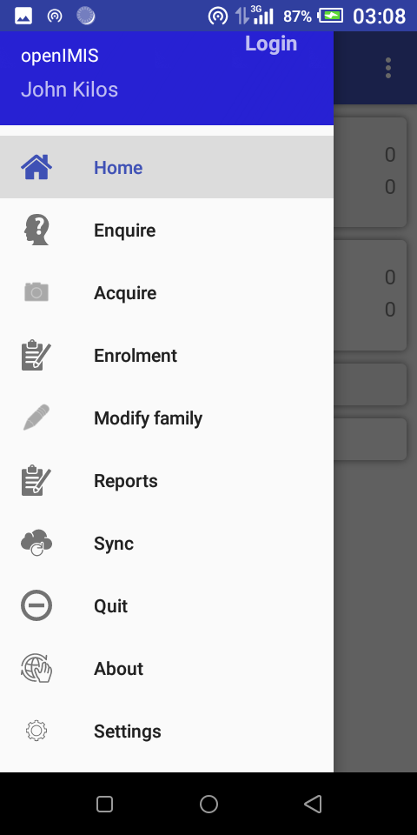

Slide 9
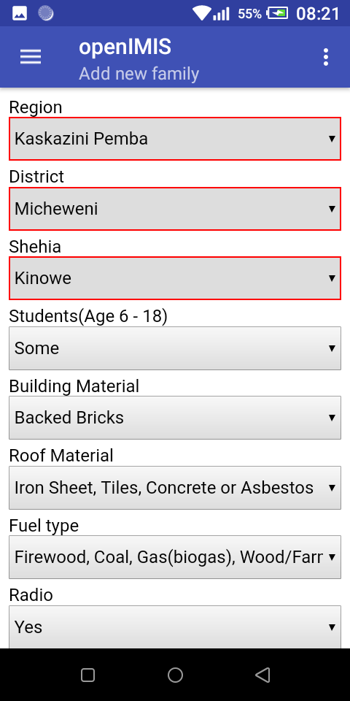
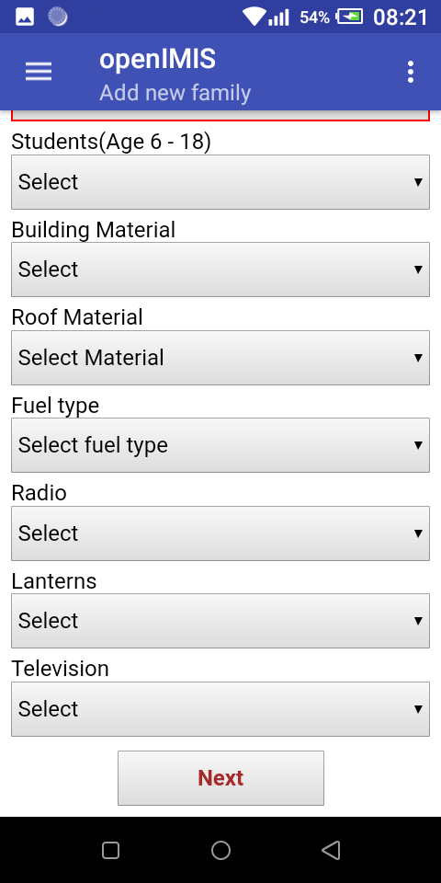
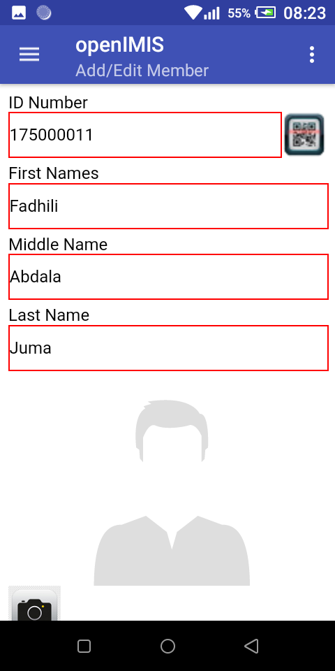

Slide 10
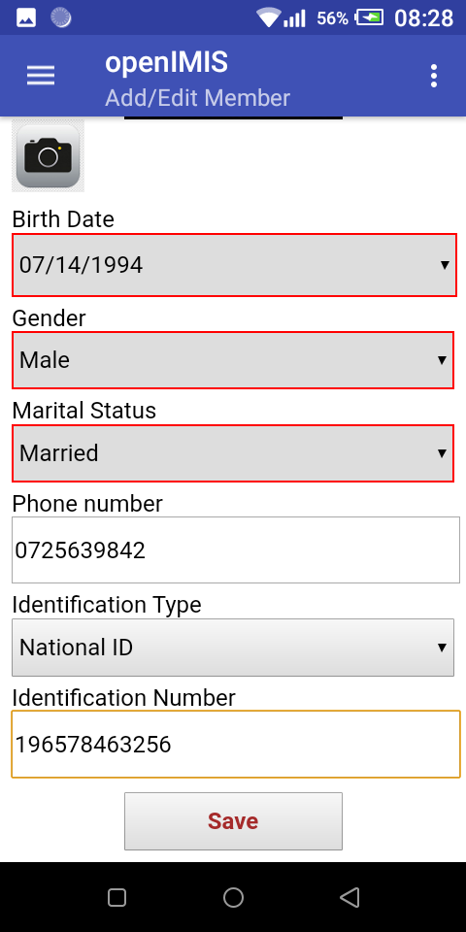
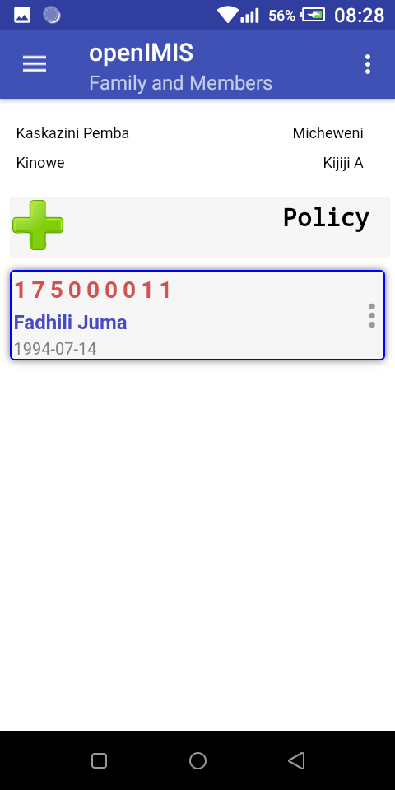
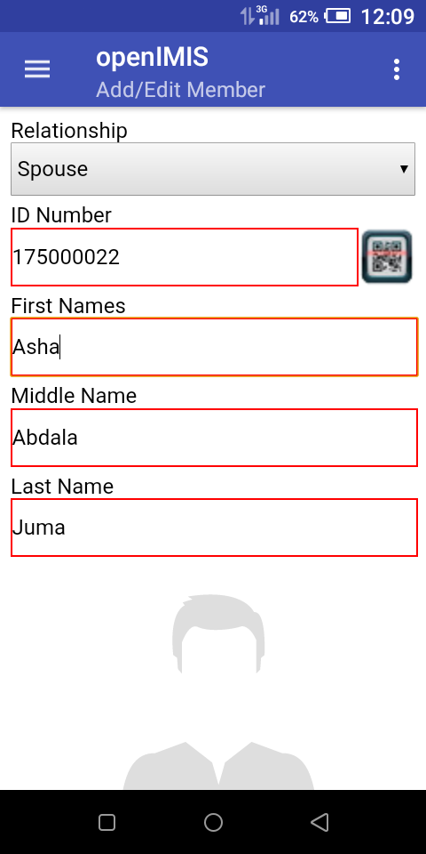

Slide 11
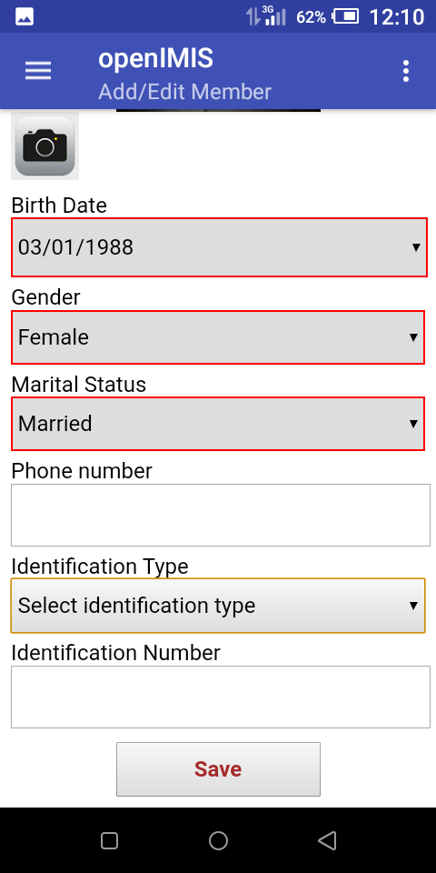
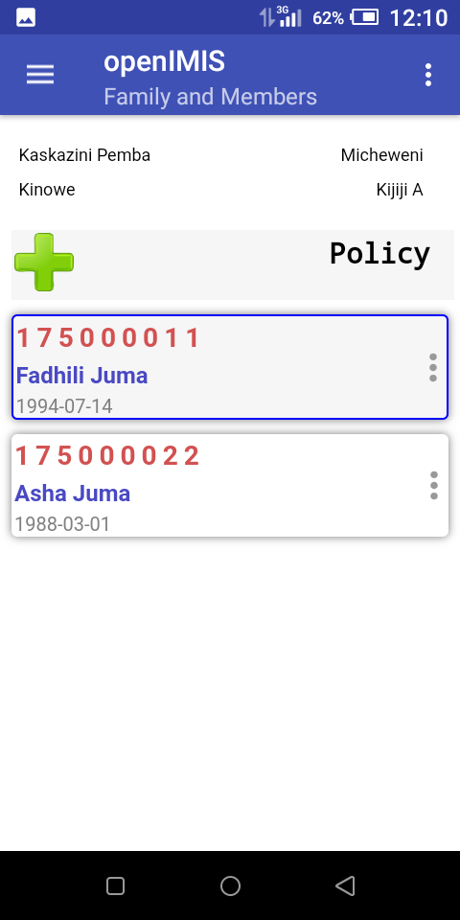
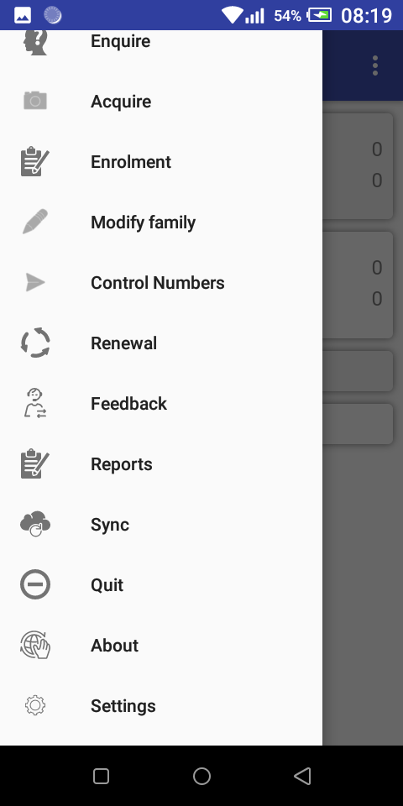

Slide 12
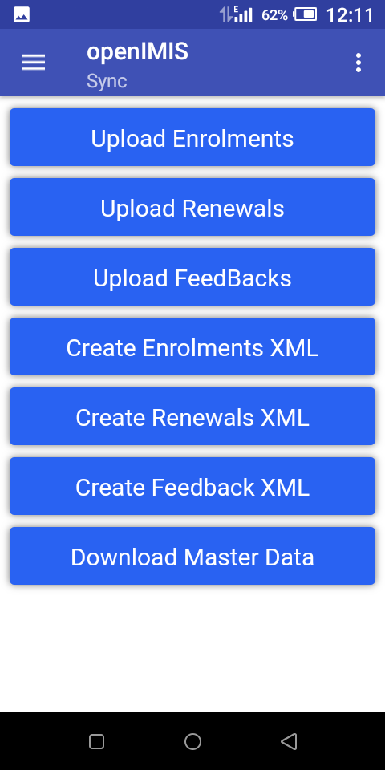
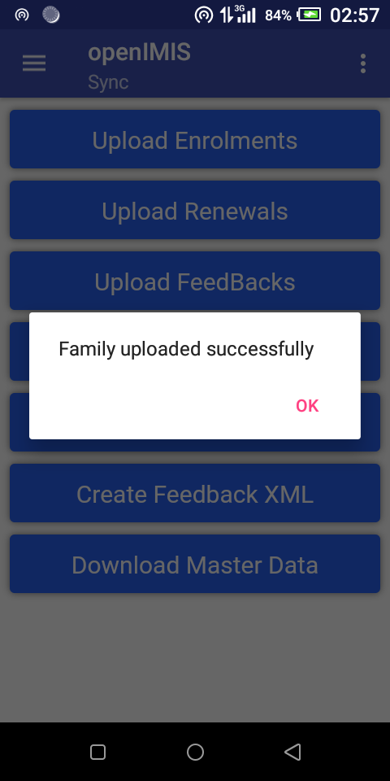

Slide 13
CLAIMING SYSTEM
Health facility code
Claim admin
Claim code
Insurance check
ID number
Date
Diagnosis
Visit type
Services (Code, Quantity and Price)
Items (Code, Quantity, Price and Description)

Slide 14
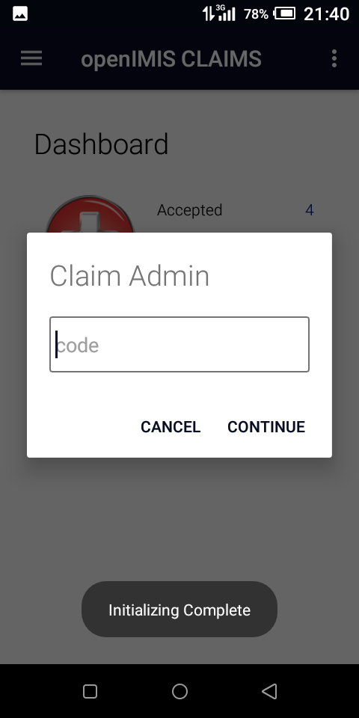
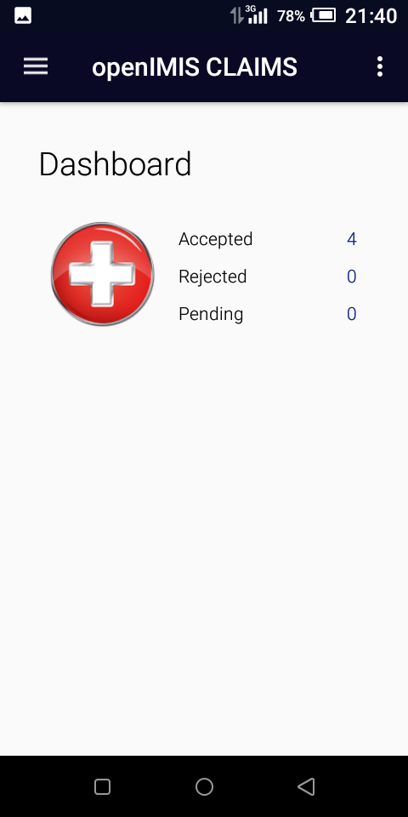
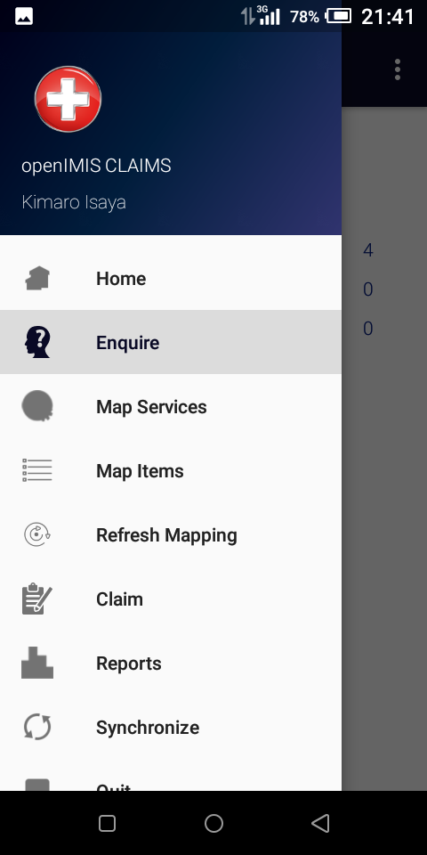

Slide 15
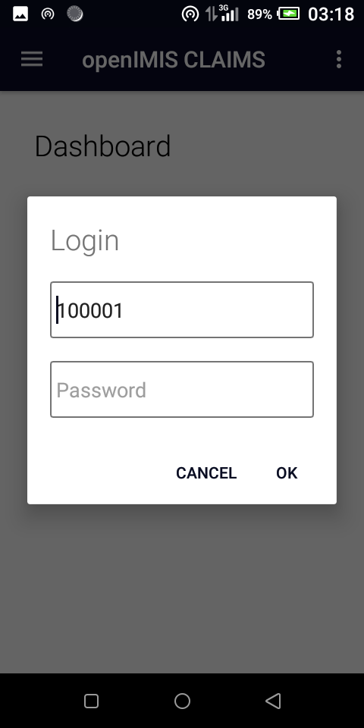
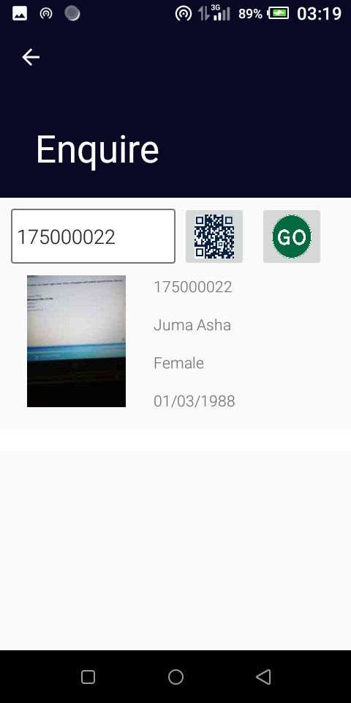

Slide 16
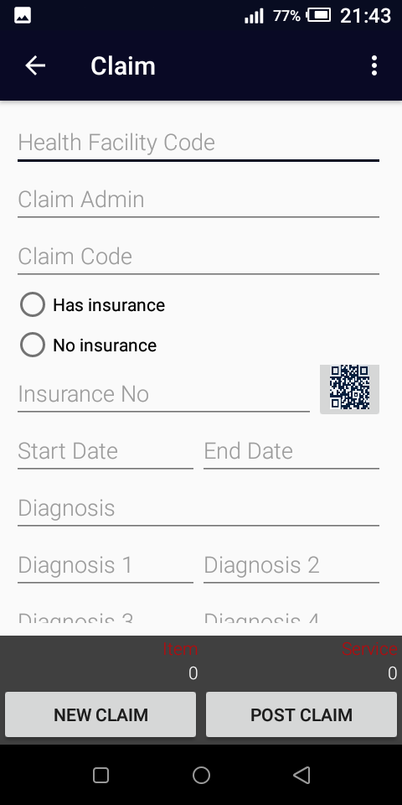
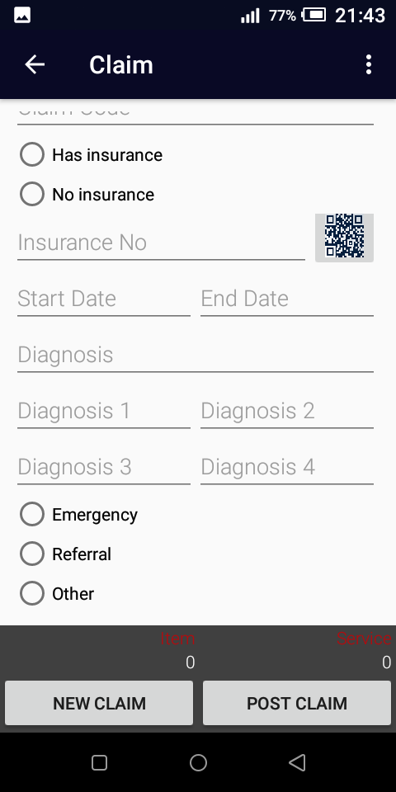
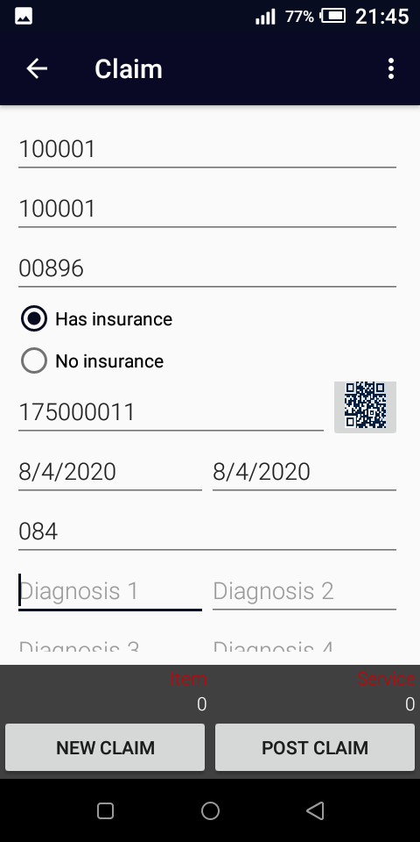

Slide 17
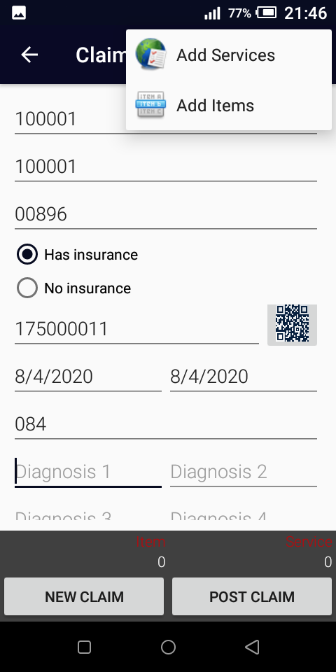
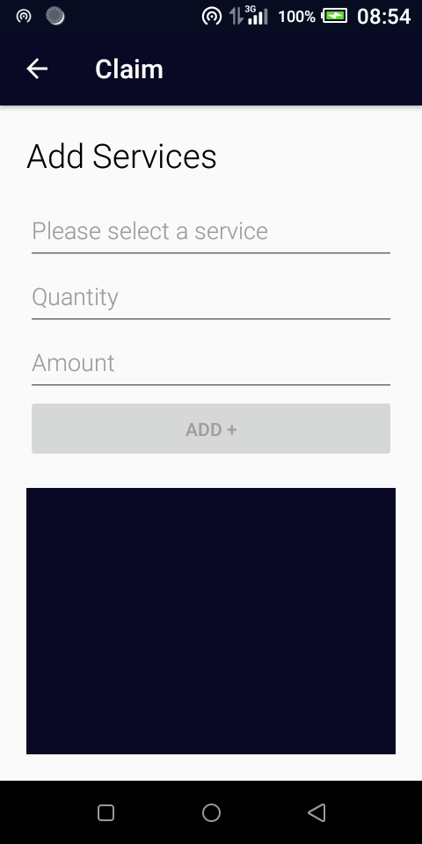
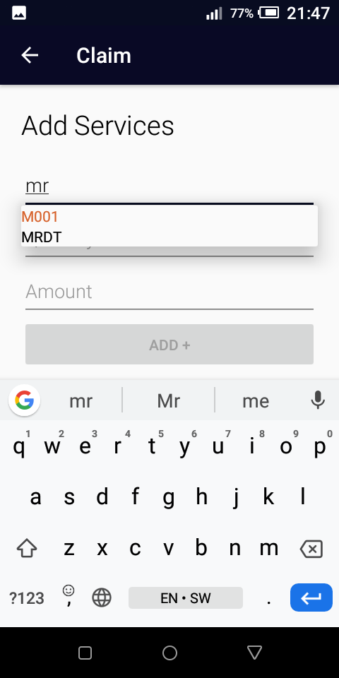

Slide 18
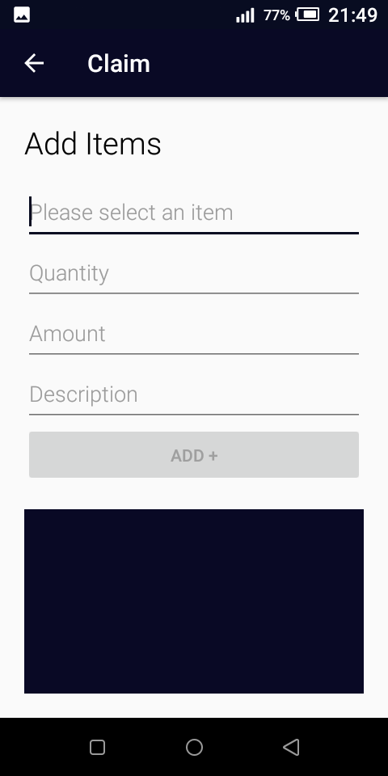
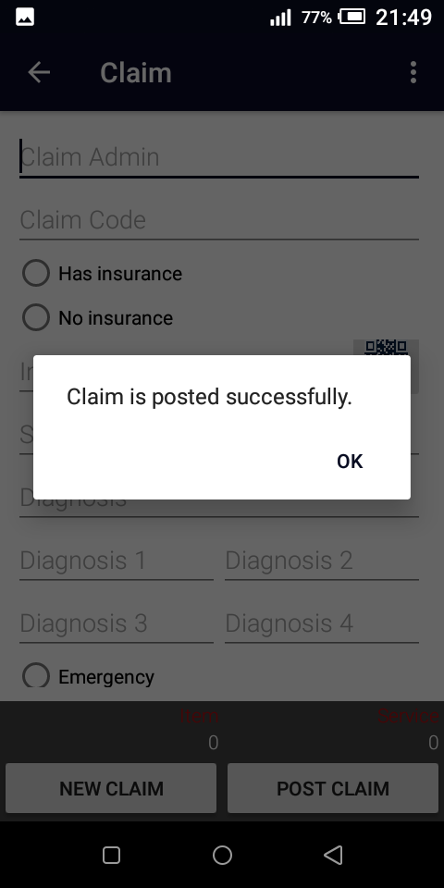

Slide 19
