Slide 1
FHIR R4 Integration
Faris Ahmetasevic

Slide 2
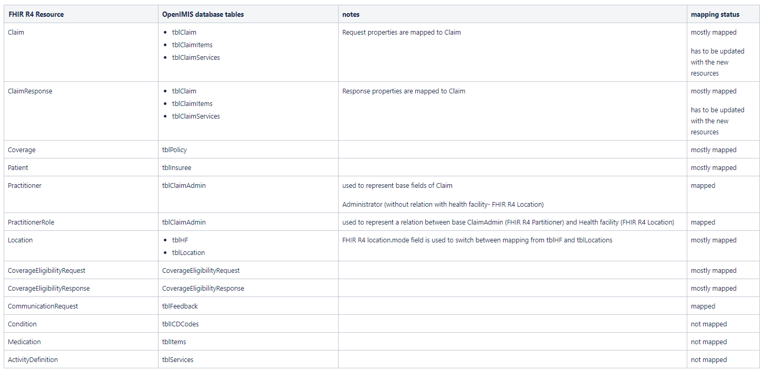
Mapping Table

Slide 3
Next Steps
Provide mapping of the additional resources to openIMIS (Condition, Medication, ActivityDefinition, Contract)
Update existing resource mappings with respect to the new added resources (i.e. Claim, ClaimResponse)
Testing, Bug fixing
Finish within 2 weeks and start developing tool for data transfer from openIMIS to FHIR database

Slide 4
Difficulties
Recognize a pattern how fields were mapped
Fully understand the mapping process
Fields with extensions or references to other resources and codes

