Slide 1
Beneficiary Management with Social Security System (SOSYS)
For Social Security Fund (SSF) Nepal
April 22, 2020

Slide 2
Social Security Fund (SSF)
Formed under Ministry of Labour, Employment and Social Security (MOLESS)
Contribution based Social Security Scheme
Schemes
Medical, health and maternity benefit
Accidental and disability benefit
Benefits for dependent family members
Old-age benefit
Contribution 31% (20% from Employer + 11% from Employee)

Slide 3
Social Security System (SOSYS)
Proprietary Software developed by Professional Computer Services (PCS)
Web based application
Technology Stack
ASP.NET C#
Oracle Database
Windows Server
Role based security

Slide 4
Functional Overview
Scheme Management
Employer Registration
Contributor Registration
Contribution Registration
Claim Management
Investment Management
Office Automation System
Account
payroll
Inventory
Fixed Assets
Social Security Program
Internal Business Processes

Slide 5
Context Diagram
Employer
SOSYS
SYSTEM
MOLESS
Third Party
Contributor

Slide 6
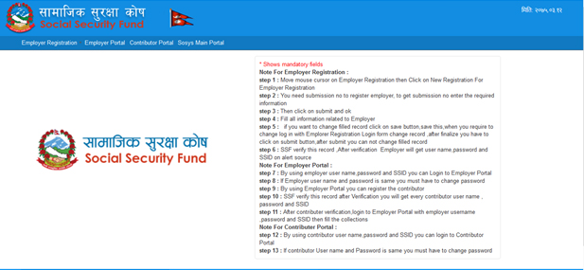
DIFFERENT PORTAL OF THE SYSTEM
SOSYS Main Portal
Employer
Portal
Contributor Portal
HOME PAGE
Fig: Home Page of System

Slide 7
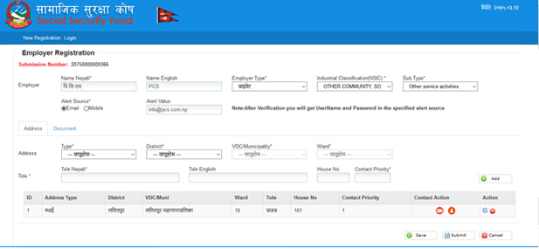
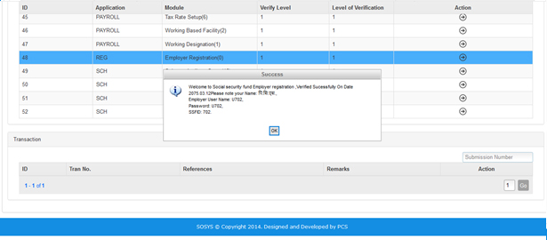
Employer Registration
Employer
Register/Login
Submission No.
User name and pw
Sent to Employer
Generate User name and pw
Verifies
SSF

Slide 8
Employer Entity
Employer Name
Business Type
Business Category
Documents (VAT/PAN/Company Registration)
Address/es
Details of Chairperson
Details of CEO

Slide 9
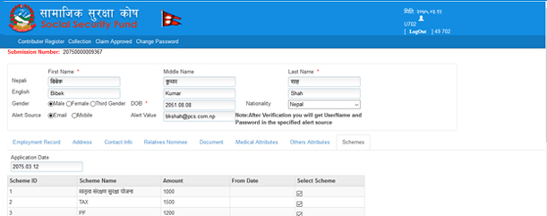
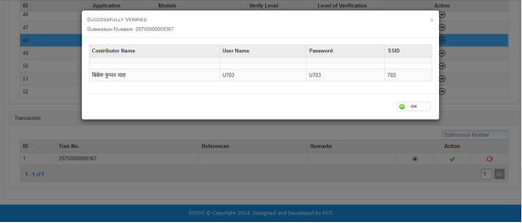
Contributor Registration
Employer
Login
Register
Contributors
Contributor
Send
User name
and pw to Contributor
Generate
User name
and pw
Verifies
SSF

Slide 10
Contributor Entity
SSID No.
Employee Name
Address/es
DOB
Gender
Nationality
Phone
Email
Blood Group
Employment Type (Permanent/Contract/Wages)
Position
Employment Start Date
Documents(Passport/PAN/Citizenship)
Relationships + Nominee Details

Slide 11
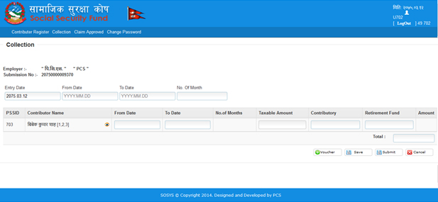
Contribution Collection
Employer
Login
Enter Contribution
Payment Gateway
Status send to Contributor/Employer
Verifies
SSF

Slide 12
openIMIS – SOSYS interoperability
Single/Batch Registration
Eligibility Status
SOSYS
openIMIS
Valuated Claims

Slide 13
Claim Reimbursement Module
Process Claim
Pay Claim
Payment Gateway
SSF
Health Facilities

Slide 14
Thank you !

Slide 15
Nirmal Dhakal
Technical Advisor, S2HSP, Kathmandu
nirmal.dhakal@giz.de

