Slide 1
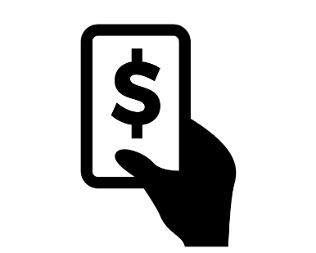
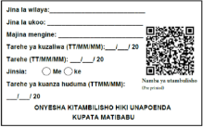
Visit household
ID card issued on the spot with pre printed unique ID no. (bar code)
Inform, advise and convince
Collect contribution amount (mobile payment), personal data and capture photo)
Notes:
Approaching clients and enrolling
A key question – when is policy activated/coverage started?
Financial transaction – norm, accounting requirement

Slide 2
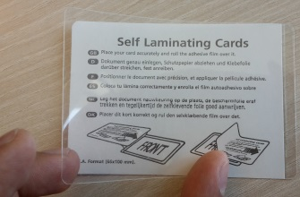
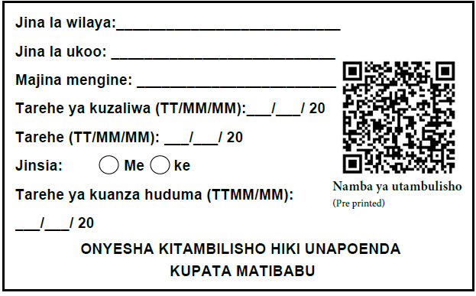
Sample enrolment form turned into an insurance card
Tear, fold, place inside cold lamination
Tear here

