Slide 1
openIMIS Demo – Offline version
(shortened version)
02.10.2019
Introduction -
openIMIS system characteristics & data captured

Slide 2

Overview
openIMIS
Data flow 1
Access to the system 2
Data captured 3
Beneficiary related 3a
Claims related 3b
Configuration related data 3c
Reporting and data analysis 3d

Slide 3
How will the session run?
We have limited time but we will try to make it as interactive as possible
Section 1: 10 mins (Please type your questions in the Chat)
Quick poll result and Q&A: 5 mins
Section 2: 10 mins (Please type your questions in the Chat)
Virtual Breakout session to practice: 10 mins
Section 3: 10 mins (Please type your questions in the Chat)
Q&A: 10 mins

Slide 4
Overview
openIMIS
Data flow 1
Access to the system 2
Data captured 3
Beneficiary related 3a
Claims related 3b
Configuration related data 3c
Reporting and data analysis 3d

Slide 5




Communication within openIMIS
Central Server
Internet
Internet
Physical transport
online
mobile
offline

Slide 6
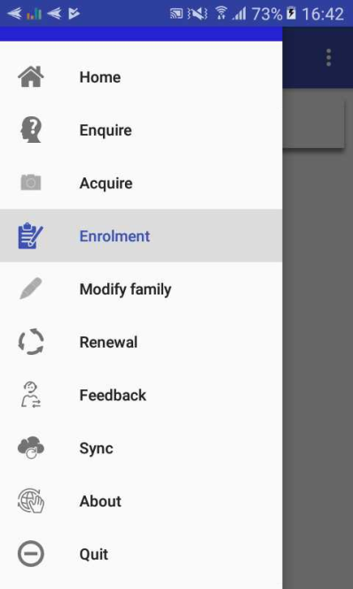
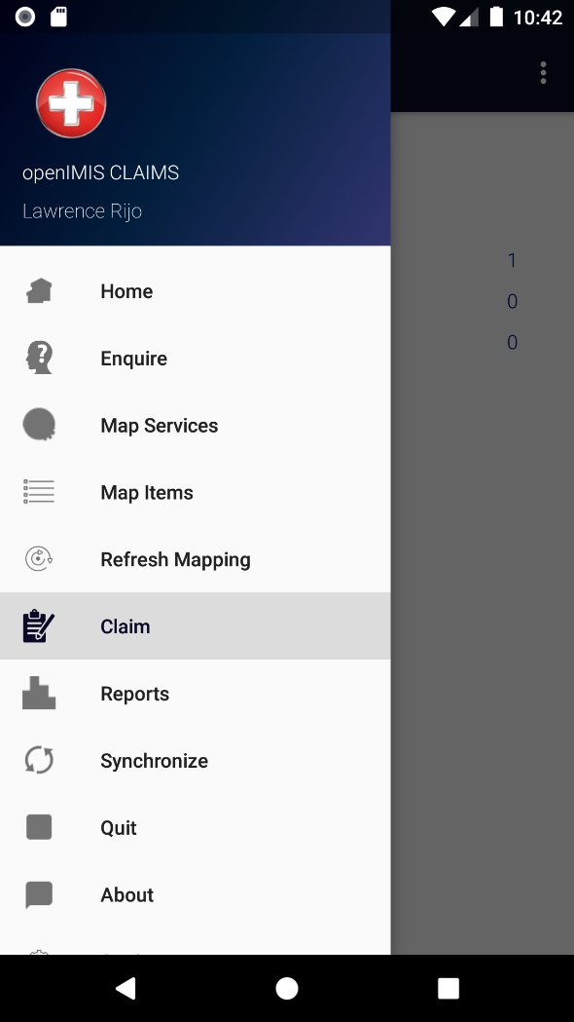
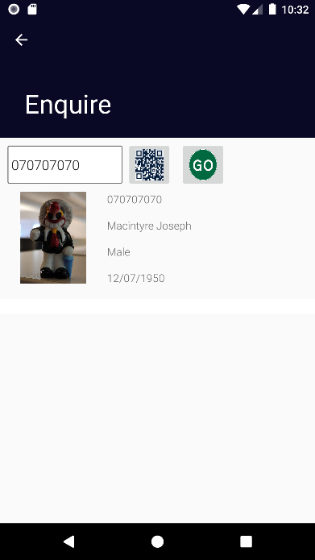
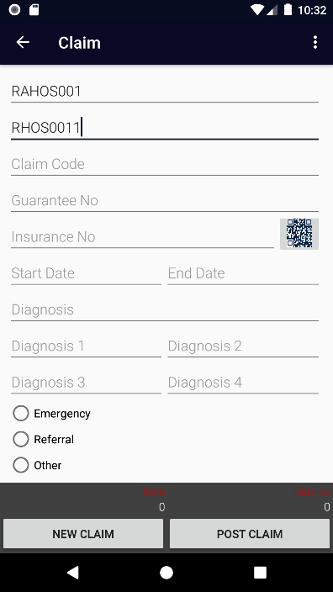
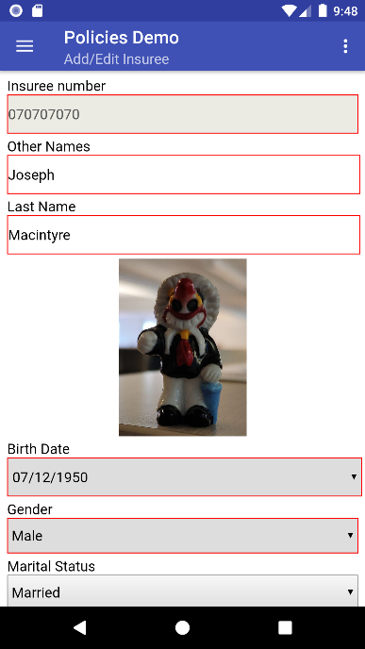
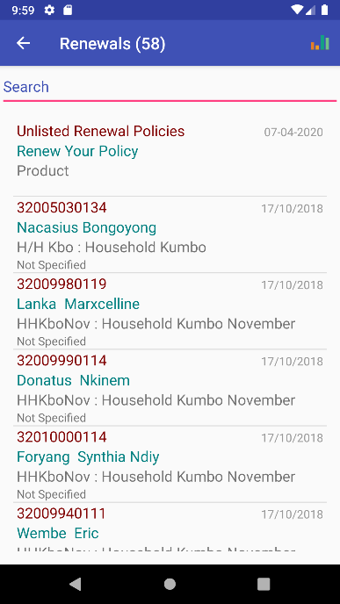
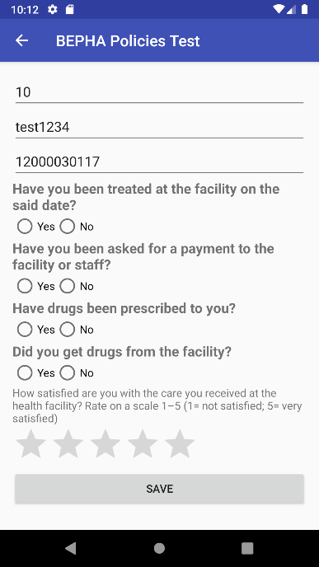
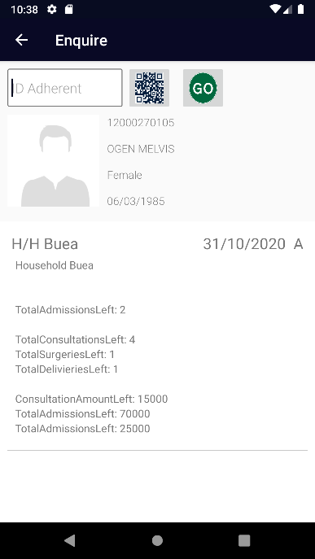
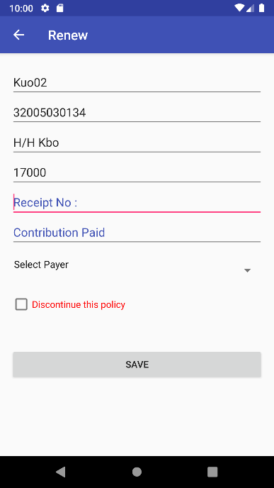
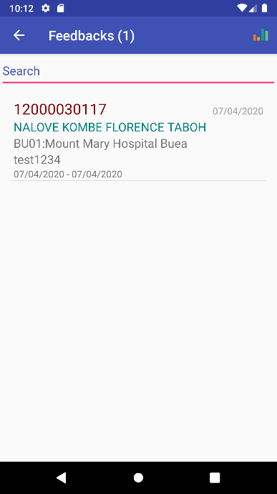

Mobile phone applications
Insurance Agent (Enrollment Officer)
Server
Health Facility Staff (Claim Administrator)
Mobile network
Acquiring of
Photos & Data
Renewal
of a policy
Acquiring
of feedbacks
Retrieving
of coverage
Submission of claims

Slide 7

Data flow with mobile apps
Central Server
Internet
Extract
Upload
(Login credentials)
Upload
(Login credentials)
Master Data
Extract
EO/CA Code
Data entry
Extract

Slide 8

Data flow with offline components
Central Server
Internet
1. Downloading of data extract from server
2. Uploading of data extract
3.Data entry on offline client
Physical transport
Online client
5. Uploading of entered data
Offline client
4. Downloading of entered data

Slide 9
Poll result and Q & A

Slide 10
Overview
openIMIS
Data flow 1
Access to the system 2
Data captured 3
Beneficiary related 3a
Claims related 3b
Configuration related data 3c
Reporting and data analysis 3d

Slide 11
Access to the system
Based on Role and Location which in openIMIS is configured through:
Location – Levels
Profiles (to define roles)
User account creation and allocation of role and location

Slide 12
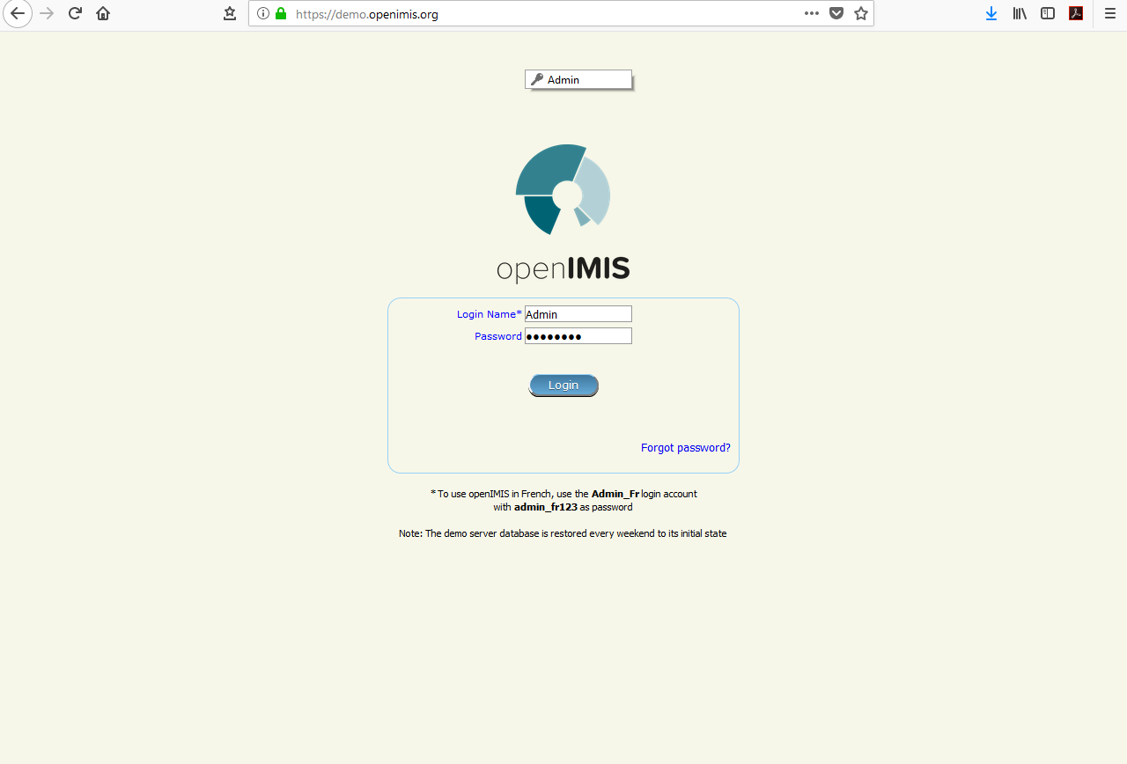
Login Screen

Slide 13
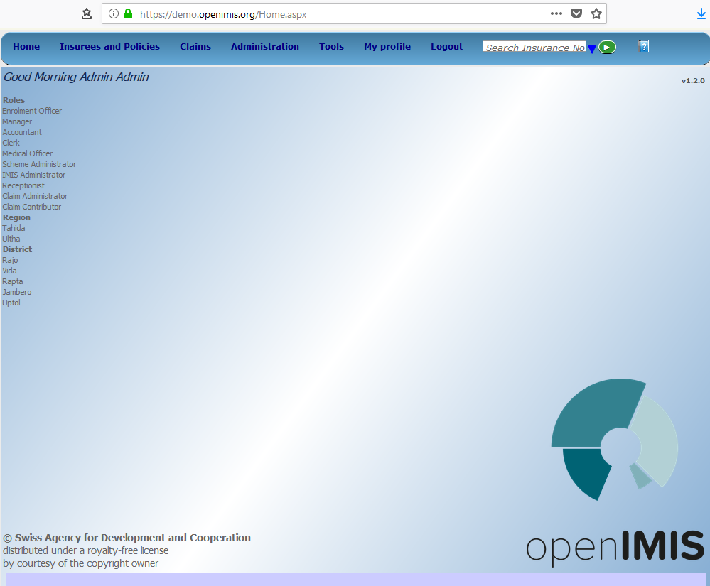
Home page

Slide 14
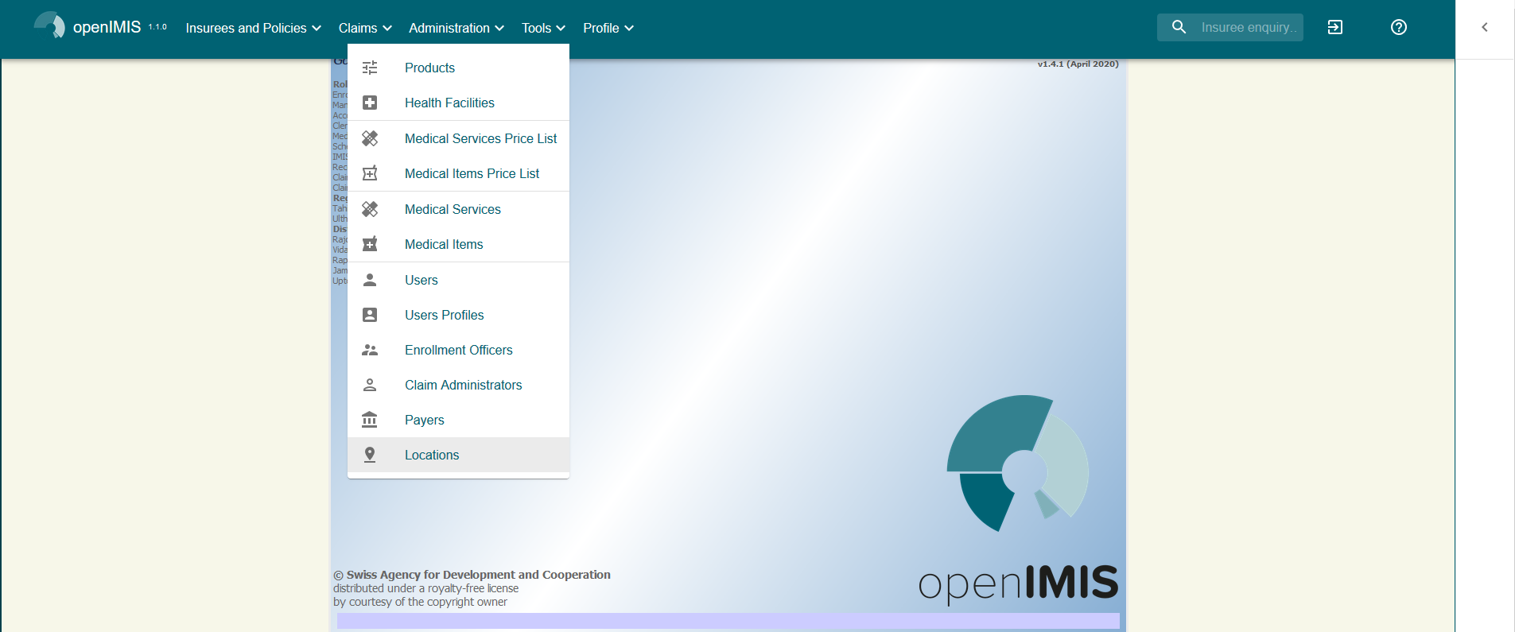
Adminstration -> Locations

Slide 15
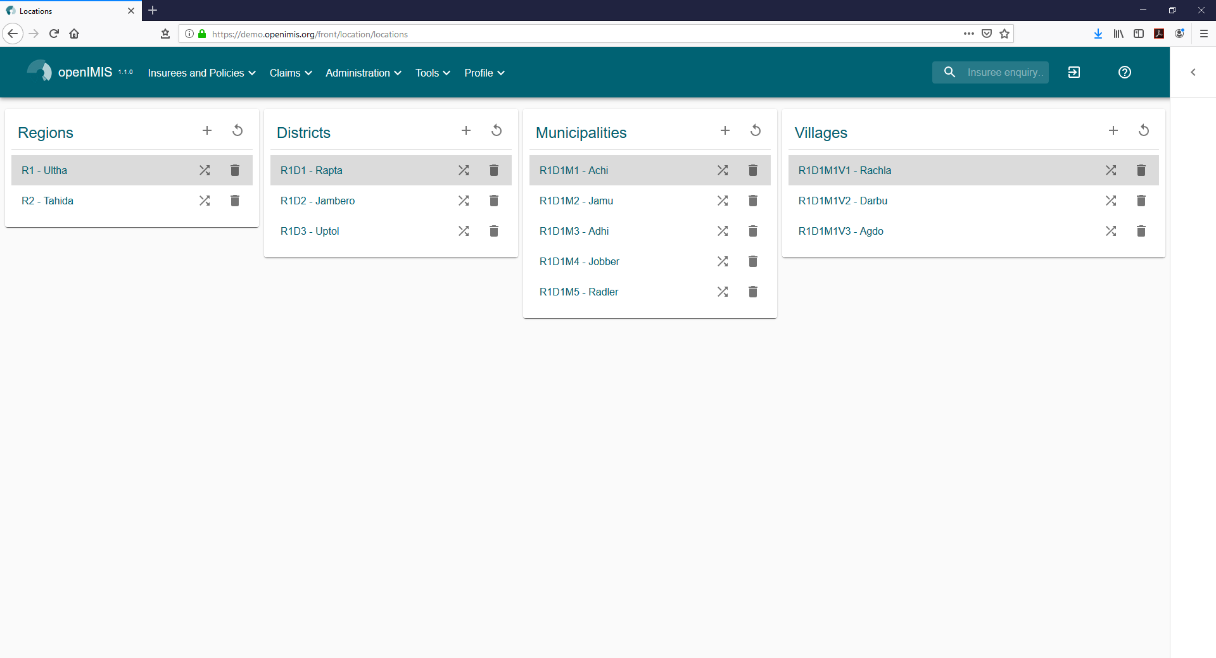
Locations

Slide 16
Adminstration -> User Profiles

Slide 17
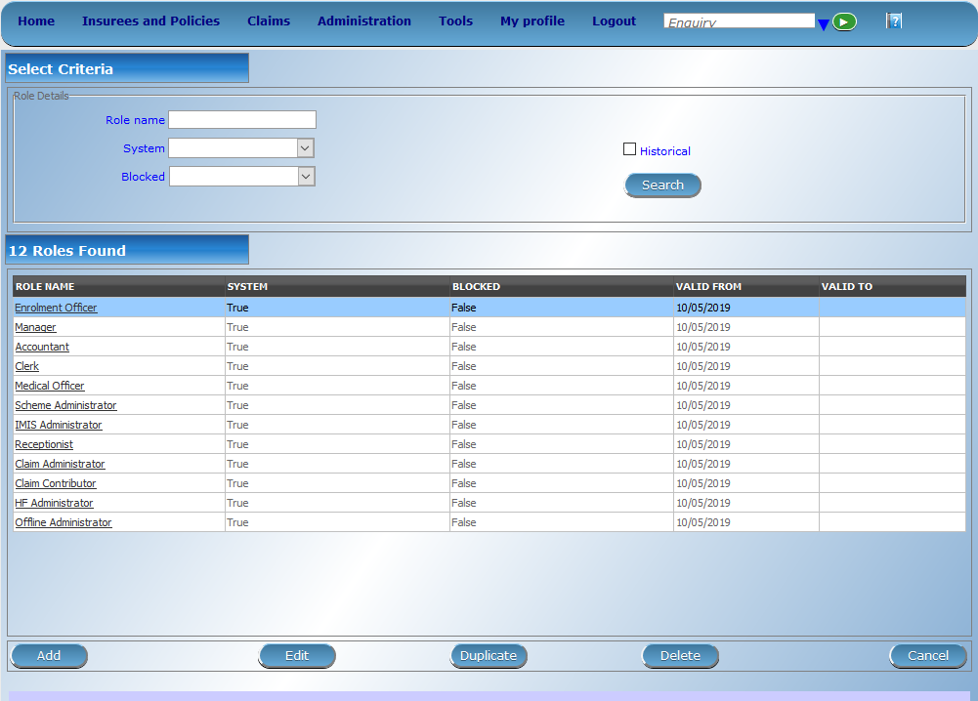
Profiles – I

Slide 18
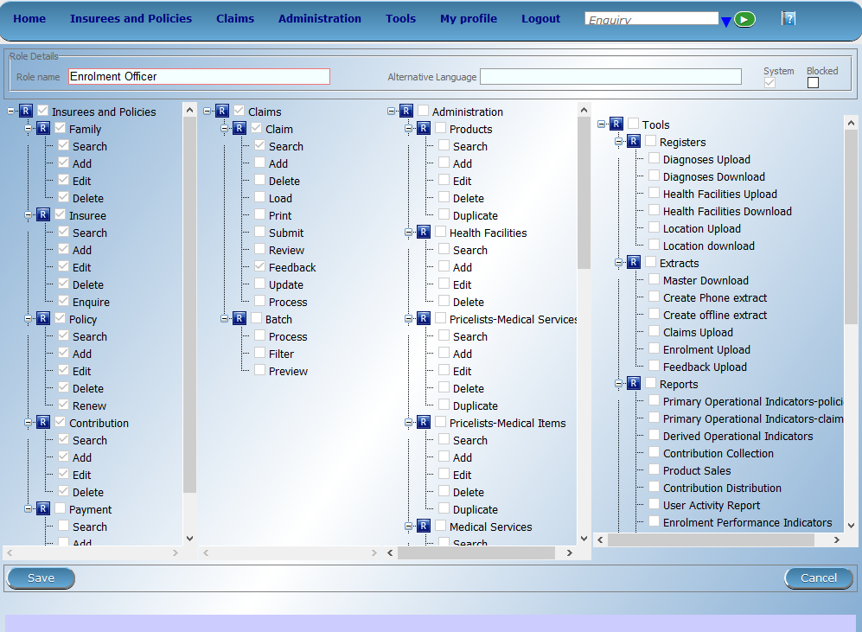
Profiles - II

Slide 19
Adminstration -> Enrolment Officers

Slide 20
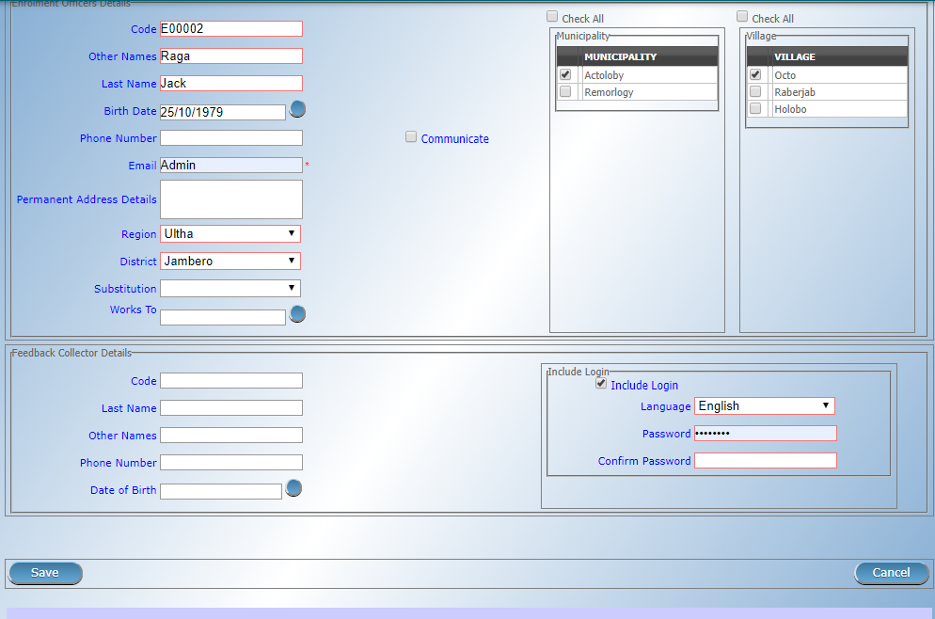
User account: Enrolment Officers

Slide 21
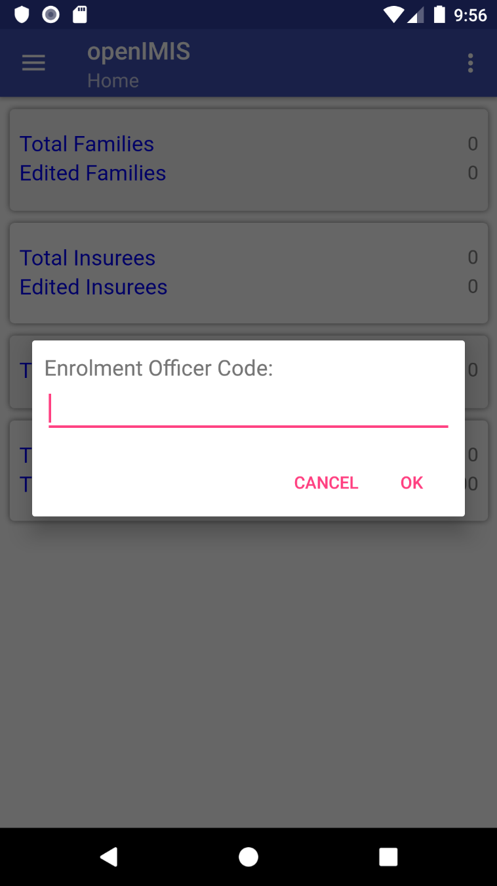
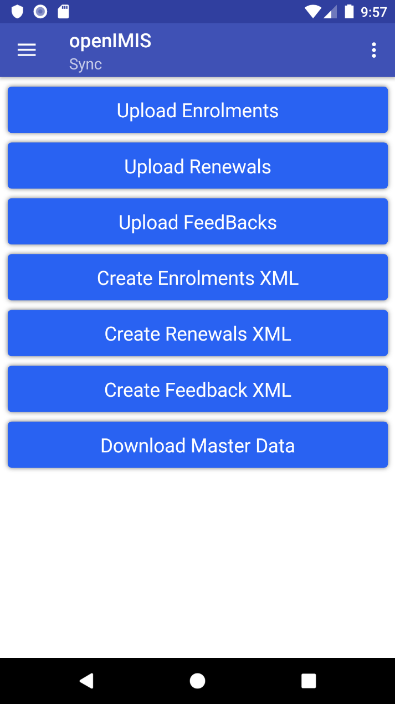
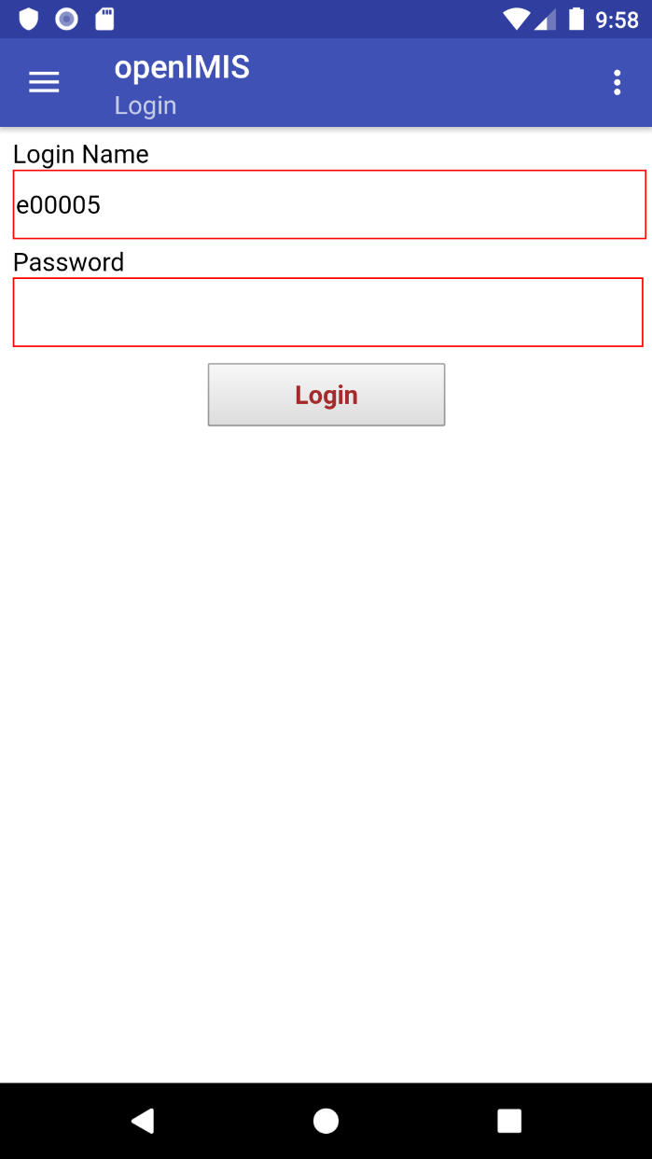
User account in apps: Enrolment Officers

Slide 22
Adminstration -> Claim admistrators

Slide 23
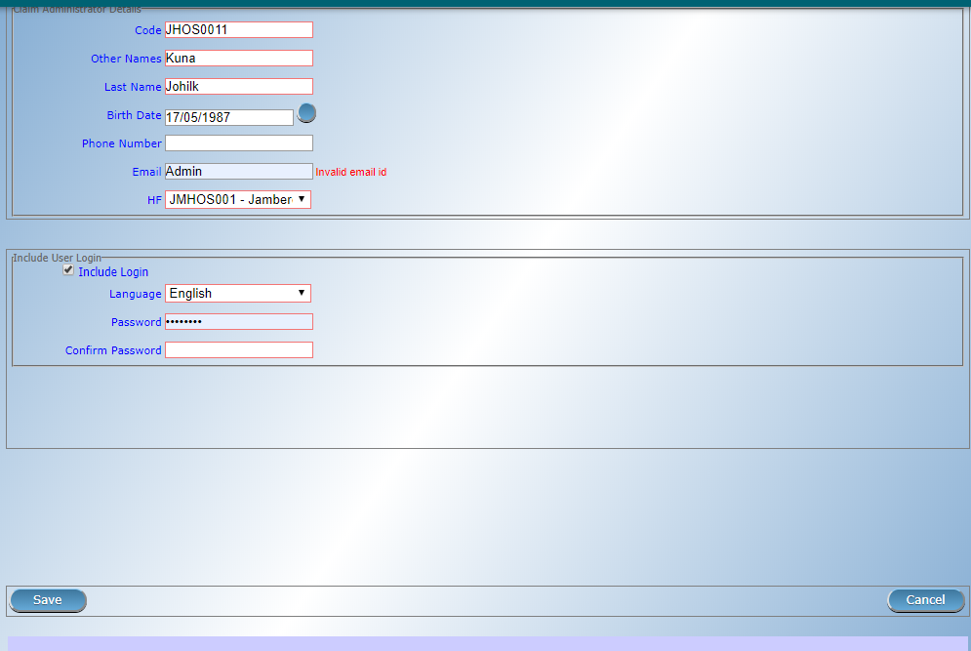
User account: Claim administrators

Slide 24
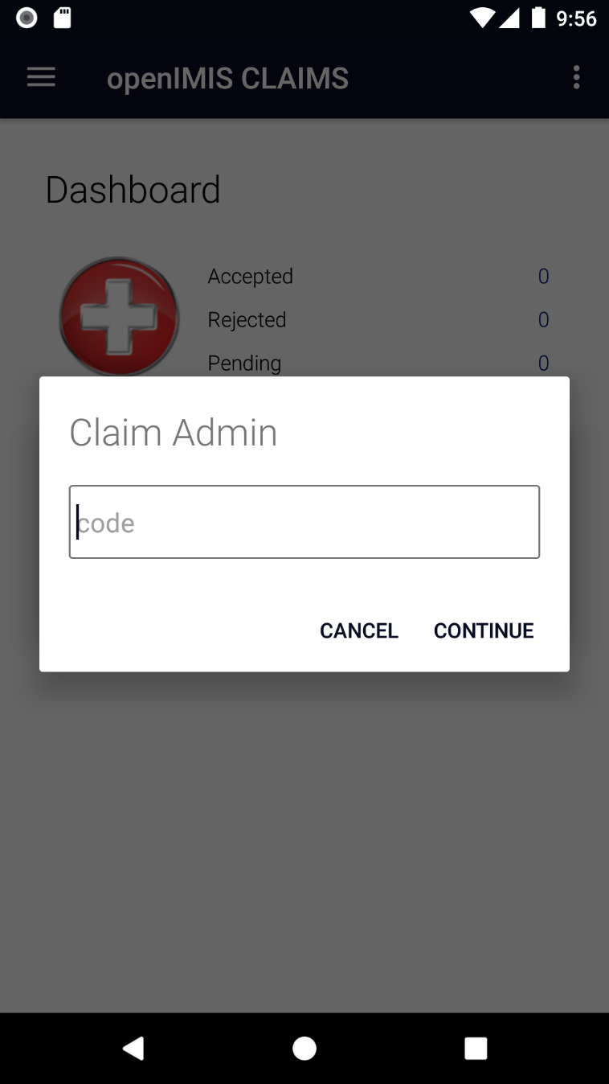
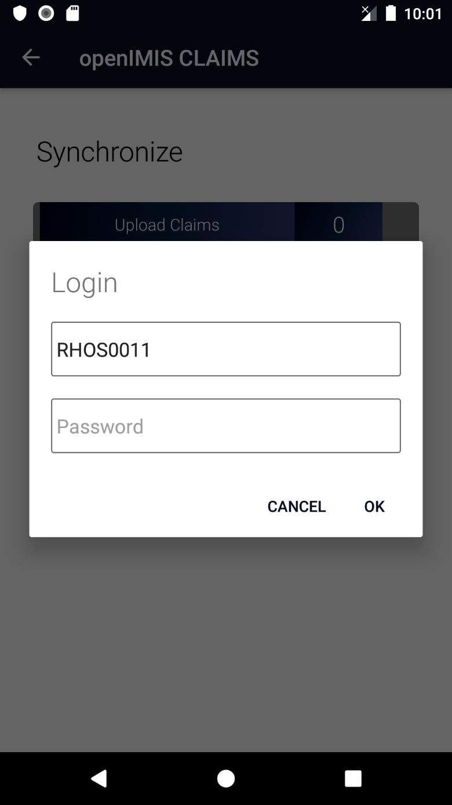
User account in apps: Claim admin

Slide 25
Adminstration -> Users

Slide 26
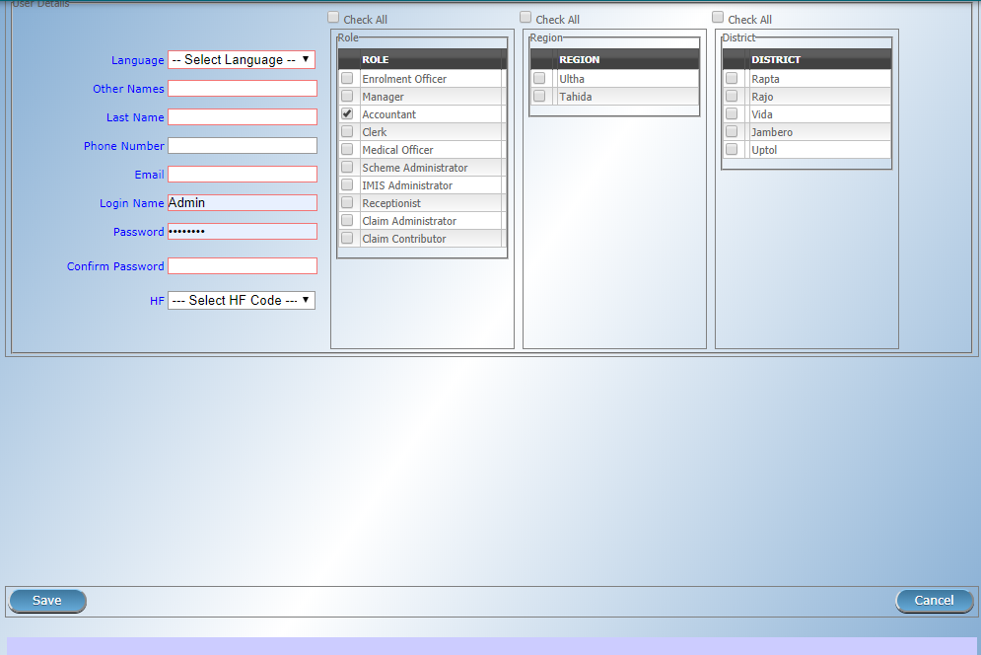
User account: Other Users

Slide 27
Practice round: Breakout room
You will be split into groups of 3 and after 10 mins will be brought back to the main session. Use the time to do the following tasks:
Feel free to talk and help out each other
Go to the demo server: demo.openimis.org and use the provided login
Go to Locations and Add your own location (atleaset one under each sub level) (Hint: add your initials to it so you can identify it easily)
Go to Users and Add an account for yourself with the role Scheme Administrator and IMIS Administrator
Log out and login using the new account you created for yourself
Add one new Enrolment Officer for the location that you created
If you have questions at any point please type them in the Chat!

Slide 28
Overview
openIMIS
Data flow 1
Access to the system 2
Data captured 3
Beneficiary related 3a
Claims related 3b
Configuration related data 3c
Reporting and data analysis 3d

Slide 29
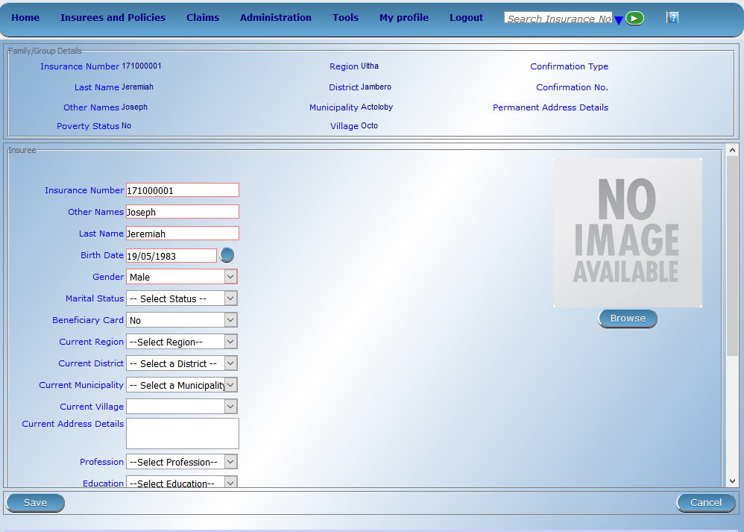

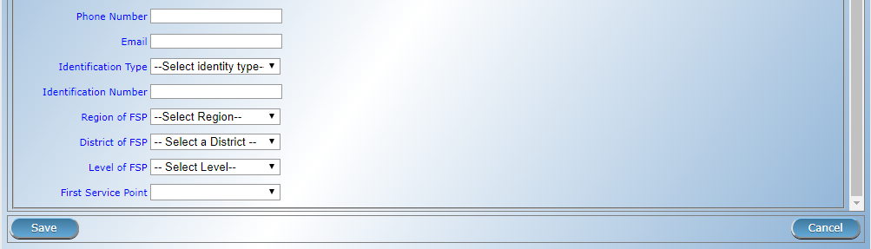
Beneficiary data - I

Slide 30
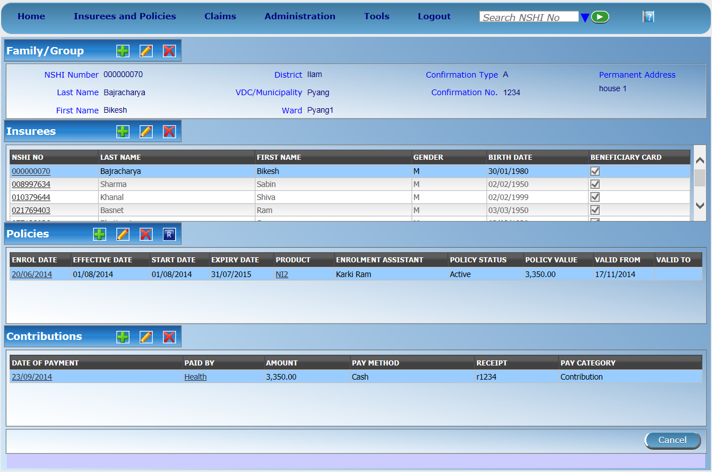
Beneficiary data - II

Slide 31
Overview
openIMIS
Data flow 1
Access to the system 2
Data captured 3
Beneficiary related 3a
Claims related 3b
Configuration related data 3c
Reporting and data analysis 3d

Slide 32
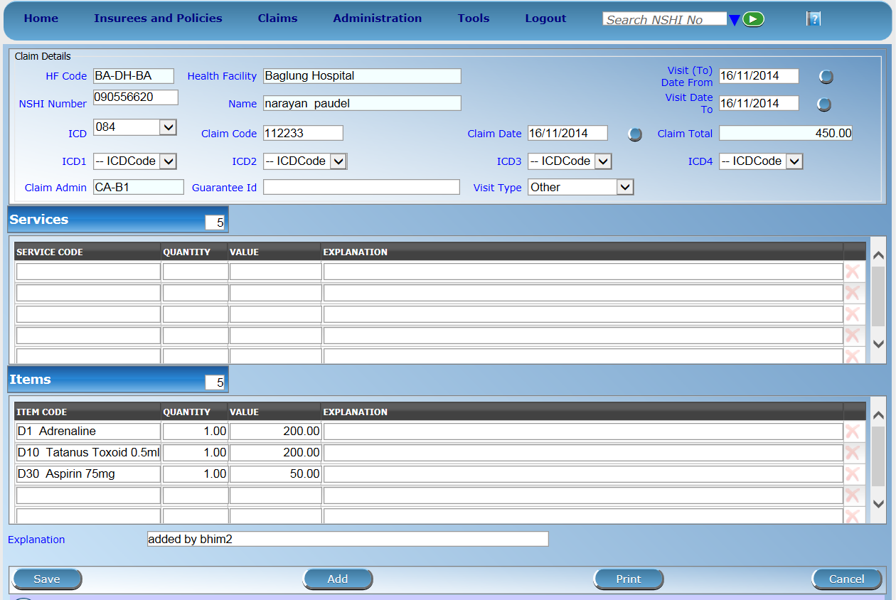
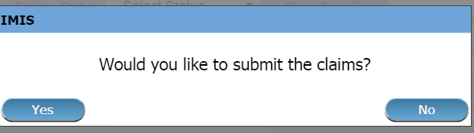
Claim entry page

Slide 33
SECTION 2

Slide 34
Overview
openIMIS
Data flow 1
Access to the system 2
Data captured 3
Beneficiary related 3a
Claims related 3b
Configuration related data 3c
Reporting and data analysis 3d

Slide 35








Construction of a scheme I
Purchaser
Provider
Type of facility
Services/Items
Price Lists
Contract
Contract
Client

Slide 36






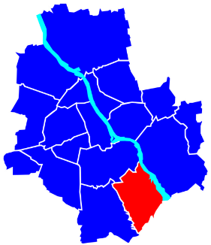
Construction of a scheme II
General definition of registers:
User Profiles
Diagnosis List
Users
Medical services
Products
Enrolment officers
Claim Administrators
Medical Items
Health facilities
Payers
Price lists
Locations

Slide 37
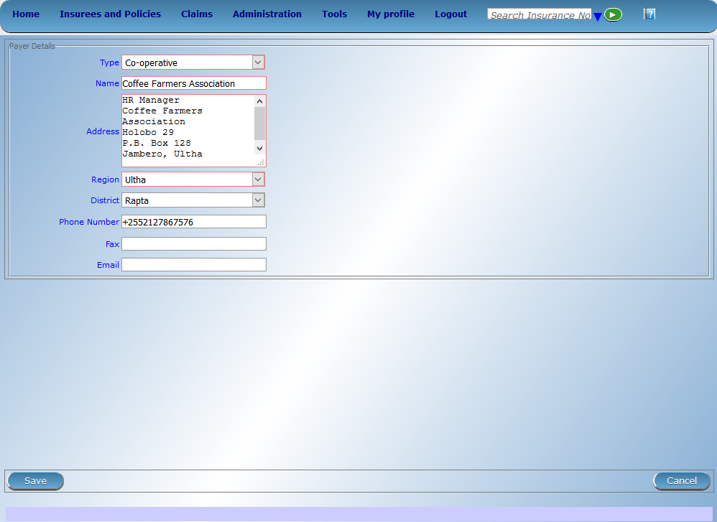
Payers

Slide 38
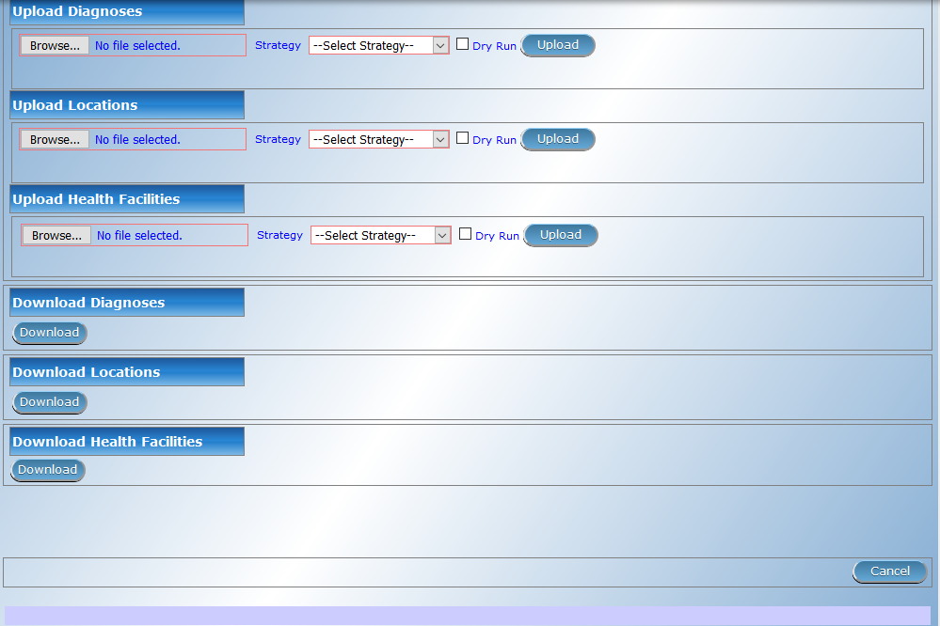
Diagnosis List

Slide 39
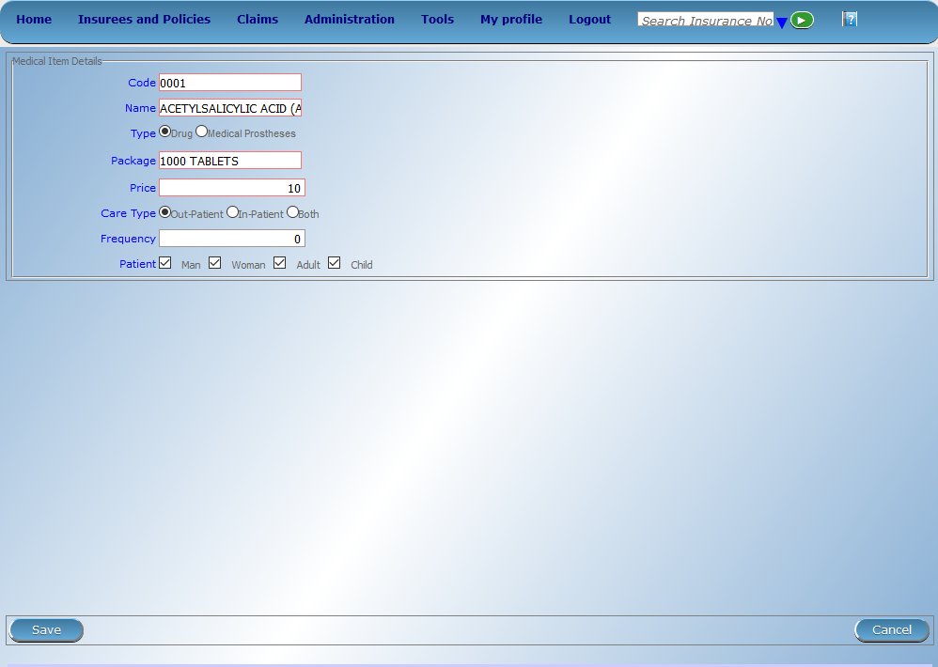
Medical Items

Slide 40

Medical Services

Slide 41
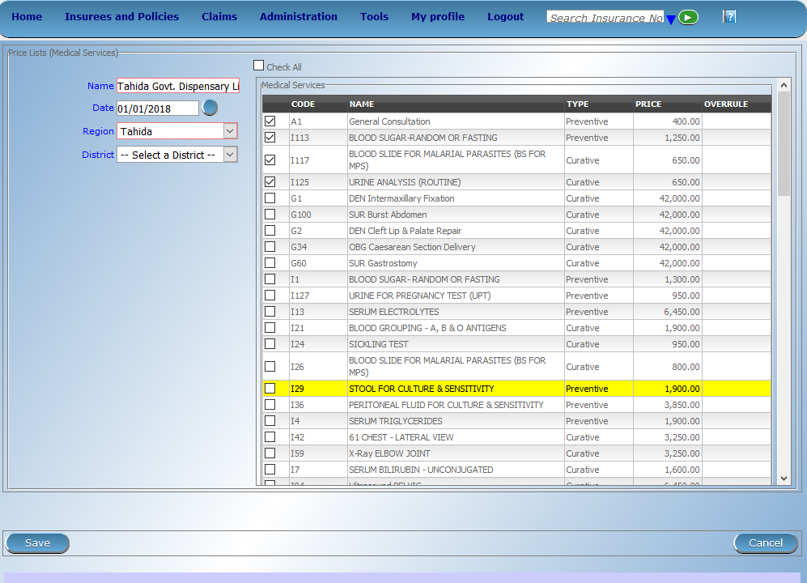
Price List -> Medical Services

Slide 42

Price List -> Medical Items

Slide 43
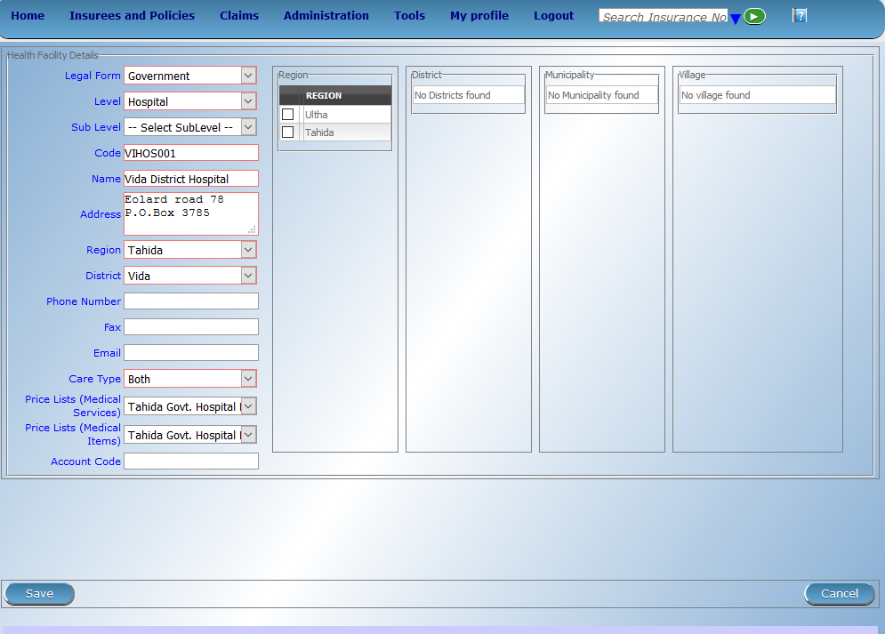
Health Facilities

Slide 44
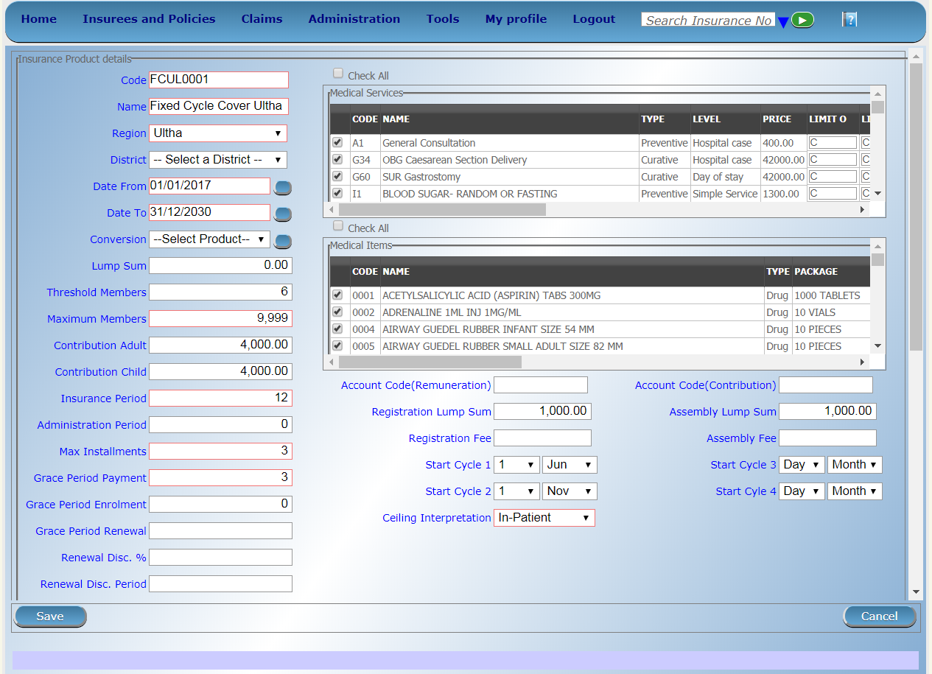
Products – I

Slide 45
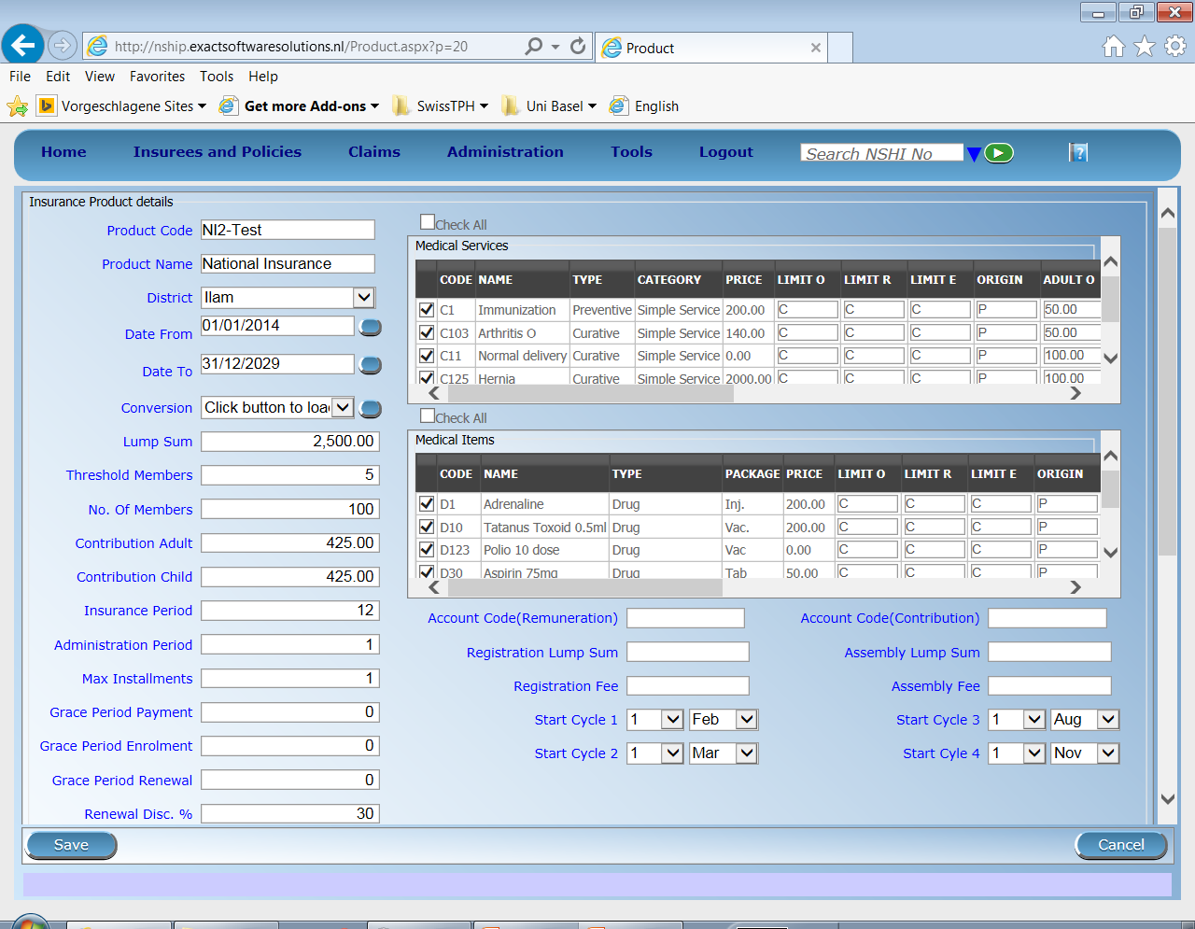
Products – II

Slide 46
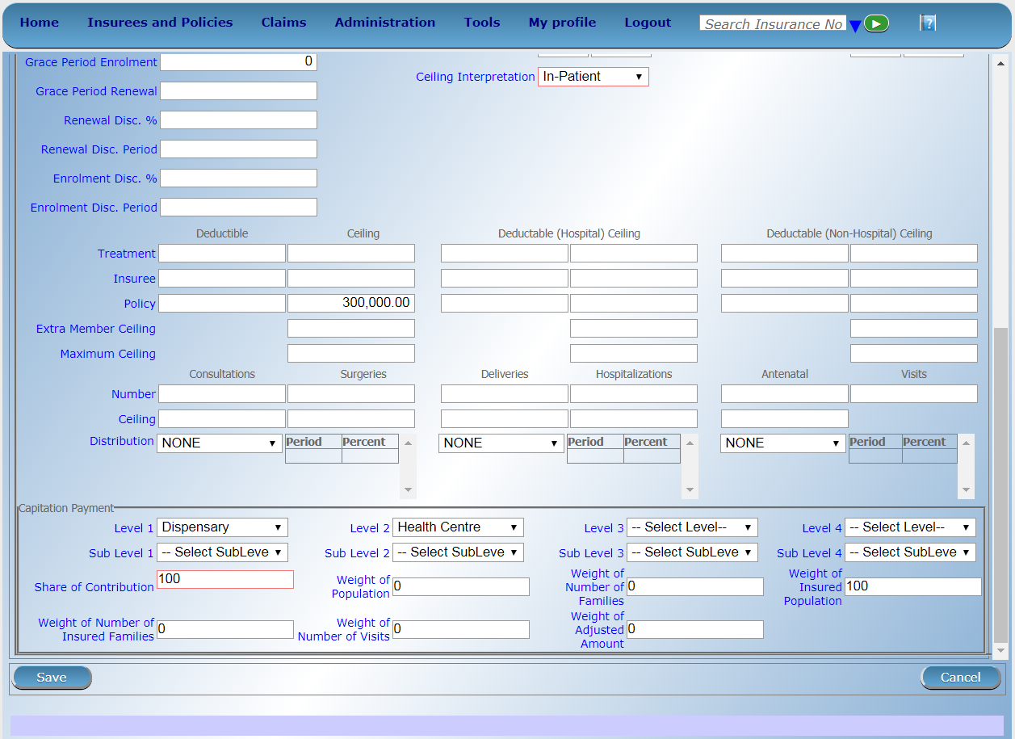
Products – III

Slide 47
SECTION 3

Slide 48
Overview
openIMIS
Data flow 1
Access to the system 2
Data captured 3
Beneficiary related 3a
Claims related 3b
Configuration related data 3c
Reporting and data analysis 3d

Slide 49
Types of reports
Standard operational reports
Customizable reporting options

Slide 50
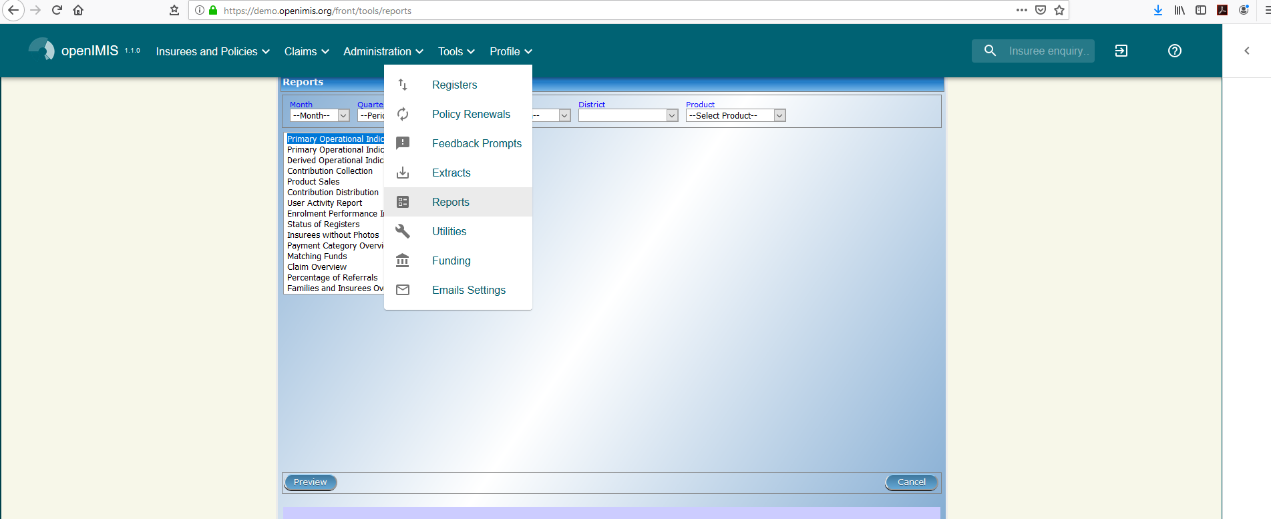
Tools -> Report

Slide 51
Standard operational reports
Reports on management of families, insurees, policies, premiums, claims:
Primary Operational Indicators-policies & claims
Derived Operational Indicators
Contribution Collection
Product Sales
Contribution Distribution
User Activity Report
Enrolment Performance Indicators
Status of registers
Insurees without photos
Matching Funds
Claim Overview
Percentage of Referrals
Families and Insurees Overview
Pending Insurees
Renewals
Capitation Payment
Rejected Photos

Slide 52
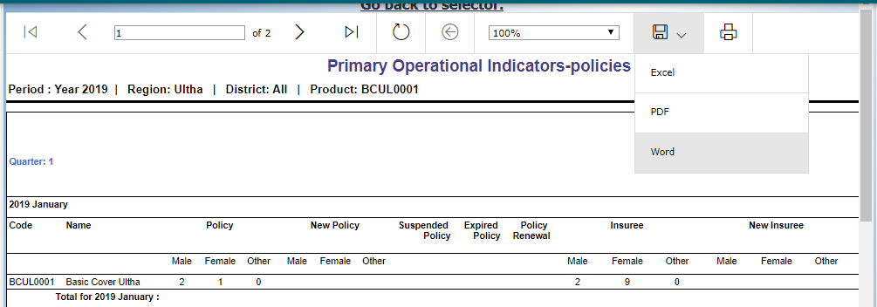
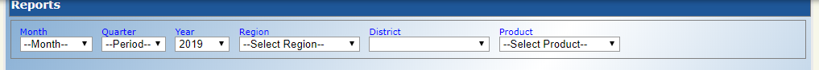
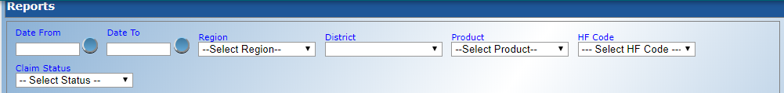
Generation of standard reports

Slide 53
Customizable reporting options – DHIS 2
Server
FHIR Server/FHIR Reference Module
DHIS 2 FHIR Adapter
Operational database of openIMIS
mobile
DHIS 2 Tracker
online client
Aggregation
DHIS 2
offline client
Dashboards

Slide 54
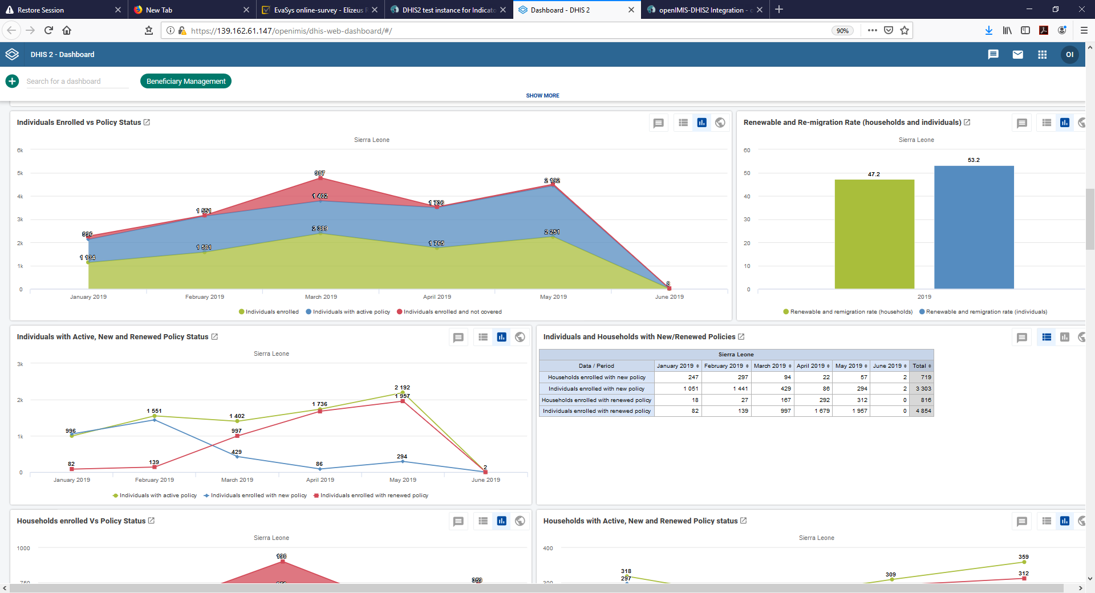
Customizable reporting options – dashboards
More details here: https://openimis.atlassian.net/wiki/spaces/OP/pages/900857929/DHIS2+test+instance+for+Indicator+Dashboards

Slide 55
Q & A
For the first quarter of 2020 (Jan – Mar):
How many new policies were sold? How many of these policies were sold to Female headed households?
What were the total number of New Insurees joining in this period and how many of these individuals were Male?
What was the total contribution collected in Jambero District for product BCUL0001?
What is the status of registers in the systems – specifically the number of Services and Medical Items?

Slide 56
Attributions for icons
Creative Commons CC BY 3.0 license applies to all icons:
Payment by Loki Ba / CC BY 3.0
Hospital by ibrandify / CC BY 3.0
Hospital by Vectors Point / CC BY 3.0
Pharmacy by Eucalyp / CC BY 3.0
Medication by sahua d / CC BY 3.0
Network by Creative Stall / CC BY 3.0
Worker by Nikita Kozin / CC BY 3.0
Contract by Adrien Coquet / CC BY 3.0
Family by Gan Khoon Lay / CC BY 3.0

Slide 57



Thank you!
Except where otherwise noted, this work is licensed under
https://creativecommons.org/licenses/by-sa/4.0/legalcode

