Slide 2
Organizational structure
Key roles and responsibilities
Communication within openIMIS
Building a scheme
Processes
  Enrolment process
  Health Service Utilization Process
  Claims Process
  Renewal process
  Reporting

Slide 3


Organizational Structure of ABC scheme
Departments/Units / Teams, hierarchy, interaction

Slide 4
Key roles and responsibilities
Roles | Responsibilities
Role A | Check reports… Enter data….
Role B | ……. …
Role C | …..

Slide 5
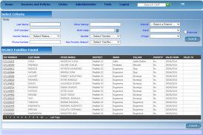






Communication within openIMIS
central server
Internet
Internet
Internet
physical
transport
on-line
mobile
off-line

Slide 6


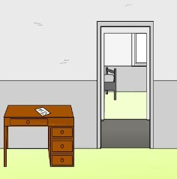
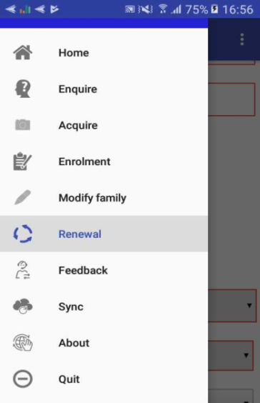
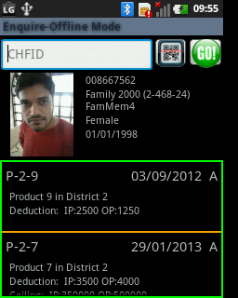
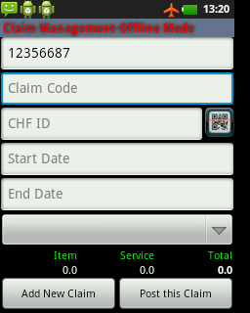

Data transfer using mobile phone
Insurance Agent
Health Facility staff
Server
Mobile
network
Enrolment
Renewal
Feedback
Client identification
Claim submission

Slide 7


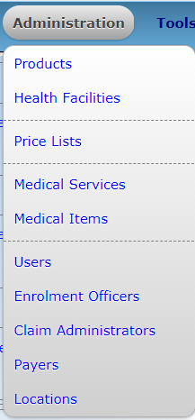







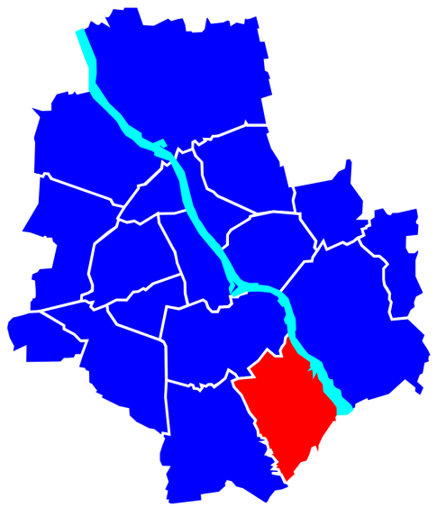




Building a scheme – I
Describe how initial configurations are done
Is someone paying on behalf on the insured family/group?
Notes:
Visualization of all registers – missing is diagnosis list – under tools registers

Slide 8
















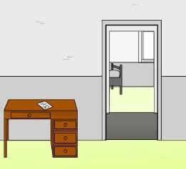

Building a scheme - II
Notes:
Visualization of all registers – missing is locations, payers, users (represented here but decide whether to give details)

Slide 9
Processes
General approach
Describe your processes (process, forms, mobile and web application)
Practice filling of forms where applicable (as many exercises as possible!)
Practice using openIMIS (as many exercises as possible!)
Undertake a role play
Practice with pre created scenarios to identify mistakes/exceptional scenarios (as many exercises as possible!)
Keep it as practical/hands on as possible – key is Practice! Practice! Practice!

Slide 10
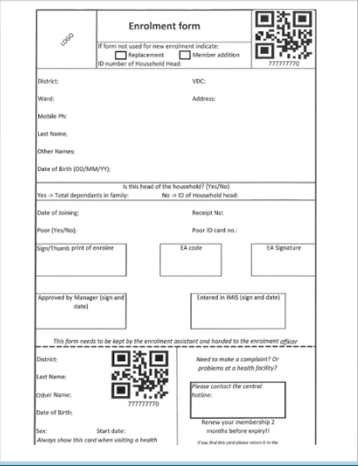
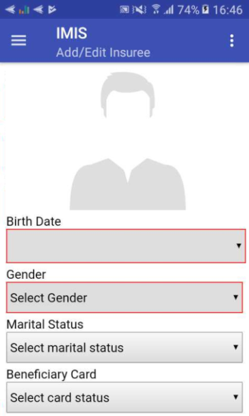
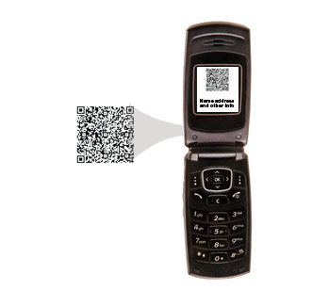


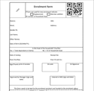


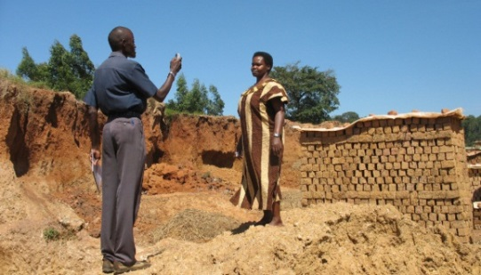
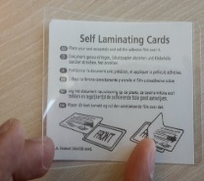
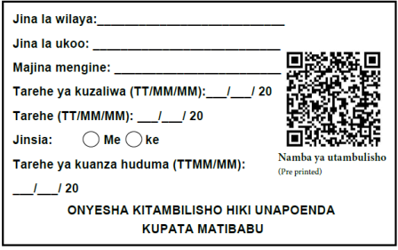
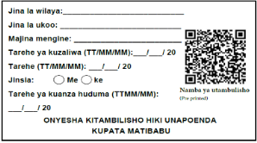
Enrolment – I (Sample Process)
Collect contribution
Describe how your process works! Who are the key actors? What is the flow of data? What forms are involved?

Slide 11
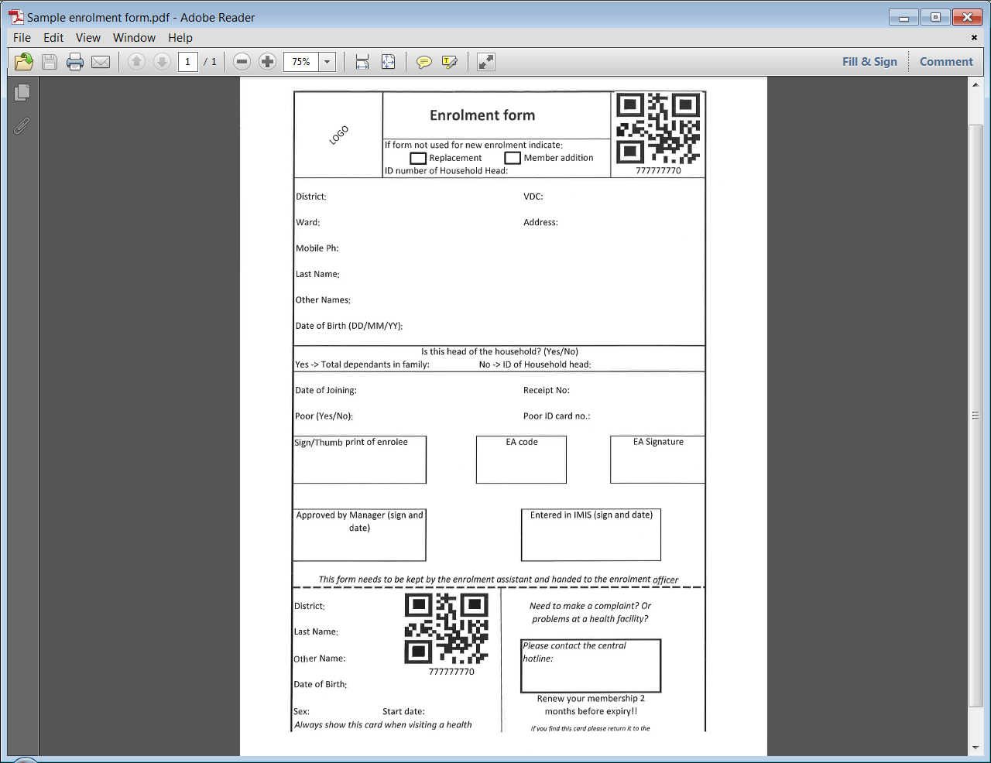
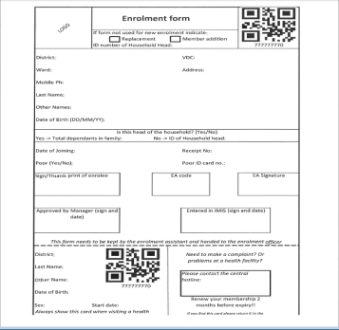

Enrolment - II (Forms involved)
Explain each form needed in the process and practice filling it

Slide 12
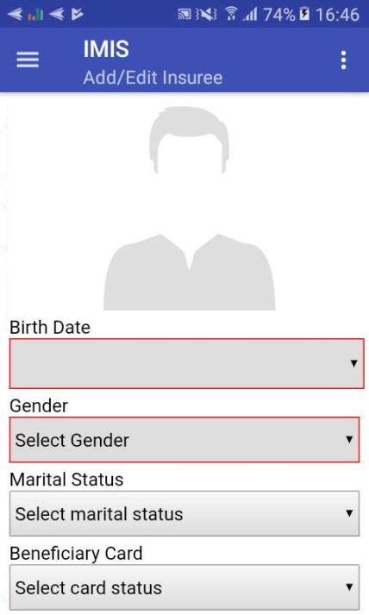
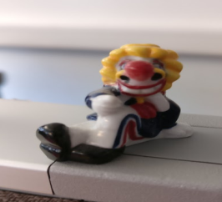
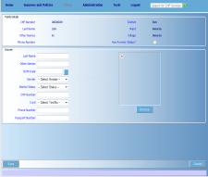

Enrolment – III a (Use of mobile application)
Describe with a case how you use mobile phones during the process!
1.acquiring of a photo of an insuree
by a mobile phone
3.assigning it to
the record of the insuree
(automatically)
2.sending it on
the central server
12

Slide 13
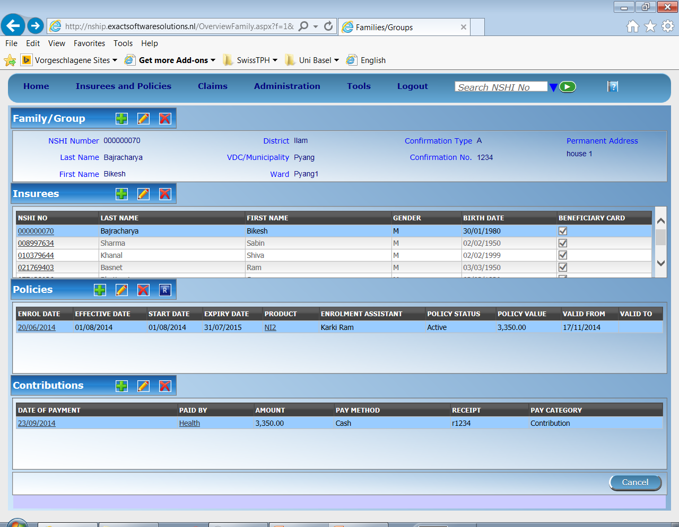
Enrolment – III b (Use of web application)
Describe with a case how you use web application during the process!

Slide 14
Enrolment – IV (Role play)
Split participants into teams
Allocate each person a role (relevant to them) described in the process
Undertake role play (first to the last step!)
Rotate roles
Re do role play
Repeat process to give more practice

Slide 15
Enrolment – V (Scenarios)
Develop more complex scenarios prior to the training
Once familiar introduce participants to the complicated scenarios
Ask them to role play and identify problems/resolve the solution
Emphasis should be on practicing the exceptions to the standard cases expected

Slide 16
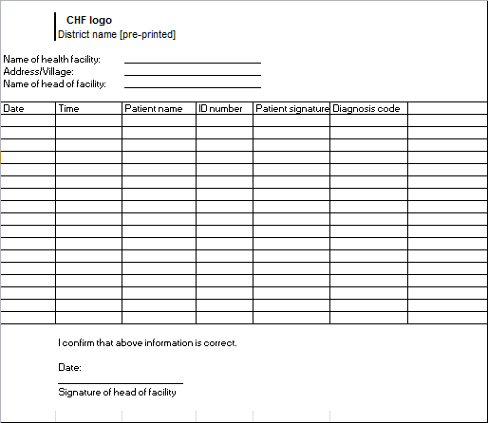

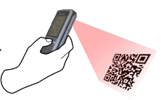

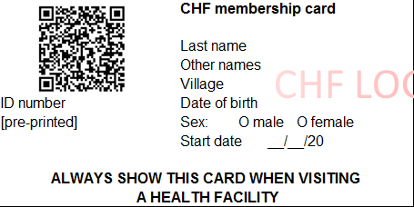
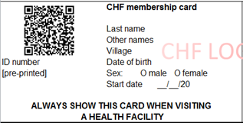
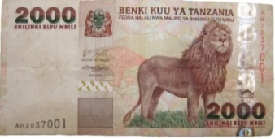
Health Service Utilization – I (Sample Process)
Describe how your process works! Who are the key actors? What is the flow of data? What forms are involved?
Reception1st registers patient in OPD/IPD register
Receptionist scans card with phone (offline & online) connectivity OK
EXPIRED
Send patient for treatment

Slide 17
Health Service Utilization - II (Forms involved)
Explain each form needed in the process and practice filling it

Slide 18
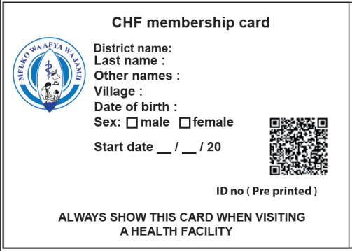
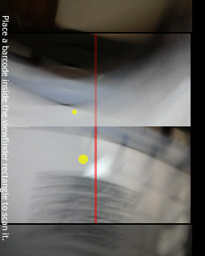
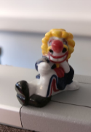
Health Service Utilization – III a (Use of mobile application)
Describe with a case how you use mobile phones during the process!
1. insuree’s ID number read by phone through QR code
3.retrieving photo and information
on coverage
2.send it to
the central server

Slide 19
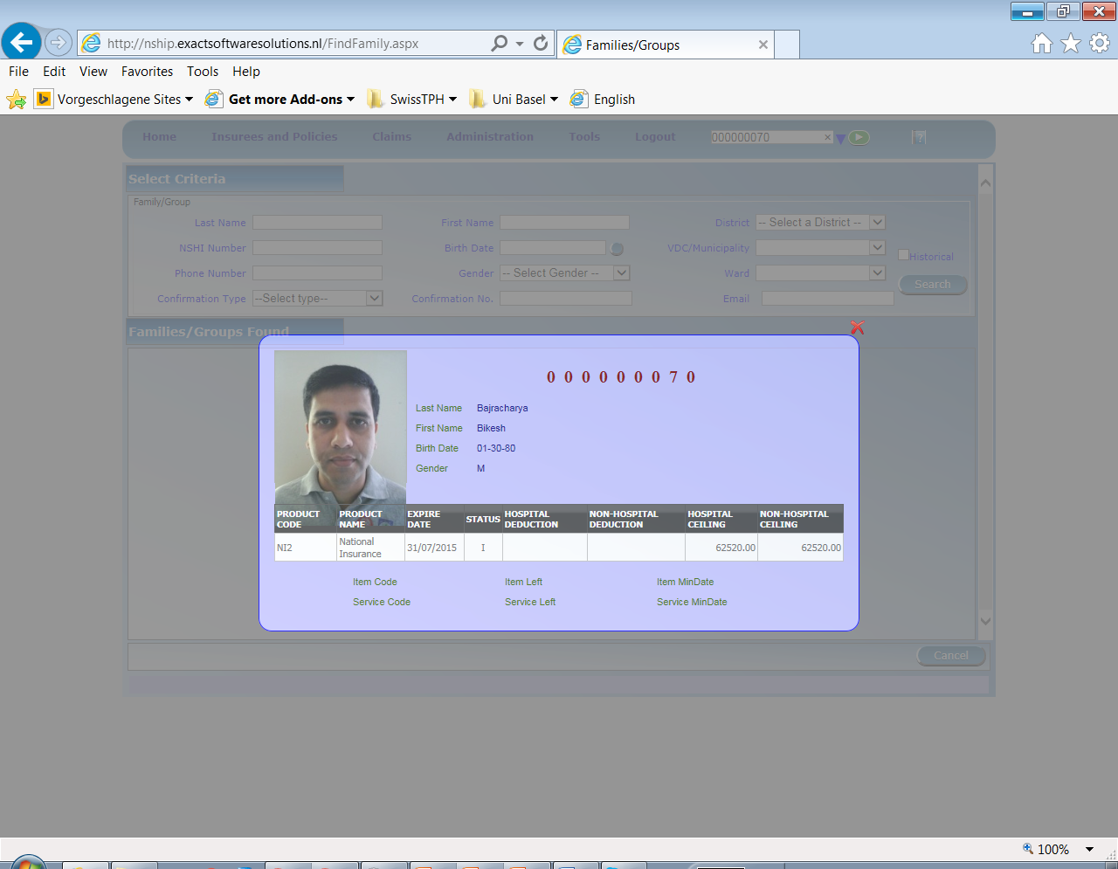

Health Service Utilization – III b (Use of web application)
Describe with a case how you use web application during the process!

Slide 20
Health Service Utilization – IV (Role play)
Split participants into teams
Allocate each person a role (relevant to them) described in the process
Undertake role play (first to the last step!)
Rotate roles
Re do role play
Repeat process to give more practice

Slide 21
Health Service Utilization – V (Scenarios)
Develop more complex scenarios prior to the training
Once familiar introduce participants to the complicated scenarios
Ask them to role play and identify problems/resolve the solution
Emphasis should be on practicing the exceptions to the standard cases expected

Slide 22
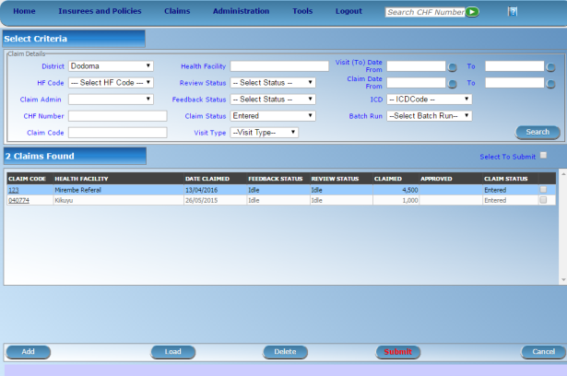




Claims Process – I (Sample Process)
server
mobile
network
health facility
Internet
network
Describe how your process works! Who are the key actors? What is the flow of data? What forms are involved?
mobile client
on-line client
Internal claims processing in IMIS
CHF office
off-line client
Automated Checking (client status, price lists, etc.)
Review by a Medical Advisor
Automated final claim calculations (remaining limits, etc.)
Generating consolidated claims report
paper forms
on-line client

Slide 23
Claims Process - II (Forms involved)
Explain each form needed in the process and practice filling it

Slide 24
Claims Process – III a (Use of mobile application)
1. insuree’s ID number read by phone through QR code
Describe with a case how you use mobile phones during the process!
2. claim details entered
3. send it to the
central server

Slide 25
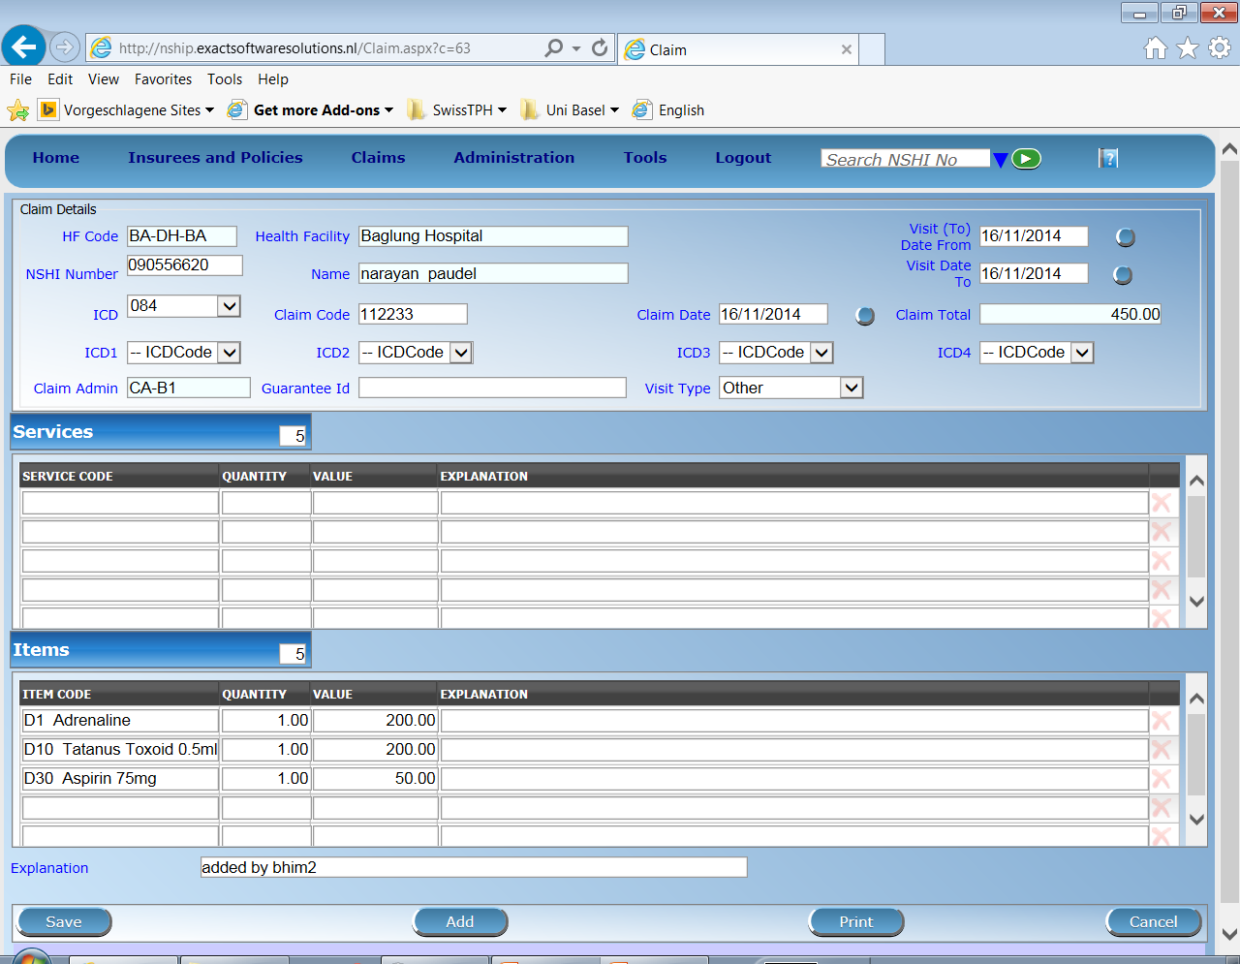
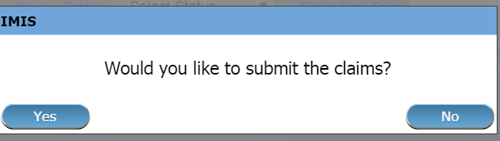
Claims Process – III b (Use of web application)
Describe with a case how you use web application during the process!

Slide 26
Claims Process – IV (Role play)
Split participants into teams
Allocate each person a role (relevant to them) described in the process
Undertake role play (first to the last step!)
Rotate roles
Re do role play
Repeat process to give more practice

Slide 27
Claims Process – V (Scenarios)
Develop more complex scenarios prior to the training
Once familiar introduce participants to the complicated scenarios
Ask them to role play and identify problems/resolve the solution
Emphasis should be on practicing the exceptions to the standard cases expected

Slide 28
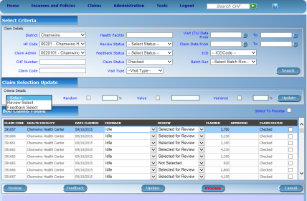
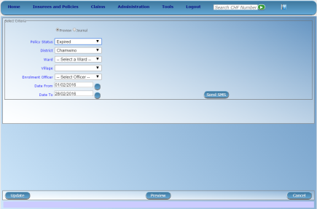





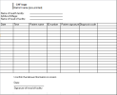

Renewal Process – I (Sample Process)
mobile
Network - sms
server
Describe how your process works! Who are the key actors? What is the flow of data? What forms are involved?
mobile
Network – data transfer
Renewal trigger
CHF office
Print out of
generated
Renewal list OR
offline file to be
uploaded to
mobile phone

Slide 29
Renewal Process - II (Forms involved)
Explain each form needed in the process and practice filling it

Slide 30
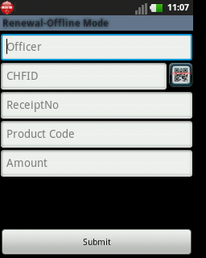
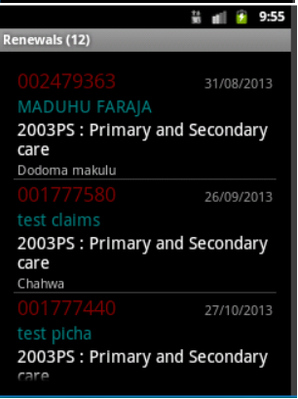

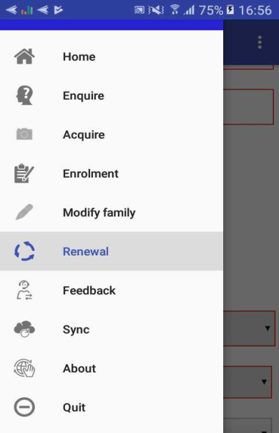
Renewal Process – III a (Use of mobile application)
Describe with a case how you use mobile phones during the process!
server

Slide 31
Renewal Process – III b (Use of web application)
Describe with a case how you use web application during the process!

Slide 32
Renewal Process – IV (Role play)
Split participants into teams
Allocate each person a role (relevant to them) described in the process
Undertake role play (first to the last step!)
Rotate roles
Re do role play
Repeat process to give more practice

Slide 33
Renewal Process – V (Scenarios)
Develop more complex scenarios prior to the training
Once familiar introduce participants to the complicated scenarios
Ask them to role play and identify problems/resolve the solution
Emphasis should be on practicing the exceptions to the standard cases expected

Slide 34
Reporting – I (Sample Process)
server
Describe how your process works! Who are the key actors? What is the flow of data? What forms are involved?
Internal claims processing in IMIS
CHF office
Automated Checking (client status, price lists, etc.)
Review by a Medical Advisor
Automated final claim calculations (remaining limits, etc.)
Generating consolidated claims report
on-line client

Slide 35
Reporting - II (Forms involved)
Explain each form needed in the process and practice filling it

Slide 36
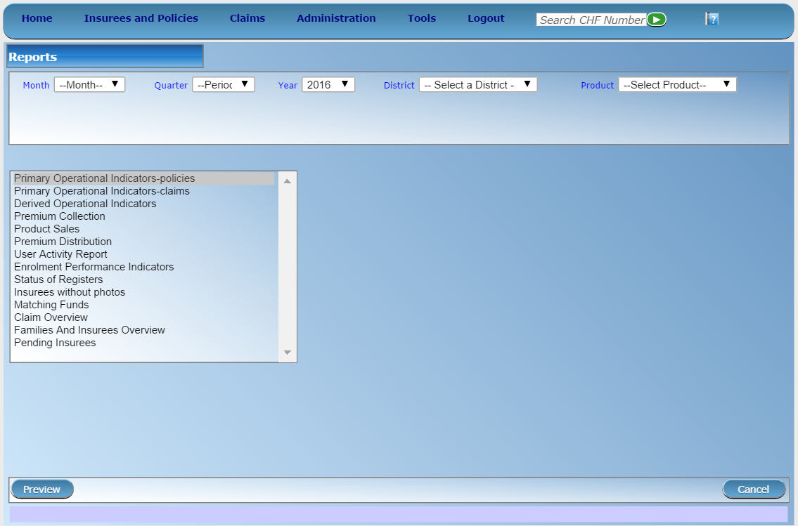
Reporting – III a (Use of application)
Describe with a case how you use mobile phones during the process!
36

Slide 37
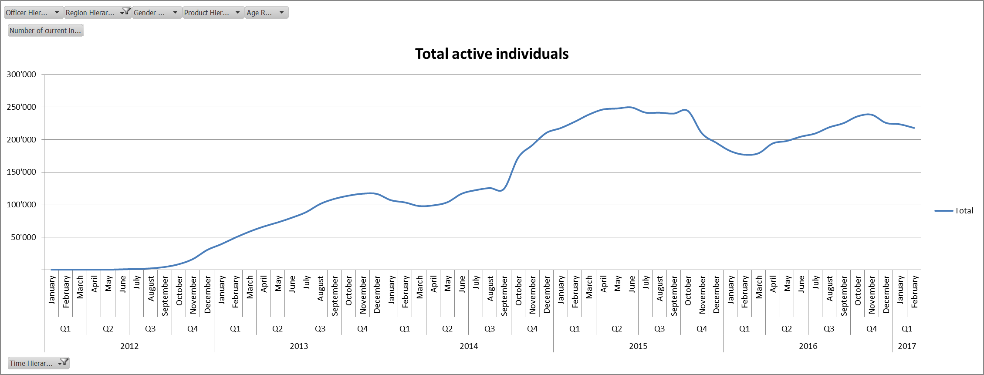
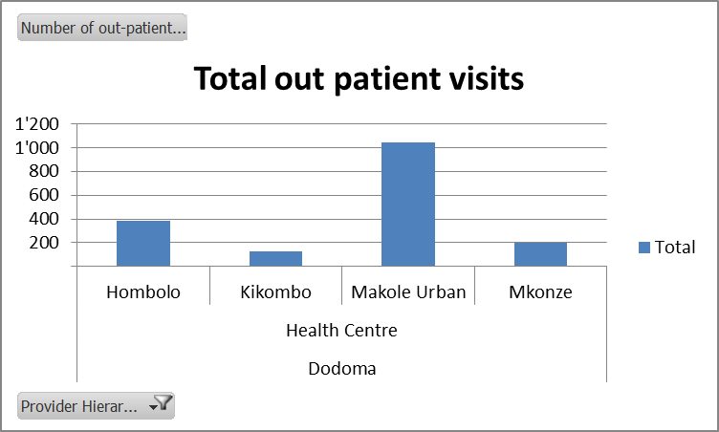
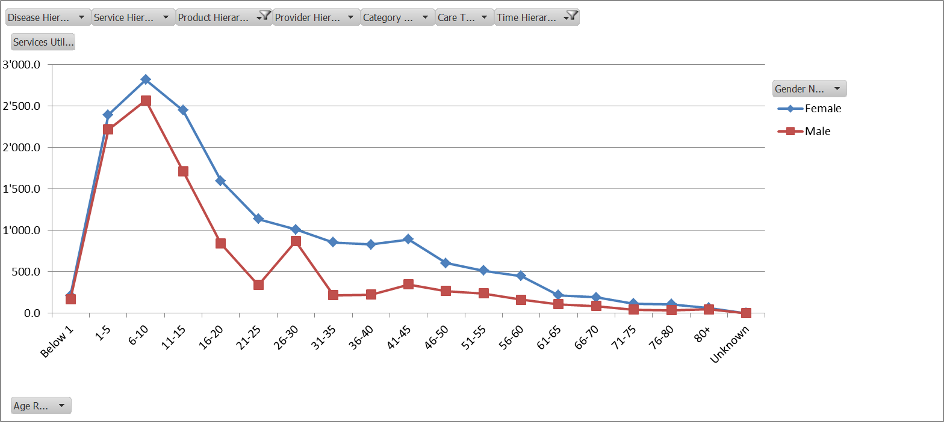
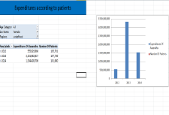



Reporting – III b (Analytical Reporting component)
Front-end (Excel)
mobile
network
server
Operational database of IMIS
IMIS Data Warehouse
ETL
mobile phone clients
AR-IMIS
External data sources (eg. DHIS)
off-line clients
on-line clients

Slide 38
Reporting – IV (Role play)
Split participants into teams
Allocate each person a role (relevant to them) described in the process
Undertake role play (first to the last step!)
Rotate roles
Re do role play
Repeat process to give more practice

Slide 39
Reporting – V (Scenarios)
Develop more complex scenarios prior to the training
Once familiar introduce participants to the complicated scenarios
Ask them to role play and identify problems/resolve the solution
Emphasis should be on practicing the exceptions to the standard cases expected

